Slide 1
ACUTE LIVER FAILURE
IN CHILDREN
Recognition • Etiology • Evaluation • Management
Dr. Manar Shawabkeh
Clinical practice + board examination review
Notes:
[Sources]
• User-provided UpToDate screenshots: Acute liver failure in children—etiology, evaluation, management, complications, and outcomes.
• User-provided Nelson Textbook of Pediatrics, Chapter 412 screenshots.

Slide 2
CASE OPENING
Imagine this child arriving in your clinic
A previously healthy 3-year-old
•
3 days of poor intake, nausea, abdominal discomfort and malaise
FIRST DECISION
Does this child meet pediatric acute liver failure criteria?
•
Now drowsy and tachypneic; no clear chronic liver disease history
•
Mild jaundice; hepatomegaly; no obvious ingestion reported
•
Labs: ALT/AST markedly elevated, glucose low, INR 2.1 after vitamin K
CLINICAL DANGER
PALF may deteriorate rapidly—even before encephalopathy is obvious.
DR. MANAR SHAWABKEH
02
Notes:
[Sources]
• User-provided UpToDate screenshots: Acute liver failure in children—etiology, evaluation, management, complications, and outcomes.
• User-provided Nelson Textbook of Pediatrics, Chapter 412 screenshots.

Slide 3
PEDIATRIC ACUTE LIVER FAILURE
PALF is a rapidly progressive syndrome—not a single disease
Core concept
Clinical consequence
•
Final common pathway of many disparate conditions
•
Cause may be known—or remain indeterminate
•
Major synthetic, excretory and detoxifying dysfunction
•
Individualized diagnostic strategy is required
•
May account for ~10% of pediatric liver transplants
•
Early multidisciplinary transplant-center involvement
REMEMBER
The child may appear nonspecific before liver dysfunction is recognized.
DR. MANAR SHAWABKEH
03
Notes:
[Sources]
• User-provided UpToDate screenshots: Acute liver failure in children—etiology, evaluation, management, complications, and outcomes.
• User-provided Nelson Textbook of Pediatrics, Chapter 412 screenshots.

Slide 4
PEDIATRIC ACUTE LIVER FAILURE
Diagnosis requires all three pillars
PILLAR
REQUIRED FINDING
1. Acute onset
Hepatic failure within 8 weeks; no prior chronic liver disease
2. Acute liver injury
AST or ALT >100 IU/L and/or defined biliary dysfunction
3. Coagulopathy
Persists after vitamin K; threshold depends on encephalopathy
BOARD PEARL
Encephalopathy is not mandatory when coagulopathy is severe.
DR. MANAR SHAWABKEH
04
Notes:
[Sources]
• User-provided UpToDate screenshots: Acute liver failure in children—etiology, evaluation, management, complications, and outcomes.
• User-provided Nelson Textbook of Pediatrics, Chapter 412 screenshots.

Slide 5
PEDIATRIC ACUTE LIVER FAILURE
The INR threshold changes with encephalopathy
COAGULATION
ENCEPHALOPATHY
PALF THRESHOLD
PT ≥15 s or INR ≥1.5
Present
Meets criterion
PT ≥20 s or INR ≥2.0
With or without
Meets criterion
WHY THIS MATTERS
Encephalopathy may be difficult to assess in young children and may appear late.
DR. MANAR SHAWABKEH
05
Notes:
[Sources]
• User-provided UpToDate screenshots: Acute liver failure in children—etiology, evaluation, management, complications, and outcomes.
• User-provided Nelson Textbook of Pediatrics, Chapter 412 screenshots.

Slide 6
PEDIATRIC ACUTE LIVER FAILURE
Biochemical injury can be hepatocellular or biliary
PATTERN
THRESHOLD
Hepatocellular
AST or ALT >100 IU/L (unless explained by myopathy)
Biliary
Total bilirubin >5 mg/dL; direct bilirubin >2 mg/dL; and/or GGT >100 IU/L
CASE CHECK
Our child: acute onset + marked aminotransferases + INR 2.1 after vitamin K → PALF even if encephalopathy is uncertain.
DR. MANAR SHAWABKEH
06
Notes:
[Sources]
• User-provided UpToDate screenshots: Acute liver failure in children—etiology, evaluation, management, complications, and outcomes.
• User-provided Nelson Textbook of Pediatrics, Chapter 412 screenshots.

Slide 7
PEDIATRIC ACUTE LIVER FAILURE
The prodrome is often nonspecific
Early / easily missed
Recognition clues
•
Abdominal discomfort
•
Jaundice or bleeding tendency
•
Malaise ± fever
•
Hypoglycemia
•
Anorexia, nausea or vomiting
•
Changing mental status
•
Symptoms may wax and wane
•
Ascites or rapidly shrinking liver
DR. MANAR SHAWABKEH
07
Notes:
[Sources]
• User-provided UpToDate screenshots: Acute liver failure in children—etiology, evaluation, management, complications, and outcomes.
• User-provided Nelson Textbook of Pediatrics, Chapter 412 screenshots.

Slide 8
PEDIATRIC ACUTE LIVER FAILURE
Neurologic deterioration may emerge after admission
FEATURE
AT PRESENTATION / COURSE
Encephalopathy
53% at admission; 13% grade 3–4
New encephalopathy
Additional 15% within 7 days
Seizure
7%
Ascites
22%
PEDIATRIC CAVEAT
Encephalopathy is less often observed under 3 years and may be clinically subtle.
DR. MANAR SHAWABKEH
08
Notes:
[Sources]
• User-provided UpToDate screenshots: Acute liver failure in children—etiology, evaluation, management, complications, and outcomes.
• User-provided Nelson Textbook of Pediatrics, Chapter 412 screenshots.

Slide 9
PEDIATRIC ACUTE LIVER FAILURE
Assess encephalopathy according to developmental age
STAGE
INFANT / CHILD
ADOLESCENT
I
Inconsolable; poor attention; “not acting like self”
Confusion; mood or sleep change; forgetful
II
Similar behavior; difficult neurologic assessment
Drowsy; inappropriate behavior; dysarthria/ataxia
III
Somnolence, stupor, combativeness
Stuporous; obeys simple commands; rigidity
EXAM CLUE
Asterixis is more useful in older children; early signs in infants may be only behavior or sleep change.
DR. MANAR SHAWABKEH
09
Notes:
[Sources]
• User-provided UpToDate screenshots: Acute liver failure in children—etiology, evaluation, management, complications, and outcomes.
• User-provided Nelson Textbook of Pediatrics, Chapter 412 screenshots.

Slide 10
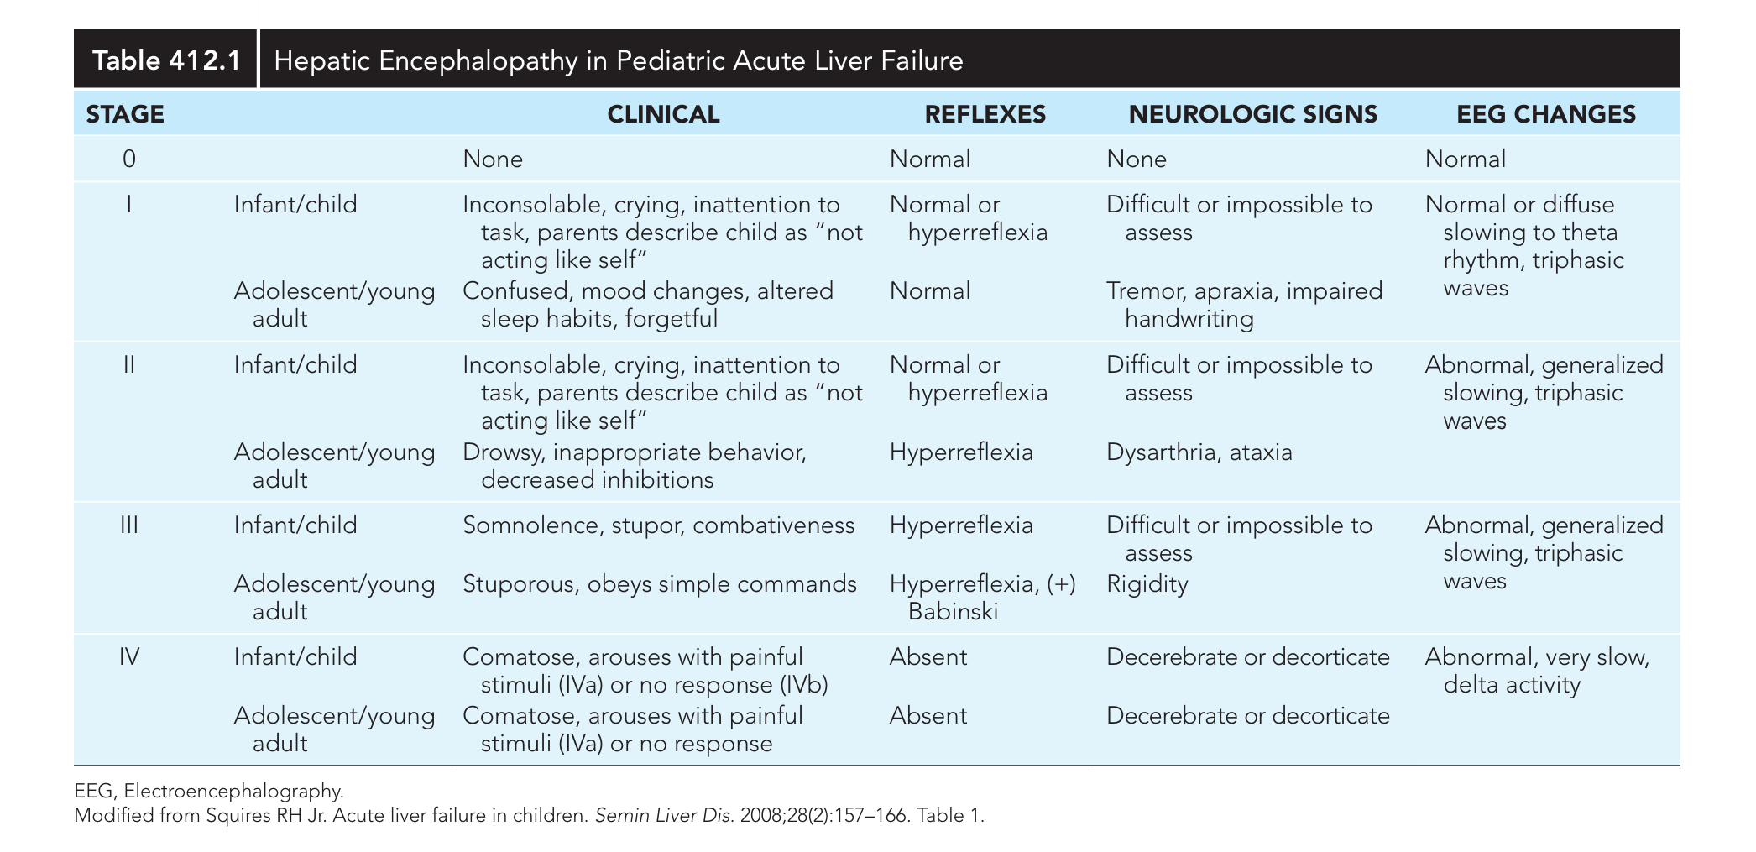

Slide 11
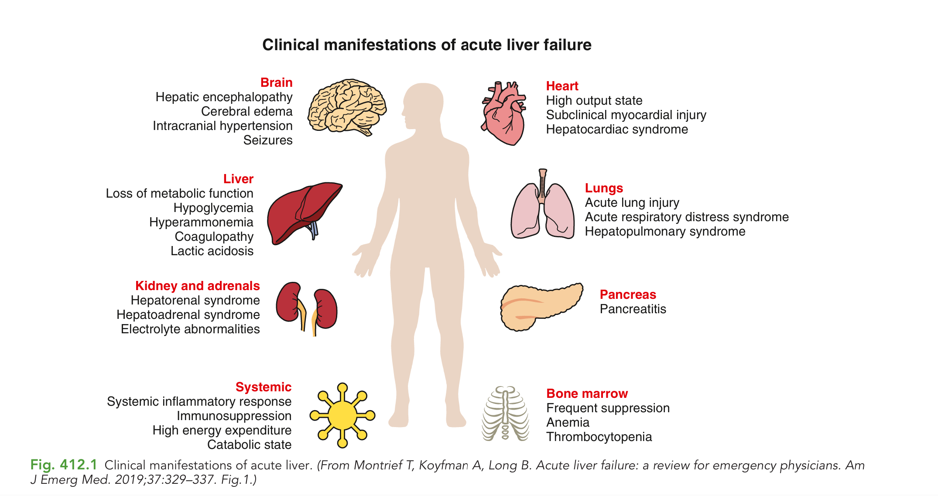

Slide 12
PEDIATRIC ACUTE LIVER FAILURE
Acute liver failure is a multisystem disorder
SYSTEM
KEY MANIFESTATIONS
Brain
Encephalopathy • cerebral edema • intracranial hypertension • seizures
Liver / metabolic
Hypoglycemia • hyperammonemia • coagulopathy • lactic acidosis
Kidney / adrenals
Hepatorenal syndrome • adrenal dysfunction
Heart / lungs
High-output state • myocardial injury • acute lung injury / ARDS
Pancreas
Pancreatitis
DR. MANAR SHAWABKEH
10
Notes:
[Sources]
• User-provided UpToDate screenshots: Acute liver failure in children—etiology, evaluation, management, complications, and outcomes.
• User-provided Nelson Textbook of Pediatrics, Chapter 412 screenshots.

Slide 13
PEDIATRIC ACUTE LIVER FAILURE
Organize causes before ordering tests
Major categories
Exposure-related + other
•
Infectious
•
Toxin or drug-related
•
Immune dysregulation
•
Pregnancy-related disease
•
Metabolic / genetic
•
HLH and GALD
•
Vascular / ischemic
•
Indeterminate
REGIONAL CLUE
In resource-limited settings, infectious causes predominate; hepatitis A is most common.
DR. MANAR SHAWABKEH
11
Notes:
[Sources]
• User-provided UpToDate screenshots: Acute liver failure in children—etiology, evaluation, management, complications, and outcomes.
• User-provided Nelson Textbook of Pediatrics, Chapter 412 screenshots.

Slide 14
PEDIATRIC ACUTE LIVER FAILURE
Age is the fastest way to narrow metabolic causes
AGE
METABOLIC / GENETIC CAUSES
<6 months
Galactosemia • Niemann–Pick C • tyrosinemia • glycosylation defect • mitochondrial disease • LARS1 • NBAS
7 months–4 years
Mitochondrial disease • tyrosinemia • hereditary fructose intolerance • urea-cycle defects • LARS1 • NBAS
5–18 years
Wilson disease • mitochondrial disease • fatty liver of pregnancy
DR. MANAR SHAWABKEH
12
Notes:
[Sources]
• User-provided UpToDate screenshots: Acute liver failure in children—etiology, evaluation, management, complications, and outcomes.
• User-provided Nelson Textbook of Pediatrics, Chapter 412 screenshots.

Slide 15
PEDIATRIC ACUTE LIVER FAILURE
Infection remains a high-priority cause
Hepatitis viruses
Other viruses
•
A, B, D; rarely E
•
EBV • HSV • adenovirus
•
Combined HBV + HDV may be fulminant
•
CMV • enterovirus • influenza A
•
HAV dominates in resource-limited settings
•
Parvovirus B19 • HHV-6 • VZV • SARS-CoV-2
TREAT WHILE TESTING
High-risk HSV: obtain blood PCR and initiate acyclovir while awaiting results.
DR. MANAR SHAWABKEH
13
Notes:
[Sources]
• User-provided UpToDate screenshots: Acute liver failure in children—etiology, evaluation, management, complications, and outcomes.
• User-provided Nelson Textbook of Pediatrics, Chapter 412 screenshots.

Slide 16
PEDIATRIC ACUTE LIVER FAILURE
Acetaminophen: the leading identifiable cause
Acute hepatic failure in children and adolescents — United States and England
01
Acute intentional overdose
02
Repeated supratherapeutic dosing
A single massive ingestion may cause severe hepatocellular injury and acute liver failure.
A therapeutic misadventure may occur when an ill child receives doses exceeding weight-based recommendations over several days.
CLINICAL PEARL
Always calculate the total acetaminophen dose in mg/kg/day — including combination products — and ask about dosing on every preceding day.
DR. MANAR SHAWABKEH
10
Notes:
[Sources]
- Nelson Textbook of Pediatrics. Pediatric Acute Liver Failure chapter (user-provided excerpt).
[/Sources]

Slide 17
PEDIATRIC ACUTE LIVER FAILURE
Always reconstruct the exposure history
GROUP
EXAMPLES FROM THE SOURCE
Analgesic
Acetaminophen
Antibiotics
Amoxicillin-clavulanate, ciprofloxacin, nitrofurantoin, minocycline, dapsone, doxycycline, trimethoprim-sulfamethoxazole
Antiepileptics
Valproate, phenytoin, carbamazepine
Other prescribed drugs
Isoniazid, rifampin, pyrazinamide, methyldopa, hydralazine, labetalol, halothane
NSAIDs / supplements
Diclofenac, ibuprofen, indomethacin, naproxen; herbs and weight-loss supplements
DR. MANAR SHAWABKEH
14
Notes:
[Sources]
• User-provided UpToDate screenshots: Acute liver failure in children—etiology, evaluation, management, complications, and outcomes.
• User-provided Nelson Textbook of Pediatrics, Chapter 412 screenshots.

Slide 18
PEDIATRIC ACUTE LIVER FAILURE
Clinical manifestations: recognize deterioration early
PRESENTATION
COMMON FINDINGS
MULTISYSTEM DISEASE
May be the first sign of liver disease
or complicate known disease:
ACUTE-ON-CHRONIC LIVER FAILURE
• Progressive jaundice
• Fetor hepaticus
• Fever, anorexia, vomiting
• Abdominal pain
• Hemorrhagic diathesis ± ascites
Respiratory rate may increase early.
Respiratory failure may occur in stage IV coma.
OMINOUS SIGN
Rapid decrease in liver size without clinical improvement
HEPATIC ENCEPHALOPATHY — WATCH CLOSELY
INFANTS
OLDER CHILDREN
Irritability • Poor feeding • Sleep-rhythm change
Asterixis • Somnolence • Confusion • Combativeness
Rapid progression → painful-stimulus response only → deep coma
DR. MANAR SHAWABKEH
11
Notes:
[Sources]
- Nelson Textbook of Pediatrics. Pediatric Acute Liver Failure: Clinical Manifestations (user-provided excerpt).
[/Sources]

Slide 19
PEDIATRIC ACUTE LIVER FAILURE
Positive autoimmune markers support—but do not prove—AIH
Evidence that supports AIH
Interpret carefully
•
Marked autoimmune markers
•
Markers may occur in Wilson or DILI
•
Elevated total protein or IgG
•
Mild isolated ANA is common
•
Compatible histology
•
IgG may be normal
•
Apparent corticosteroid response
•
Simplified AIH score may lack sensitivity in PALF
SCREEN ALL AGES
Outside the neonatal period, consider AIH early because it is potentially treatable.
DR. MANAR SHAWABKEH
15
Notes:
[Sources]
• User-provided UpToDate screenshots: Acute liver failure in children—etiology, evaluation, management, complications, and outcomes.
• User-provided Nelson Textbook of Pediatrics, Chapter 412 screenshots.

Slide 20
PEDIATRIC ACUTE LIVER FAILURE
Two age-linked immune diagnoses must not be missed
DIAGNOSIS
WHEN TO THINK
DISCRIMINATING CLUES
HLH
Especially infants / <5 years
Fever, hepatosplenomegaly, ≥2 cytopenias, triglycerides ↑, ferritin often >5000, fibrinogen ↓, sCD25 ↑
GALD
Newborn; first days of life
Refractory hypoglycemia, severe coagulopathy, hypoalbuminemia, ascites, ferritin >1000; AST/ALT normal or near-normal; extrahepatic iron
DR. MANAR SHAWABKEH
16
Notes:
[Sources]
• User-provided UpToDate screenshots: Acute liver failure in children—etiology, evaluation, management, complications, and outcomes.
• User-provided Nelson Textbook of Pediatrics, Chapter 412 screenshots.

Slide 21
PEDIATRIC ACUTE LIVER FAILURE
Order tests in parallel: severity + cause + transplant readiness
Minimum liver-specific
Minimum general
•
AST, ALT
•
CBC with differential
•
Total + conjugated bilirubin
•
Electrolytes and glucose
•
Alkaline phosphatase, albumin
•
BUN and creatinine
•
PT/INR, PTT, ammonia
•
Amylase and lipase
PRACTICAL POINT
Blood volume is limited in young children—prioritize tests that change immediate treatment.
DR. MANAR SHAWABKEH
17
Notes:
[Sources]
• User-provided UpToDate screenshots: Acute liver failure in children—etiology, evaluation, management, complications, and outcomes.
• User-provided Nelson Textbook of Pediatrics, Chapter 412 screenshots.

Slide 22
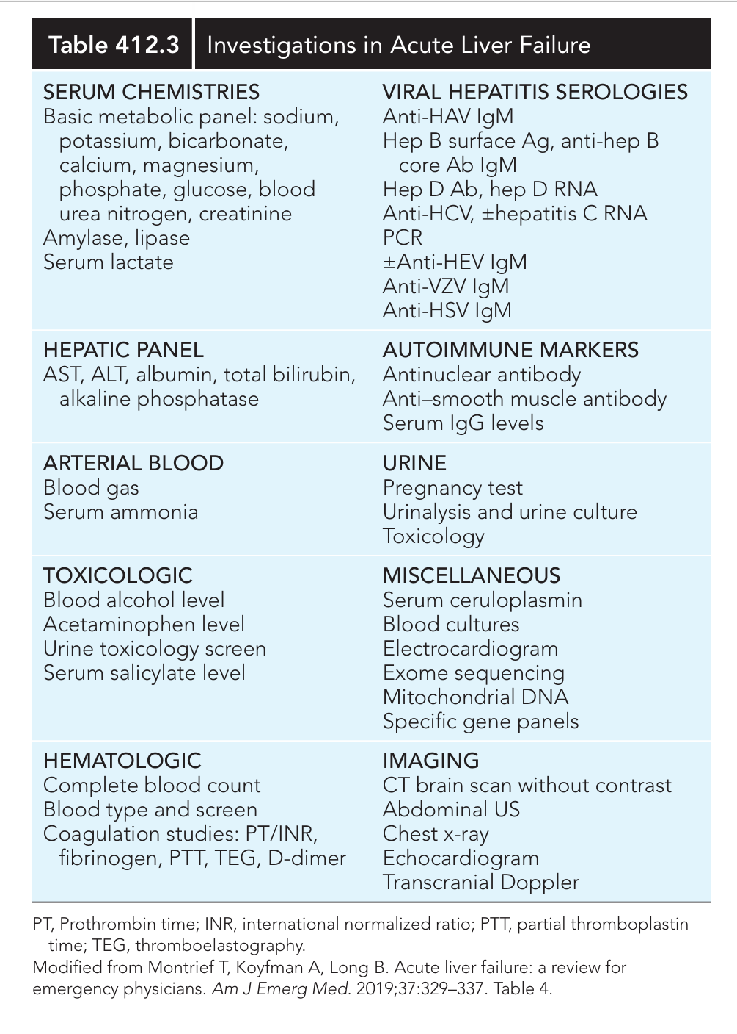
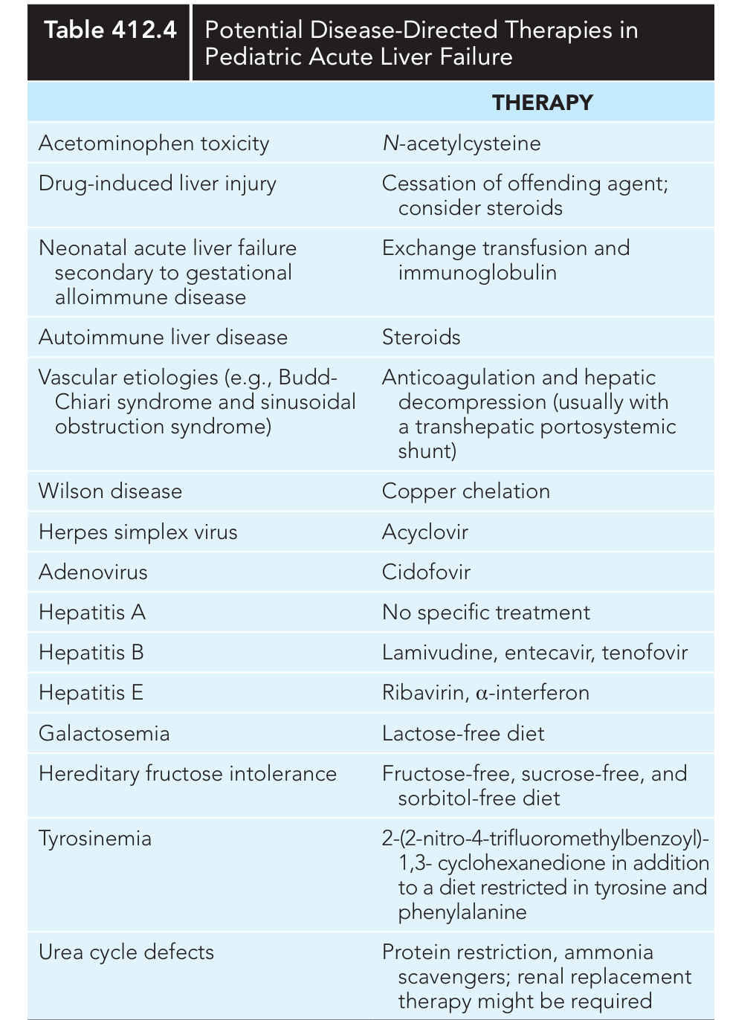

Slide 23
PEDIATRIC ACUTE LIVER FAILURE
Targeted tests should follow age and phenotype
SUSPECTED CAUSE
TARGETED TESTS / CLUES
Acetaminophen
Serum level—especially unexplained adolescent ALF or possible ingestion
HSV
Blood PCR in all young infants and high-risk patients
HLH
Ferritin, triglycerides, fibrinogen, soluble IL-2 receptor alpha
AIH
ANA, anti-smooth muscle, liver-kidney microsomal antibody, total IgG
Wilson (>5 years)
Ceruloplasmin; mixed/unconjugated bilirubin, low ALP, DAT-negative hemolysis
Metabolic
Glucose, lactate, pyruvate, ammonia, CK; amino acids and acylcarnitine in young children
DR. MANAR SHAWABKEH
18
Notes:
[Sources]
• User-provided UpToDate screenshots: Acute liver failure in children—etiology, evaluation, management, complications, and outcomes.
• User-provided Nelson Textbook of Pediatrics, Chapter 412 screenshots.

Slide 24
PEDIATRIC ACUTE LIVER FAILURE
Liver biopsy is selective—not routine
Why not routine
When it may help
•
Percutaneous bleeding risk
•
Possible Wilson with inconclusive criteria
•
Often diffuse hepatocellular necrosis
•
Indeterminate or autoimmune-marker positive PALF
•
Histology may have limited treatment value
•
When immunosuppression is being considered
SAFER APPROACH
When biopsy is required, a transvenous / transjugular approach reduces hemorrhage risk.
DR. MANAR SHAWABKEH
19
Notes:
[Sources]
• User-provided UpToDate screenshots: Acute liver failure in children—etiology, evaluation, management, complications, and outcomes.
• User-provided Nelson Textbook of Pediatrics, Chapter 412 screenshots.

Slide 25
PEDIATRIC ACUTE LIVER FAILURE
Management starts on multiple parallel paths
•
Evaluate the cause—guided by age; prioritize treatable diagnoses
•
Monitor every organ system and detect trajectory changes
•
Identify and treat complications promptly
•
Provide medical support to maximize native-liver survival
•
Engage pediatric ICU, hepatology and transplant specialists early
DR. MANAR SHAWABKEH
20
Notes:
[Sources]
• User-provided UpToDate screenshots: Acute liver failure in children—etiology, evaluation, management, complications, and outcomes.
• User-provided Nelson Textbook of Pediatrics, Chapter 412 screenshots.

Slide 26
PEDIATRIC ACUTE LIVER FAILURE
Once PALF is recognized, outpatient management is over
1. TRANSFER
Arrange immediate emergency transfer and consultation with a pediatric liver-transplant center.
2. MONITOR
Most children require initial PICU monitoring with frequent clinical and neurologic assessment.
3. TREND
Track mental status, respiratory effort, heart rate, blood pressure, infection signals and strict input/output.
DR. MANAR SHAWABKEH
21
Notes:
[Sources]
• User-provided UpToDate screenshots: Acute liver failure in children—etiology, evaluation, management, complications, and outcomes.
• User-provided Nelson Textbook of Pediatrics, Chapter 412 screenshots.

Slide 27
PEDIATRIC ACUTE LIVER FAILURE
Specific therapy depends on the cause
CAUSE
DISEASE-DIRECTED APPROACH IN SOURCE
Acetaminophen toxicity
N-acetylcysteine
HSV
Acyclovir
Autoimmune hepatitis
Corticosteroids; decision requires clinical judgment
Wilson disease
Copper-directed therapy; plasma exchange may temporize
Galactosemia
Lactose-free diet
Hereditary fructose intolerance
Fructose-, sucrose- and sorbitol-free diet
Tyrosinemia
Nitisinone + tyrosine/phenylalanine restriction
Urea-cycle defects
Protein restriction, ammonia scavengers ± renal replacement
DR. MANAR SHAWABKEH
22
Notes:
[Sources]
• User-provided UpToDate screenshots: Acute liver failure in children—etiology, evaluation, management, complications, and outcomes.
• User-provided Nelson Textbook of Pediatrics, Chapter 412 screenshots.

Slide 28
PEDIATRIC ACUTE LIVER FAILURE
Trend dynamic change—not isolated values
ROUTINE MONITORING
IMPORTANT DETAIL
CBC, electrolytes, renal function
At least daily; often more frequently
Glucose, calcium, phosphorus
Correct promptly; glucose target 90–120 mg/dL
Ammonia
Arterial ideal; venous free-flowing sample promptly iced
PT/INR; total/direct bilirubin
Follow synthetic dysfunction and trajectory
Blood cultures
If infection suspected or any clinical deterioration
DR. MANAR SHAWABKEH
23
Notes:
[Sources]
• User-provided UpToDate screenshots: Acute liver failure in children—etiology, evaluation, management, complications, and outcomes.
• User-provided Nelson Textbook of Pediatrics, Chapter 412 screenshots.

Slide 29
PEDIATRIC ACUTE LIVER FAILURE
Fluid and glucose management require a narrow balance
Avoid both extremes
Initial strategy
•
Overhydration → pulmonary/peripheral edema
•
D10 half-normal saline or similar
•
Underhydration → kidney dysfunction, hypotension, encephalopathy
•
15 mEq potassium/L if renal function permits
•
Aim total daily fluids at 90–95% maintenance
•
Adjust glucose/electrolytes to monitoring
•
Avoid fixed-electrolyte maintenance fluids such as LR
DR. MANAR SHAWABKEH
24
Notes:
[Sources]
• User-provided UpToDate screenshots: Acute liver failure in children—etiology, evaluation, management, complications, and outcomes.
• User-provided Nelson Textbook of Pediatrics, Chapter 412 screenshots.

Slide 30
PEDIATRIC ACUTE LIVER FAILURE
Nutrition should prevent catabolism
•
Maintain nutrition support; avoid prolonged fasting and catabolic stress
•
Special “hepatic” formulas have little supporting pediatric evidence
•
Use enteral feeding when safe
•
If oral/enteral feeding is unsafe, initiate parenteral nutrition
•
Some children require higher dextrose concentrations through central access
DR. MANAR SHAWABKEH
25
Notes:
[Sources]
• User-provided UpToDate screenshots: Acute liver failure in children—etiology, evaluation, management, complications, and outcomes.
• User-provided Nelson Textbook of Pediatrics, Chapter 412 screenshots.

Slide 31
PEDIATRIC ACUTE LIVER FAILURE
Extracorporeal support is a bridge—not definitive therapy
Potential roles
Limits / avoid routine use
•
Artificial liver support
•
No modality established as definitive treatment
•
Plasma exchange ± hemodialysis
•
Plasma exchange outcome evidence in children is limited
•
Bioartificial systems
•
Glucocorticoids only for suspected AIH
•
Temporizing measure in Wilson disease
•
IV NAC not beneficial in non-acetaminophen PALF
EXAM TRAP
Do not generalize adult non-acetaminophen NAC practice to children.
DR. MANAR SHAWABKEH
26
Notes:
[Sources]
• User-provided UpToDate screenshots: Acute liver failure in children—etiology, evaluation, management, complications, and outcomes.
• User-provided Nelson Textbook of Pediatrics, Chapter 412 screenshots.

Slide 32
PEDIATRIC ACUTE LIVER FAILURE
No score can safely decide transplantation alone
TOOL
LIMITATION / ROLE
Clichy, MELD, PELD
Weak association with pediatric outcome
King’s College criteria
Useful in adults; not useful in PALF
Liver Injury Unit (LIU)
Uses peak bilirubin, PT/INR and ammonia; insufficient for critical LT decisions
Children’s Hospital LA score
Admission albumin, ammonia and bilirubin; promising but limitations remain
BEST PRACTICE
Use trajectory + multidisciplinary transplant assessment—not one number.
DR. MANAR SHAWABKEH
27
Notes:
[Sources]
• User-provided UpToDate screenshots: Acute liver failure in children—etiology, evaluation, management, complications, and outcomes.
• User-provided Nelson Textbook of Pediatrics, Chapter 412 screenshots.

Slide 33
CASE RESOLUTION
Return to the child: act before the cause is known
•
PALF confirmed: acute injury + INR 2.1 after vitamin K
•
Urgent PICU and pediatric transplant-center consultation
•
Immediate parallel evaluation: severity labs, toxicology, infection, immune and age-based metabolic tests
•
Correct hypoglycemia; modest fluid restriction; strict neurologic and cardiorespiratory monitoring
•
Start disease-directed treatment promptly when a treatable cause is suspected
CORE MESSAGE
Recognize early. Use age to prioritize causes. Treat while testing. Follow the trajectory.
DR. MANAR SHAWABKEH
28
Notes:
[Sources]
• User-provided UpToDate screenshots: Acute liver failure in children—etiology, evaluation, management, complications, and outcomes.
• User-provided Nelson Textbook of Pediatrics, Chapter 412 screenshots.

Slide 34
Acute Liver Failure in Children
Metabolic & Electrolyte Complications
Dr. Manar Shawabkeh
Monitor early — correct aggressively — avoid cerebral edema
Hypoglycemia
Action point
↓Glu
May need GIR 10–15 mg/kg/min. Use central line if glucose concentration >12.5% is required with fluid restriction.
Impaired gluconeogenesis + depleted glycogen stores. Treat with continuous IV glucose; target serum glucose 90–120 mg/dL.
Hypokalemia
Action point
↓K
Check serial potassium, renal function and urine output before K replacement.
May reflect dilution from volume overload, ascites, or renal wasting.
Hypophosphatemia
Action point
↓PO₄
Aim to maintain phosphate >3 mg/dL when possible. Hyperphosphatemia with renal impairment is a poor sign.
Monitor frequently; phosphate may fall profoundly during active liver-cell regeneration.
Acid–base disturbances
Action point
pH
Follow VBG/ABG, lactate and bicarbonate; persistent acidosis should trigger metabolic + perfusion reassessment.
Respiratory alkalosis from hyperventilation; respiratory acidosis from failure; metabolic acidosis from necrosis, shock or IEM.
Pearl: Severe or refractory hypoglycemia should raise concern for inherited metabolic disease as a trigger/cause of liver failure.

Slide 35
PEDIATRIC ACUTE LIVER FAILURE
Supportive Management: Stabilize, Protect, Bridge
OVERALL AIM
Promote spontaneous hepatic regeneration — or bridge safely to liver transplantation
1 Supportive care
2 Organ support
3 Hemostasis: avoid routine correction
MONITOR CLOSELY
INR • renal function • blood gases • glucose
CORE MEASURES
• Maintain normothermia; treat fever
• Consider broad-spectrum antibiotics, antifungals, N-acetylcysteine and gastric protection
NUTRITION TARGETS
• Carbohydrate 6–13 g/kg/day
• Fat 1–4 g/kg/day
• Protein ≈1 g/kg/day
RESPIRATORY
• Intubate for grade ≥3 encephalopathy or respiratory failure
• Use appropriate sedation, analgesia ± neuromuscular blockade
• Avoid hypoxemia and hypercarbia
CARDIOVASCULAR
• ⅔ maintenance: 0.9% saline + 10% dextrose
• Targets: glucose 4–8 mmol/L; Na 140–150 mmol/L
• MAP >50th percentile; urine output >1 mL/kg/h
• Assess fluid responsiveness; consider early vasopressors
CORRECT ONLY IF
• Active bleeding
• Before an invasive procedure
IF BLEEDING / PROCEDURE PLANNED
• Discuss FFP with transplant surgery/anesthesia if INR is markedly prolonged
• Cryoprecipitate if fibrinogen <1.0 g/L
• Platelet threshold: ≤50,000/µL
• Refractory bleeding: thromboelastography
• Consider recombinant factor VIIa 40 µg/kg only if FFP, platelets and cryoprecipitate fail
ESCALATE EARLY
Neuromonitoring & neuroprotection • Kidney replacement therapy • Extracorporeal liver support • Early transplant-team involvement
Dr. Manar Shawabkeh
Notes:
[Sources]
- User-provided clinical management figure: image(395).png (accessed 2026-08-04).
[/Sources]

Slide 36
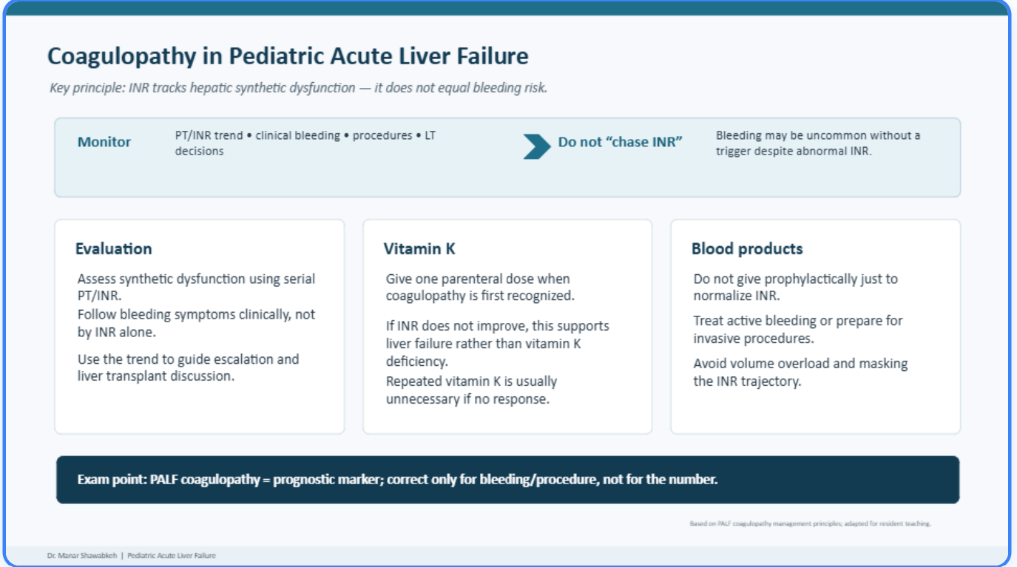

Slide 37
PEDIATRIC ACUTE LIVER FAILURE
Ten points to remember for the exam
#
POINT
1
INR ≥1.5 requires encephalopathy; INR ≥2.0 does not
2
Coagulopathy must persist after vitamin K
3
Encephalopathy is subtle and may appear late in young children
4
Age guides metabolic and genetic testing
5
HLH: fever + cytopenias + very high ferritin + low fibrinogen
6
GALD: neonatal failure + near-normal AST/ALT + extrahepatic iron
7
Wilson: >5 years + hemolysis + low ALP + mixed/unconjugated bilirubin
8
AIH markers are supportive, not diagnostic
9
Transjugular biopsy is safer when biopsy is necessary
10
No prognostic score replaces clinical trajectory and transplant-center judgment
DR. MANAR SHAWABKEH
29
Notes:
[Sources]
• User-provided UpToDate screenshots: Acute liver failure in children—etiology, evaluation, management, complications, and outcomes.
• User-provided Nelson Textbook of Pediatrics, Chapter 412 screenshots.

Slide 38
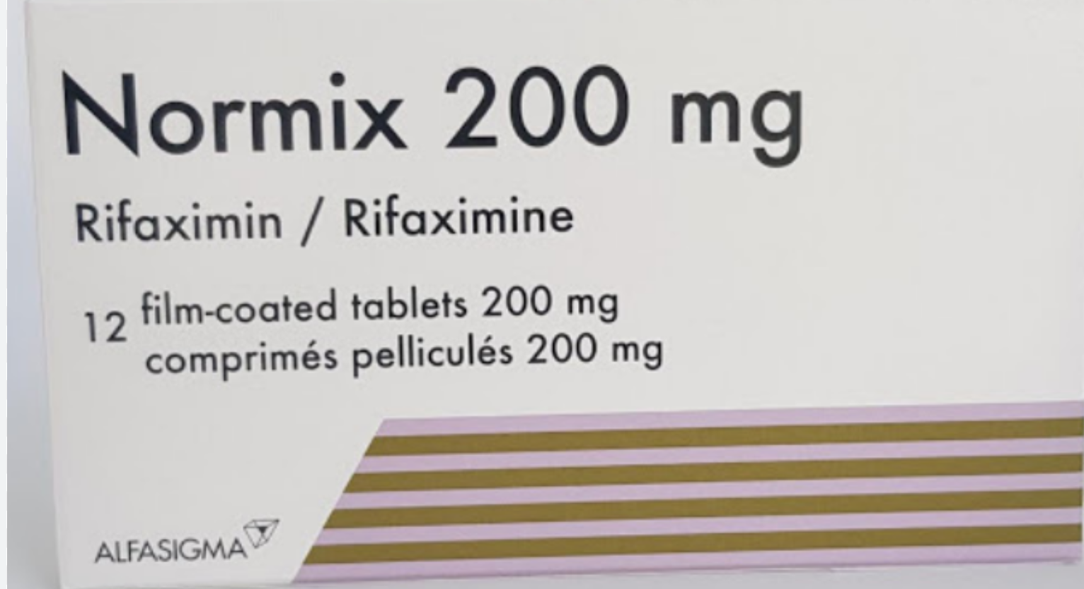
PEDIATRIC ACUTE LIVER FAILURE
Supportive management: correct complications early
ELECTROLYTES & PROGNOSIS
BLEEDING & ORGAN SUPPORT
• Replace calcium, phosphorus and magnesium parenterally as required
• Hypophosphatemia may reflect liver regeneration
• Early phosphorus replacement is associated with better prognosis
• Give parenteral vitamin K for coagulopathy
• Use FFP, cryoprecipitate, platelets, factor VII or PCC only for clinically significant bleeding or before an invasive procedure
• Plasmapheresis: temporary correction without volume overload
• Continuous hemofiltration: fluid overload, acute renal failure and hyperammonemia
WARNING Hyperphosphatemia predicts failure of spontaneous recovery
INFECTION
HEPATIC ENCEPHALOPATHY / HYPERAMMONEMIA
Monitor closely: ≥50% develop serious infection. Common pathogens are gram-positive organisms; gram-negative and fungal infections also occur.
• Restrict protein to 1 g/kg according to encephalopathy severity
• Consider lactulose or rifaximin
Correct encephalopathy triggers: GI bleeding • infection • constipation • sedatives • electrolyte imbalance • hypovolemia
N-acetylcysteine does not improve outcome in non-acetaminophen acute liver failure.
Rifaximin (Normix® 200 mg)
DR. MANAR SHAWABKEH
12
Notes:
[Sources]
- Nelson Textbook of Pediatrics. Pediatric Acute Liver Failure: Supportive Management (user-provided excerpt).
- Medication image: user-provided Normix 200 mg package photograph.
[/Sources]

Slide 39
PALF: THE CLINICAL MINDSET
Recognize
Prioritize
Reassess
the syndrome early
by age and treatability
the trajectory continuously
Dr. Manar Shawabkeh
Notes:
[Sources]
• User-provided UpToDate screenshots: Acute liver failure in children—etiology, evaluation, management, complications, and outcomes.
• User-provided Nelson Textbook of Pediatrics, Chapter 412 screenshots.

