Slide 1
ACUTE
MASTOIDITIS
AOM
↓
Recognize early • image selectively • escalate safely
periostitis
↓
Resident-focused clinical & board review
coalescence
DR. MANAR SHAWABKEH
Notes:
[Sources]
Nelson Textbook of Pediatrics, 22nd ed., Chapter: Acute Mastoiditis (user-provided pages 4016–4019).
Johns Hopkins All Children’s Hospital. Acute Mastoiditis Clinical Pathway. 2020.
UCSF Infectious Diseases Management Program. Mastoiditis. Accessed 2026.
AAP Pediatrics in Review. Mastoiditis. 2024.

Slide 2
CORE CONCEPT
The disease begins where the middle ear ends
Suppurative infection extends from the middle ear into the mastoid air-cell system.
BOARD PEARL
Inflammation alone ≠ coalescent mastoiditis
“Mastoid opacification”
on imaging is common
with uncomplicated AOM.
Look for bone erosion,
periosteal change,
or abscess.
Pressure and pus erode thin bony septa
Cortical breach permits extracranial or intracranial spread
DR. MANAR SHAWABKEH • PEDIATRICS RESIDENT TEACHING
02
Notes:
[Sources]
Nelson Textbook of Pediatrics, 22nd ed., Chapter: Acute Mastoiditis (user-provided pages 4016–4019).
Johns Hopkins All Children’s Hospital. Acute Mastoiditis Clinical Pathway. 2020.
UCSF Infectious Diseases Management Program. Mastoiditis. Accessed 2026.
AAP Pediatrics in Review. Mastoiditis. 2024.

Slide 3
RECOGNITION
A displaced pinna is the bedside clue you should not miss
Classic triad
Infants
Postauricular erythema, swelling, and tenderness
The pinna may appear
“down and out.”
Auricle protrudes outward and downward
Concurrent AOM or recent AOM—often within 2 weeks
Absence of dramatic external signs
does not exclude disease.
DR. MANAR SHAWABKEH • PEDIATRICS RESIDENT TEACHING
03
Notes:
[Sources]
Nelson Textbook of Pediatrics, 22nd ed., Chapter: Acute Mastoiditis (user-provided pages 4016–4019).
Johns Hopkins All Children’s Hospital. Acute Mastoiditis Clinical Pathway. 2020.
UCSF Infectious Diseases Management Program. Mastoiditis. Accessed 2026.
AAP Pediatrics in Review. Mastoiditis. 2024.

Slide 4
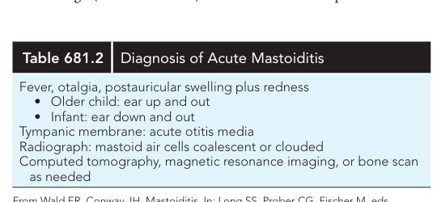
DIAGNOSIS
Clinical diagnosis first; imaging answers the complication question
At presentation, document facial nerve function.
CBC: often neutrophilic leukocytosis
CRP/ESR: severity and trend—not diagnostic
Culture otorrhea or operative middle-ear fluid
Blood culture if toxic or systemically ill
DR. MANAR SHAWABKEH • PEDIATRICS RESIDENT TEACHING
04
Notes:
[Sources]
Nelson Textbook of Pediatrics, 22nd ed., Chapter: Acute Mastoiditis (user-provided pages 4016–4019).
Johns Hopkins All Children’s Hospital. Acute Mastoiditis Clinical Pathway. 2020.
UCSF Infectious Diseases Management Program. Mastoiditis. Accessed 2026.
AAP Pediatrics in Review. Mastoiditis. 2024.
Nelson Table 681.2 reproduced as a user-provided teaching image.

Slide 5
IMAGING
Image when the result will change urgency or source control
No routine imaging
Contrast CT temporal bone
MRI ± MRV
Typical findings, stable child, no neurologic signs
Uncertain diagnosis, severe disease, suspected bone erosion or abscess
Neurologic signs, altered mental status, suspected intracranial spread or venous thrombosis
CT: bone and drainable collection • MRI/MRV: brain, dura, petrous apex, venous sinus
DR. MANAR SHAWABKEH • PEDIATRICS RESIDENT TEACHING
05
Notes:
[Sources]
Nelson Textbook of Pediatrics, 22nd ed., Chapter: Acute Mastoiditis (user-provided pages 4016–4019).
Johns Hopkins All Children’s Hospital. Acute Mastoiditis Clinical Pathway. 2020.
UCSF Infectious Diseases Management Program. Mastoiditis. Accessed 2026.
AAP Pediatrics in Review. Mastoiditis. 2024.

Slide 6
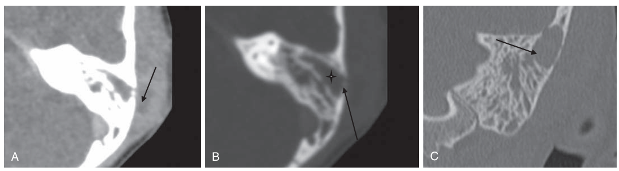
RADIOLOGY
Read CT for destruction—not merely fluid
Coalescent mastoiditis
Loss of mastoid septations
Cortical erosion
Subperiosteal collection
Opacification alone is nonspecific; bony change establishes invasive disease.
DR. MANAR SHAWABKEH • PEDIATRICS RESIDENT TEACHING
06
Notes:
[Sources]
Nelson Textbook of Pediatrics, 22nd ed., Chapter: Acute Mastoiditis (user-provided pages 4016–4019).
Johns Hopkins All Children’s Hospital. Acute Mastoiditis Clinical Pathway. 2020.
UCSF Infectious Diseases Management Program. Mastoiditis. Accessed 2026.
AAP Pediatrics in Review. Mastoiditis. 2024.
Nelson Fig. 681.1 reproduced as a user-provided teaching image.

Slide 7
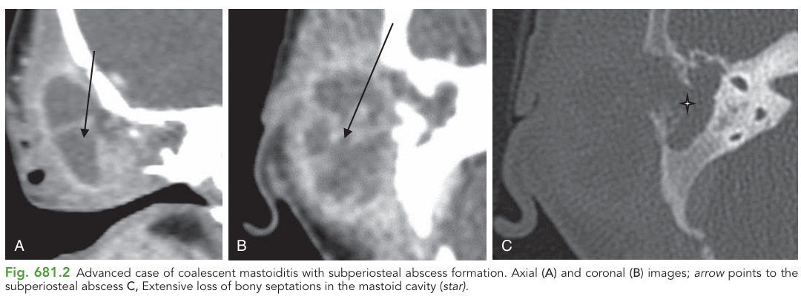
COMPLICATED DISEASE
A subperiosteal abscess means source control is now central
Urgent ENT
IV antibiotics
Drain middle ear for culture
Drain abscess ± mastoidectomy
Failure to improve within 24–48 hours requires reassessment for undrained infection.
DR. MANAR SHAWABKEH • PEDIATRICS RESIDENT TEACHING
07
Notes:
[Sources]
Nelson Textbook of Pediatrics, 22nd ed., Chapter: Acute Mastoiditis (user-provided pages 4016–4019).
Johns Hopkins All Children’s Hospital. Acute Mastoiditis Clinical Pathway. 2020.
UCSF Infectious Diseases Management Program. Mastoiditis. Accessed 2026.
AAP Pediatrics in Review. Mastoiditis. 2024.
Nelson Fig. 681.2 reproduced as a user-provided teaching image.

Slide 8
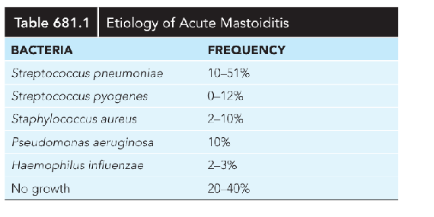
MICROBIOLOGY
The pathogen profile changes with ear history
Acute disease / intact TM history
S. pneumoniae • GAS • S. aureus • H. influenzae
Chronic drainage, cholesteatoma, tubes
Broaden for gram-negative organisms, including Pseudomonas, according to local susceptibility.
A negative culture is common—do not use it to exclude mastoiditis.
DR. MANAR SHAWABKEH • PEDIATRICS RESIDENT TEACHING
08
Notes:
[Sources]
Nelson Textbook of Pediatrics, 22nd ed., Chapter: Acute Mastoiditis (user-provided pages 4016–4019).
Johns Hopkins All Children’s Hospital. Acute Mastoiditis Clinical Pathway. 2020.
UCSF Infectious Diseases Management Program. Mastoiditis. Accessed 2026.
AAP Pediatrics in Review. Mastoiditis. 2024.
Nelson Table 681.1 reproduced as a user-provided teaching image.

Slide 9
INITIAL MANAGEMENT
Start IV therapy—and match the spectrum to the phenotype
Uncomplicated acute mastoiditis
Ampicillin–sulbactam OR ceftriaxone
Urgent ENT; tailor to local antibiogram
MRSA history/carriage or severe invasive disease
Add vancomycin
Stop if cultures do not support MRSA
Chronic suppurative OM / cholesteatoma / tubes
Include antipseudomonal coverage
e.g., cefepime, ceftazidime, or piperacillin–tazobactam
Suspected intracranial extension
CNS-penetrating broad therapy
ENT + ID + neurosurgery; follow local CNS pathway
Regimens vary by resistance patterns, allergy, age, renal function, and institutional pathway.
DR. MANAR SHAWABKEH • PEDIATRICS RESIDENT TEACHING
09
Notes:
[Sources]
Nelson Textbook of Pediatrics, 22nd ed., Chapter: Acute Mastoiditis (user-provided pages 4016–4019).
Johns Hopkins All Children’s Hospital. Acute Mastoiditis Clinical Pathway. 2020.
UCSF Infectious Diseases Management Program. Mastoiditis. Accessed 2026.
AAP Pediatrics in Review. Mastoiditis. 2024.

Slide 10
MANAGEMENT PATHWAY
Reassess at 24–48 hours: improvement is the decision point
1
2
3
4
Admit + IV antibiotics
ENT evaluation + culture
Clinical reassessment
Step-down or source control
Improving: oral step-down when clinically appropriate; complete total course per complication and local protocol.
Not improving: repeat examination and imaging; look for abscess, coalescence, resistant pathogen, or intracranial spread.
DR. MANAR SHAWABKEH • PEDIATRICS RESIDENT TEACHING
10
Notes:
[Sources]
Nelson Textbook of Pediatrics, 22nd ed., Chapter: Acute Mastoiditis (user-provided pages 4016–4019).
Johns Hopkins All Children’s Hospital. Acute Mastoiditis Clinical Pathway. 2020.
UCSF Infectious Diseases Management Program. Mastoiditis. Accessed 2026.
AAP Pediatrics in Review. Mastoiditis. 2024.

Slide 11
ENT & SOURCE CONTROL
Surgery is driven by anatomy, complications, and response
Myringotomy ± tube
Obtain culture • drain middle ear • persistent effusion or coalescent disease
Abscess drainage
Drain a postauricular/subperiosteal collection
Mastoidectomy
Coalescent disease • abscess • intracranial complication • failure of appropriate IV therapy
Do not wait for neurologic deterioration before involving ENT.
DR. MANAR SHAWABKEH • PEDIATRICS RESIDENT TEACHING
11
Notes:
[Sources]
Nelson Textbook of Pediatrics, 22nd ed., Chapter: Acute Mastoiditis (user-provided pages 4016–4019).
Johns Hopkins All Children’s Hospital. Acute Mastoiditis Clinical Pathway. 2020.
UCSF Infectious Diseases Management Program. Mastoiditis. Accessed 2026.
AAP Pediatrics in Review. Mastoiditis. 2024.

Slide 12
RED FLAGS
Complications follow predictable anatomic routes
Extracranial
Subperiosteal abscess • facial palsy • labyrinthitis
Venous
Sigmoid/lateral sinus thrombosis • otitic hydrocephalus
Intracranial
Epidural/subdural empyema • meningitis • brain abscess
Petrous apex
Gradenigo syndrome: otorrhea + deep facial pain + CN VI palsy
Headache • vomiting • papilledema • focal deficit • seizure • altered mental status = urgent MRI/MRV and multidisciplinary care
DR. MANAR SHAWABKEH • PEDIATRICS RESIDENT TEACHING
12
Notes:
[Sources]
Nelson Textbook of Pediatrics, 22nd ed., Chapter: Acute Mastoiditis (user-provided pages 4016–4019).
Johns Hopkins All Children’s Hospital. Acute Mastoiditis Clinical Pathway. 2020.
UCSF Infectious Diseases Management Program. Mastoiditis. Accessed 2026.
AAP Pediatrics in Review. Mastoiditis. 2024.

Slide 13
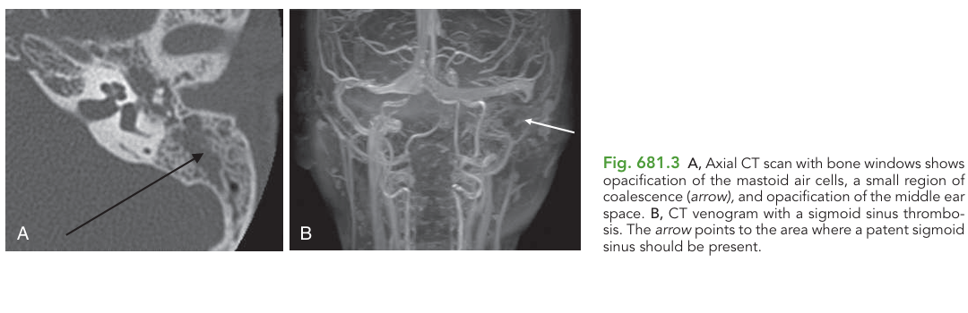
INTRACRANIAL SPREAD
Venous sinus thrombosis may be clinically subtle
When to suspect
Persistent fever or headache
Papilledema or diplopia
Neurologic change
Septic course despite therapy
Obtain contrast MRI/MRV; involve ENT, ID, neurology/neurosurgery, and hematology as indicated.
DR. MANAR SHAWABKEH • PEDIATRICS RESIDENT TEACHING
13
Notes:
[Sources]
Nelson Textbook of Pediatrics, 22nd ed., Chapter: Acute Mastoiditis (user-provided pages 4016–4019).
Johns Hopkins All Children’s Hospital. Acute Mastoiditis Clinical Pathway. 2020.
UCSF Infectious Diseases Management Program. Mastoiditis. Accessed 2026.
AAP Pediatrics in Review. Mastoiditis. 2024.
Nelson Fig. 681.3 reproduced as a user-provided teaching image.

Slide 14
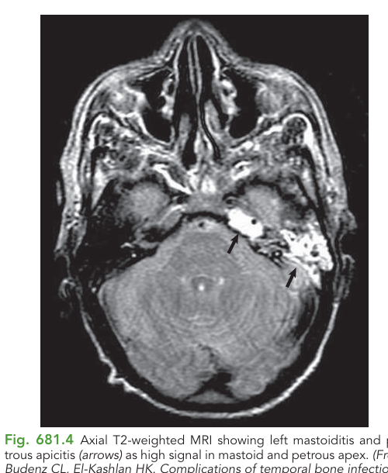
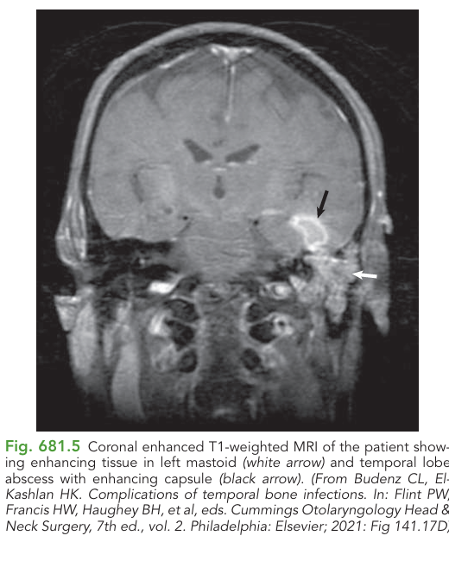
MRI PATTERNS
MRI reveals complications beyond the mastoid cortex
Petrous apicitis
Temporal lobe abscess
DR. MANAR SHAWABKEH • PEDIATRICS RESIDENT TEACHING
14
Notes:
[Sources]
Nelson Textbook of Pediatrics, 22nd ed., Chapter: Acute Mastoiditis (user-provided pages 4016–4019).
Johns Hopkins All Children’s Hospital. Acute Mastoiditis Clinical Pathway. 2020.
UCSF Infectious Diseases Management Program. Mastoiditis. Accessed 2026.
AAP Pediatrics in Review. Mastoiditis. 2024.
Nelson Figs. 681.4 and 681.5 reproduced as user-provided teaching images.

Slide 15
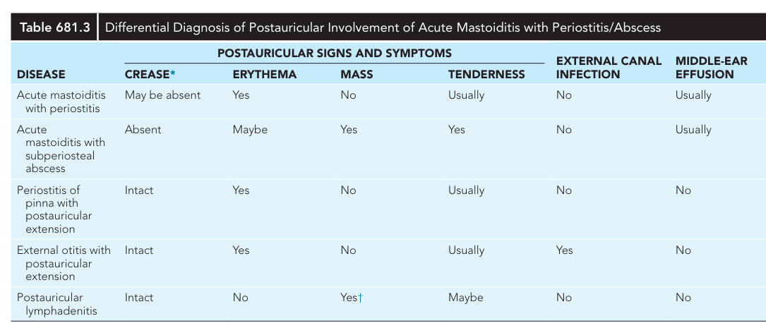
DIFFERENTIAL DIAGNOSIS
Not every red postauricular swelling is mastoiditis
Ask three discriminators: Is the canal infected? Is there middle-ear effusion? Is there a discrete mass?
DR. MANAR SHAWABKEH • PEDIATRICS RESIDENT TEACHING
15
Notes:
[Sources]
Nelson Textbook of Pediatrics, 22nd ed., Chapter: Acute Mastoiditis (user-provided pages 4016–4019).
Johns Hopkins All Children’s Hospital. Acute Mastoiditis Clinical Pathway. 2020.
UCSF Infectious Diseases Management Program. Mastoiditis. Accessed 2026.
AAP Pediatrics in Review. Mastoiditis. 2024.
Nelson Table 681.3 reproduced as a user-provided teaching image.

Slide 16
APPLICATION
Board case 1
A 3-year-old with AOM develops fever, postauricular erythema and tenderness, and outward/downward displacement of the pinna. He is alert with no focal neurologic findings.
What is the most appropriate next step?
A. Discharge on oral amoxicillin
B. Admit, begin IV antibiotics, and obtain urgent ENT assessment
C. Perform lumbar puncture before antibiotics
D. Order a noncontrast head CT and await the report
DR. MANAR SHAWABKEH • PEDIATRICS RESIDENT TEACHING
16
Notes:
[Sources]
Nelson Textbook of Pediatrics, 22nd ed., Chapter: Acute Mastoiditis (user-provided pages 4016–4019).
Johns Hopkins All Children’s Hospital. Acute Mastoiditis Clinical Pathway. 2020.
UCSF Infectious Diseases Management Program. Mastoiditis. Accessed 2026.
AAP Pediatrics in Review. Mastoiditis. 2024.

Slide 17
APPLICATION
Board case 2
A hospitalized child with mastoiditis develops severe headache, vomiting, and diplopia despite 36 hours of IV antibiotics. Examination shows papilledema.
Which investigation is most appropriate now?
A. Repeat otoscopy only
B. Temporal-bone radiograph
C. Contrast MRI with MR venography
D. Ultrasound of the postauricular tissues
DR. MANAR SHAWABKEH • PEDIATRICS RESIDENT TEACHING
17
Notes:
[Sources]
Nelson Textbook of Pediatrics, 22nd ed., Chapter: Acute Mastoiditis (user-provided pages 4016–4019).
Johns Hopkins All Children’s Hospital. Acute Mastoiditis Clinical Pathway. 2020.
UCSF Infectious Diseases Management Program. Mastoiditis. Accessed 2026.
AAP Pediatrics in Review. Mastoiditis. 2024.

Slide 18
Five decisions that prevent harm
01
Recognize the displaced pinna
02
Do not diagnose from opacification alone
03
Use CT for bone; MRI/MRV for intracranial disease
04
Start IV therapy and involve ENT early
05
Reassess at 24–48 h for source control
DR. MANAR
SHAWABKEH
Notes:
[Sources]
Nelson Textbook of Pediatrics, 22nd ed., Chapter: Acute Mastoiditis (user-provided pages 4016–4019).
Johns Hopkins All Children’s Hospital. Acute Mastoiditis Clinical Pathway. 2020.
UCSF Infectious Diseases Management Program. Mastoiditis. Accessed 2026.
AAP Pediatrics in Review. Mastoiditis. 2024.

