Slide 1

PEDIATRIC CLINICAL APPROACH
Approach to the Child
with Dizziness
A practical, board-focused framework for residents
Dr. Manar Mohammad Alshawabkeh
Pediatrician, Jordanian Board
Notes:
Cover illustration generated for this lecture. No external clinical claims on this slide.

Slide 3
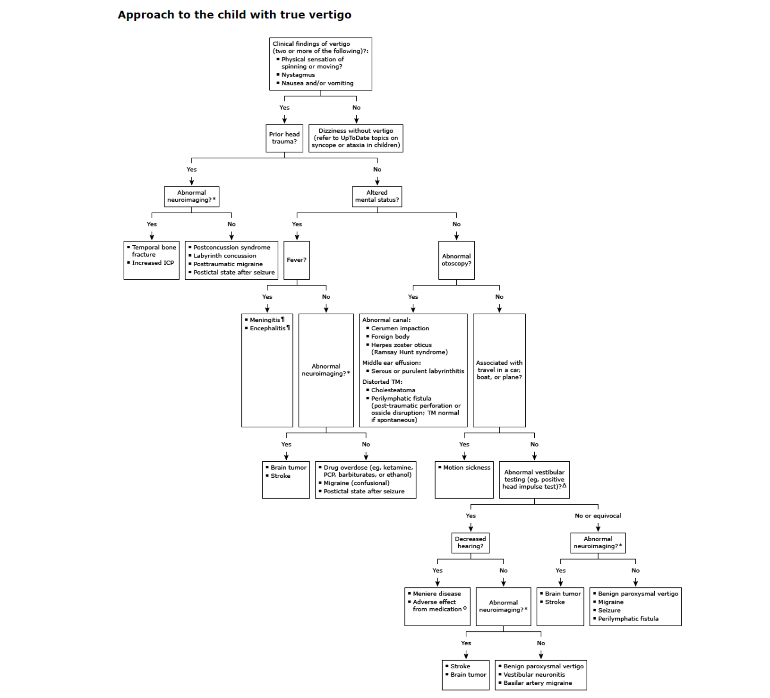

Slide 4
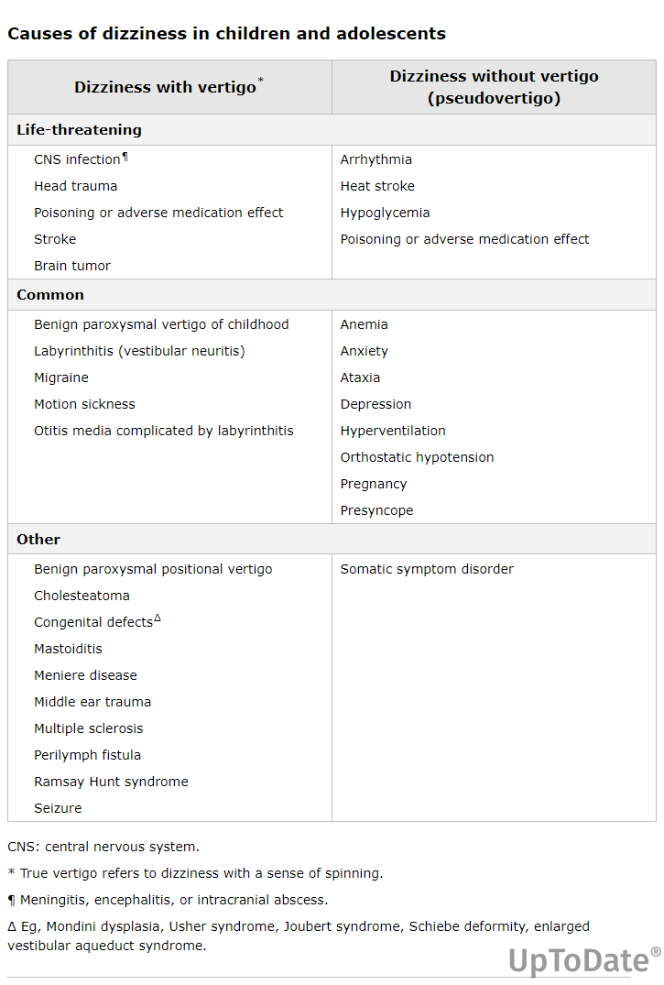

Slide 5
Initial Stabilization
Identify instability before pursuing the cause of dizziness
ALTERED MENTAL STATUS
Check bedside blood glucose immediately
Rapid ABC assessment and support
Significant head injury
Fever with CNS signs
Perform trauma assessment and stabilize according to the pediatric primary survey.
Meningismus or altered mental status raises concern for meningitis or encephalitis.
Priorities
If unstable
Cervical spine protection, neurologic status and signs of raised intracranial pressure
Support the airway and circulation. Treat septic shock and begin appropriate empiric antimicrobial therapy without delay.
BOARD PRIORITY
Stabilization precedes localization of the vestibular lesion.
Notes:
Source: UpToDate. Causes of dizziness and vertigo in children and adolescents, section on initial stabilization. User-provided excerpt, accessed September 16, 2026. https://www.uptodate.com/contents/causes-of-dizziness-and-vertigo-in-children-and-adolescents

Slide 6
Definitions
The symptom description determines the diagnostic pathway
DIZZINESS
A disturbed sense of the child’s relationship to space.
VERTIGO
DIZZINESS WITHOUT VERTIGO
Illusion of movement or spinning
No illusion of movement
Reflects vestibular system dysfunction.
Often described as lightheadedness, imbalance or near-fainting.
Peripheral
Vestibule and semicircular canals
Common clues
Central
Brainstem, cerebellum and vestibulospinal tract
Anemia, orthostatic hypotension, presyncope, hyperventilation or anxiety
BOARD PEARL
First clarify whether the child perceives movement. This separates vertigo from other forms of dizziness.
Notes:
Source: UpToDate. Causes of dizziness and vertigo in children and adolescents. User-provided excerpt, accessed September 16, 2026. https://www.uptodate.com/contents/causes-of-dizziness-and-vertigo-in-children-and-adolescents

Slide 7
Pediatric Dizziness: Prevalence and Common Causes
Dizziness-related complaints are common, while serious neurologic causes remain rare
5%
≈50%
of diagnoses in specialty clinics
Estimated prevalence in children and adolescents
Most common final diagnoses
Benign paroxysmal vertigo
Includes vertigo, balance problems, lightheadedness, fainting, unsteadiness and clumsiness.
Vestibular migraine
Head trauma
Other common causes: middle ear effusion or infection, and motion sickness
BOARD PEARL
Brain tumor, stroke and meningitis are rare causes, but clinical red flags still require urgent evaluation.
Notes:
Source: UpToDate. Causes of dizziness and vertigo in children and adolescents. User-provided excerpt. Accessed September 18, 2026. Key figures in the excerpt: estimated prevalence about 5%; benign paroxysmal vertigo, vestibular migraine and head trauma comprise about 50% of final diagnoses in specialty clinics.

Slide 8
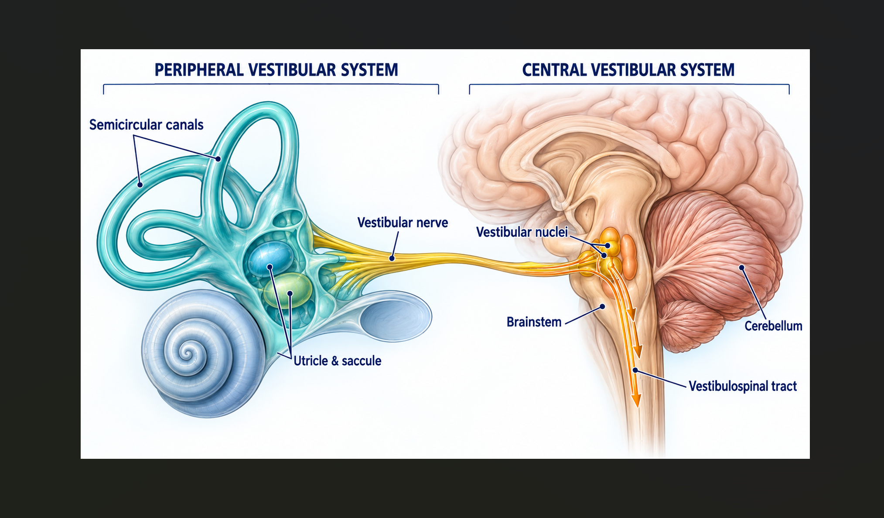

Slide 9
Vertigo Versus Other Dizziness
Symptom language alone may misclassify the complaint
HISTORY DEFINES THE CATEGORY
Ask the child to describe the sensation, then confirm the sequence with the caregiver.
SUGGESTS VERTIGO
IMPORTANT LIMITATION
Spinning, whirling, tilting or moving
Vestibular disease may cause vague imbalance or disorientation.
Younger children may show vomiting, irritability, eye movements, falling or a desire to lie still.
Presyncope and nonspecific dizziness may also be described as spinning.
BOARD PEARL
Interpret the description in the full clinical context.
Notes:
Source: UpToDate. Evaluation of dizziness and vertigo in children and adolescents. User-provided excerpt, accessed September 16, 2026. https://www.uptodate.com/contents/evaluation-of-dizziness-and-vertigo-in-children-and-adolescents

Slide 10
Dizziness Without Vertigo
Classify the complaint by physiology rather than by the word chosen
PRESYNCOPE
Seconds to minutes, near-blackout, warmth, diaphoresis, nausea, blurred vision and pallor. Usually upright, not supine.
DISEQUILIBRIUM
Unsteadiness while walking. Consider concussion, neuropathy, acute cerebellar ataxia or substance exposure.
NONSPECIFIC LIGHTHEADEDNESS
May accompany mild presyncope, concussion, hypoglycemia, anticholinergic exposure, carbon monoxide or sedatives.
PSYCHOPHYSIOLOGIC CAUSES
Hyperventilation, anxiety and depression can cause or amplify dizziness.
BOARD PEARL
Dizziness while supine raises concern for arrhythmia rather than postural hypotension.
Notes:
Source: UpToDate. Evaluation of dizziness and vertigo in children and adolescents. User-provided excerpt, accessed September 16, 2026. https://www.uptodate.com/contents/evaluation-of-dizziness-and-vertigo-in-children-and-adolescents

Slide 11
Differential Diagnosis
Prioritize dangerous central and traumatic causes before common peripheral disorders
LIFE-THREATENING CONDITIONS
COMMON AND RECURRENT CAUSES
Head trauma
Otitis media and labyrinthitis
CNS infection
Migraine syndromes
Intracranial tumor or abscess
Benign paroxysmal vertigo of childhood
Posterior circulation stroke
Medication adverse effects
Drug overdose or poisoning
Motion sickness or vestibular neuritis
BOARD PEARL
Central neurologic signs or altered mental status require urgent evaluation.
Notes:
Source: UpToDate. Causes of dizziness and vertigo in children and adolescents. User-provided excerpt, accessed September 16, 2026. https://www.uptodate.com/contents/causes-of-dizziness-and-vertigo-in-children-and-adolescents

Slide 12
History of Suspected Vertigo
Timing and associated behavior often provide more value than the word “dizzy”
TYPICAL PATTERN
ASSOCIATED SYMPTOMS
Acute and episodic
Nausea and vomiting
Episodes usually resolve over days. Continuous vertigo beyond several weeks is unusual because central compensation develops.
Common in acute peripheral vertigo and may cause dehydration or electrolyte disturbance.
Vomiting plus meningismus, ataxia, cranial nerve signs or visual symptoms suggests a central process or raised intracranial pressure.
RECURRENT EPISODES
Consider migraine variants, motion sickness or benign paroxysmal vertigo of childhood.
BOARD PEARL
Recurrent vertigo may represent migraine even without headache.
Notes:
Source: UpToDate. Evaluation of dizziness and vertigo in children and adolescents. User-provided excerpt, accessed September 16, 2026. https://www.uptodate.com/contents/evaluation-of-dizziness-and-vertigo-in-children-and-adolescents

Slide 13
Provoking Factors
The trigger helps separate vestibular vertigo from presyncope and other dizziness
Head motion or position
Most vertigo worsens with head movement. A child may lie very still.
Rolling over or lying down
Supports positional vertigo rather than postural presyncope.
Standing upright
Consider postural presyncope, especially with near-fainting symptoms.
Cough, sneeze or Valsalva
Raises concern for a perilymphatic fistula.
Car, boat or airplane travel
Pallor, diaphoresis and nausea support motion sickness.
Head or middle-ear trauma
May injure peripheral or central vestibular structures. Concussion can cause nonvestibular dizziness.
Notes:
Source: UpToDate. Evaluation of dizziness and vertigo in children and adolescents. User-provided excerpt, accessed September 16, 2026. https://www.uptodate.com/contents/evaluation-of-dizziness-and-vertigo-in-children-and-adolescents

Slide 14
Historical Red Flags
Associated findings may identify infection, poisoning or posterior fossa disease
CENTRAL OR SYSTEMIC CONCERN
ETIOLOGIC CLUES
Fever with meningismus or altered mental status
Hearing loss
Ear disease, temporal bone injury, labyrinthitis, CN VIII lesion or ototoxic medication
Staggering or ataxic gait
Recent URI
Vestibular neuritis or otitis media
Diplopia, visual loss or dysarthria
Recurrent otitis
Mastoiditis or suppurative labyrinthitis
Focal weakness, numbness or incoordination
Migraine history
Vertigo may occur without headache
BOARD PEARL
Ask adolescents privately about ethanol, sedatives, ketamine and other substances.
Notes:
Source: UpToDate. Evaluation of dizziness and vertigo in children and adolescents. User-provided excerpt, accessed September 16, 2026. https://www.uptodate.com/contents/evaluation-of-dizziness-and-vertigo-in-children-and-adolescents

Slide 15
Central Life-Threatening Causes
Fever, focal findings and altered consciousness shift the differential centrally
CNS INFECTION
POSTERIOR CIRCULATION STROKE
Fever, headache, neck stiffness or altered mental status
Vertigo may occur when the basilar artery, brainstem vestibular nuclei or cortical vestibular centers are involved.
Suspect meningitis or encephalitis and begin urgent pathogen-directed empiric therapy.
Hemiplegia, altered mental status, diplopia, dysarthria or severe ataxia strengthen concern for stroke.
MASS LESION
Tumor or abscess near the fourth ventricle may cause positional worsening, vertigo or nystagmus.
BOARD PEARL
A first acute episode that resembles migraine still requires stroke exclusion when features are atypical.
Notes:
Source: UpToDate. Causes of dizziness and vertigo in children and adolescents. User-provided excerpt, accessed September 16, 2026. https://www.uptodate.com/contents/causes-of-dizziness-and-vertigo-in-children-and-adolescents

Slide 16
Focused Physical Examination
The examination confirms vestibular dysfunction and looks for central disease
CORE EXAMINATION
VITAL-SIGN CLUES
Vital signs
Fever
Infection
Ear and hearing assessment
Hypertension with tachycardia or bradycardia
Nystagmus and ocular motor signs
Consider raised intracranial pressure or intoxication
Balance, gait and Romberg
Bradycardia with hypotension
Complete neurologic examination
Consider ethanol or barbiturate poisoning
Orthostatic changes support presyncope only when consistent with the history. They lack sensitivity and specificity in children.
Notes:
Source: UpToDate. Evaluation of dizziness and vertigo in children and adolescents. User-provided excerpt, accessed September 16, 2026. https://www.uptodate.com/contents/evaluation-of-dizziness-and-vertigo-in-children-and-adolescents

Slide 17
Ear Examination
Peripheral causes often declare themselves on otoscopy and hearing assessment
Middle-ear effusion
Erythematous or bulging tympanic membrane with reduced mobility
Mastoiditis
Protruding auricle with mastoid swelling, erythema and tenderness
Temporal bone or middle-ear injury
Hemotympanum, otorrhea, perforation or ossicular disruption
Perilymphatic fistula
Vertigo or nystagmus triggered by loud sound or pneumatic otoscopy
Cholesteatoma
Deep retraction pocket or white mass behind the tympanic membrane
Ramsay Hunt syndrome
Vesicles on the auricle or within the auditory canal
BOARD PEARL
Document hearing loss because it narrows the peripheral differential.
Notes:
Source: UpToDate. Evaluation of dizziness and vertigo in children and adolescents. User-provided excerpt, accessed September 16, 2026. https://www.uptodate.com/contents/evaluation-of-dizziness-and-vertigo-in-children-and-adolescents

Slide 18
Neurologic Examination and Gait
Walking ability helps separate peripheral vestibular disease from cerebellar disease
PERIPHERAL VESTIBULAR LESION
ACUTE CEREBELLAR LESION
The child may lean or fall toward the side of the lesion.
The child may be unable to walk without falling.
Movement is uncomfortable, but the child generally remains able to walk. Romberg may show consistent falling or tilting to one side.
The direction of falling may vary. Search for cranial nerve abnormalities, weakness, sensory change, dysmetria and abnormal reflexes.
CENTRAL RED FLAG
Inability to walk safely warrants urgent evaluation for cerebellar or posterior fossa pathology.
Notes:
Source: UpToDate. Evaluation of dizziness and vertigo in children and adolescents. User-provided excerpt, accessed September 16, 2026. https://www.uptodate.com/contents/evaluation-of-dizziness-and-vertigo-in-children-and-adolescents

Slide 19
Ocular Nystagmus
The most common physical manifestation of vertigo
Describe three features
LOCALIZATION
Peripheral pattern
PLANE
Horizontal, torsional or vertical
Usually direction-fixed and may lessen with visual fixation.
FIXATION
Does visual fixation suppress it?
Central concern
DIRECTION
Does direction change with gaze?
Vertical nystagmus, direction-changing gaze-evoked nystagmus or other focal neurologic signs.
BOARD PEARL
Use nystagmus findings with gait and neurologic examination, not in isolation.
Notes:
Source: UpToDate. Evaluation of dizziness and vertigo in children and adolescents. User-provided excerpt, accessed September 16, 2026. https://www.uptodate.com/contents/evaluation-of-dizziness-and-vertigo-in-children-and-adolescents

Slide 20
Head Impulse Test
A bedside assessment of the vestibulo-ocular reflex
TECHNIQUE
INTERPRETATION
Ask the child to fixate on a distant target.
Normal
Eyes remain fixed on the target.
Turn the head approximately 15° quickly and unpredictably.
Abnormal
The eyes move off target, followed by a corrective saccade back.
Test both directions while observing eye position.
This indicates a deficient vestibulo-ocular reflex on the side of the head turn and supports a peripheral lesion.
BOARD PEARL
The head impulse test is generally more specific than sensitive.
Notes:
Source: UpToDate. Evaluation of dizziness and vertigo in children and adolescents. User-provided excerpt, accessed September 16, 2026. https://www.uptodate.com/contents/evaluation-of-dizziness-and-vertigo-in-children-and-adolescents

Slide 21
Further Vestibular Evaluation
Escalate testing when bedside assessment remains equivocal or central disease is suspected
Static imbalance
Skew deviation, ocular tilt reaction and abnormal subjective visual vertical
Dynamic imbalance
Head-shaking visual acuity and head-shaking nystagmus
Dix-Hallpike maneuver
Tests for BPPV, which is uncommon in children
Caloric testing
Rarely used in emergency or office settings. Usually performed by vestibular specialists
Specialty consultation
Pediatric neurology or otolaryngology when diagnosis remains uncertain
Neuroimaging
MRI when cerebellar dysfunction or another central lesion is suspected
BOARD PEARL
Central suspicion lowers the threshold for consultation and MRI.
Notes:
Source: UpToDate. Evaluation of dizziness and vertigo in children and adolescents. User-provided excerpt, accessed September 16, 2026. https://www.uptodate.com/contents/evaluation-of-dizziness-and-vertigo-in-children-and-adolescents

Slide 22
New High-Yield Clinical Pearls
Useful additions not explicitly covered in the previous pediatric material
Clinical point | Board takeaway | Practical use
Dix–Hallpike | ≈80% sensitivity for BPPV | A negative test does not fully exclude BPPV; it does not diagnose other vestibulopathies.
Supine roll test | Think horizontal-canal BPPV | Use when the positional history is compatible but Dix–Hallpike is negative.
Nystagmus | Supports a vestibular origin | Absence does not exclude vestibular disease; assess spontaneous, gaze-evoked, and provoked nystagmus.
EXAM PEARL
Do not use absent nystagmus—or one negative Dix–Hallpike—to rule out all vestibular disease.
Notes:
Source: UpToDate, ‘Approach to the patient with dizziness’ (user-provided excerpt; accessed 18 Sep 2026). Scope note: This source is general/adult-focused. Only transferable bedside principles were retained; adult prevalence, geriatric data, cervical spondylosis, and adult stroke-focused HINTS guidance were excluded from this pediatric lecture slide.

Slide 23
Otitis Media and Its Complications
The most common source of vestibular disturbance in children
ACUTE OTITIS MEDIA
COMPLICATIONS CAUSING VERTIGO
Bulging erythematous tympanic membrane with middle-ear effusion
Coalescent mastoiditis
Serous or suppurative labyrinthitis
Labyrinth involvement may add vertigo, dizziness or hearing loss.
Cholesteatoma with bony labyrinth erosion
Hearing loss or mastoid findings increase concern for complicated ear disease.
BOARD PEARL
Vertigo with otitis media warrants assessment for labyrinthitis or mastoid complications.
Notes:
Source: UpToDate. Causes of dizziness and vertigo in children and adolescents. User-provided excerpt, accessed September 16, 2026. https://www.uptodate.com/contents/causes-of-dizziness-and-vertigo-in-children-and-adolescents

Slide 24
Migraine Syndromes
Children may present with vertigo or nystagmus without headache
VESTIBULAR MIGRAINE
MIGRAINE WITH BRAINSTEM AURA
Episodic vertigo with migraine history or other migraine features
Two or more brainstem-type aura symptoms, including vertigo
Headache may be absent. Vertiginous symptoms may accompany the aura of classic migraine.
Symptoms usually resolve within two hours and are often followed by throbbing headache.
BOARD PEARL
The first severe episode may require neurologic consultation and neuroimaging to exclude stroke.
Notes:
Source: UpToDate. Causes of dizziness and vertigo in children and adolescents. User-provided excerpt, accessed September 16, 2026. https://www.uptodate.com/contents/causes-of-dizziness-and-vertigo-in-children-and-adolescents

Slide 25
Benign Paroxysmal Vertigo of Childhood
A migraine-related episodic syndrome of early childhood
Episode
Brief disequilibrium, usually under one minute, without altered consciousness
During the attack
Fear, imbalance, reaching for support, nystagmus, pallor, nausea or vomiting
Pattern
Clusters of daily attacks followed by weeks of remission
Between attacks
Normal eye and neurologic examination
Course
Usually resolves by age five. Typical migraine may develop later
BOARD PEARL
Diagnosis is clinical. Differentiate from seizures when consciousness or postictal behavior is abnormal.
Notes:
Source: UpToDate. Causes of dizziness and vertigo in children and adolescents. User-provided excerpt, accessed September 16, 2026. https://www.uptodate.com/contents/causes-of-dizziness-and-vertigo-in-children-and-adolescents

Slide 26
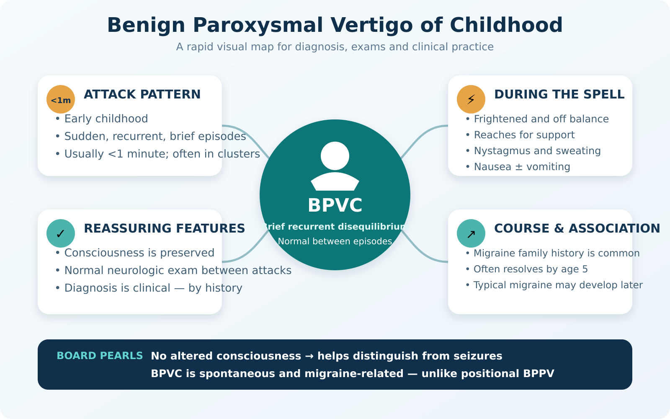

Slide 27
Motion Sickness
Sensory conflict produces autonomic symptoms during travel
Visual, vestibular and somatosensory cues do not agree
TYPICAL SETTING
TYPICAL SYMPTOMS
Boat, car or airplane travel
Pallor, diaphoresis, dizziness, nausea and vomiting
Motion sickness occurs more often in children with migraine.
A spinning sensation is uncommon.
BOARD PEARL
Travel-associated nausea and pallor favor motion sickness over true vertigo.
Notes:
Source: UpToDate. Causes of dizziness and vertigo in children and adolescents. User-provided excerpt, accessed September 16, 2026. https://www.uptodate.com/contents/causes-of-dizziness-and-vertigo-in-children-and-adolescents

Slide 28
Vestibular Neuritis Versus Labyrinthitis
Hearing loss is the key clinical separator
VESTIBULAR NEURITIS
LABYRINTHITIS
Rapid severe vertigo
Sudden vertigo plus hearing loss
Nausea, vomiting and gait instability
Viral or bacterial labyrinth infection
No hearing loss
May complicate otitis media or meningitis
Often postinfectious, but a recent viral illness occurs in fewer than half of cases.
Hearing loss may be permanent.
BOARD PEARL
Acute vertigo without hearing loss favors vestibular neuritis.
Notes:
Source: UpToDate. Causes of dizziness and vertigo in children and adolescents. User-provided excerpt, accessed September 16, 2026. https://www.uptodate.com/contents/causes-of-dizziness-and-vertigo-in-children-and-adolescents

Slide 29
BPPV and Paroxysmal Torticollis
Two episodic disorders with age-specific patterns
BPPV
PAROXYSMAL TORTICOLLIS OF INFANCY
Rare in children
Recurrent head tilt beginning in early infancy
Brief vertigo under one minute after a head-position change, often when sitting up in bed.
May include vomiting, pallor, irritability, ataxia or drowsiness. Attacks last hours and sometimes days.
Dix-Hallpike should provoke nystagmus within 30 seconds.
Usually resolves by age five and may precede migraine or BPV.
BOARD PEARL
Spasmus nutans adds head nodding and strabismus with amblyopia.
Notes:
Source: UpToDate. Causes of dizziness and vertigo in children and adolescents. User-provided excerpt, accessed September 16, 2026. https://www.uptodate.com/contents/causes-of-dizziness-and-vertigo-in-children-and-adolescents

Slide 30
Meniere Disease and Perilymphatic Fistula
Both can combine vertigo with auditory symptoms
MENIERE DISEASE
PERILYMPHATIC FISTULA
Ear fullness, tinnitus, vertigo and fluctuating unilateral sensorineural hearing loss
Sudden or fluctuating hearing loss with dizziness or vertigo
Symptoms worsen with pressure change, Valsalva, pneumatic otoscopy or loud sound.
Rare in children and represents fewer than 3% of all cases.
Pediatric cases may be associated with congenital inner-ear malformations.
Consider barotrauma, head injury, ear trauma or middle-ear infection.
BOARD PEARL
Tullio phenomenon is vertigo and nystagmus triggered by loud sound.
Notes:
Source: UpToDate. Causes of dizziness and vertigo in children and adolescents. User-provided excerpt, accessed September 16, 2026. https://www.uptodate.com/contents/causes-of-dizziness-and-vertigo-in-children-and-adolescents

Slide 31
Head Trauma
Mechanism and ear findings help localize post-traumatic dizziness
Temporal bone fracture
Dizziness with hearing loss and hemotympanum is the classic pattern.
Vestibular concussion
Temporoparietal or parieto-occipital impact may cause nausea, vertigo and nystagmus.
Whiplash injury
Hyperflexion and extension may injure the basilar artery and produce vestibular symptoms.
Middle-ear trauma
Oval-window disruption may cause a perilymphatic fistula.
Concussion
May cause dizziness with or without true vertigo.
BOARD PEARL
Sound- or pressure-induced vertigo after trauma suggests a perilymphatic fistula.
Notes:
Source: UpToDate. Causes of dizziness and vertigo in children and adolescents. User-provided excerpt, accessed September 16, 2026. https://www.uptodate.com/contents/causes-of-dizziness-and-vertigo-in-children-and-adolescents

Slide 32
Medication-Related Vertigo
Medication review should include ototoxicity and drug-induced nystagmus
PERIPHERAL VESTIBULAR TOXICITY
OTHER DRUG PATTERNS
Aminoglycosides
Cinchonism
Best-established medication cause of peripheral vestibular injury
Quinine or quinidine may cause tinnitus, nausea, headache, dizziness and visual disturbance.
Also consider furosemide, minocycline and salicylates.
Downbeat nystagmus
Consider carbamazepine, lithium or phenytoin.
BOARD PEARL
For aminoglycosides, adjust for kidney function and minimize duration and other ototoxic drugs.
Notes:
Source: UpToDate. Causes of dizziness and vertigo in children and adolescents. User-provided excerpt, accessed September 16, 2026. https://www.uptodate.com/contents/causes-of-dizziness-and-vertigo-in-children-and-adolescents

Slide 33
Drug Overdose and Poisoning
Vertigo plus behavioral change or altered mental status should trigger a toxicologic assessment
Ethanol
Nystagmus, impaired gait, altered behavior and possible hypoglycemia
Barbiturates
Depressed consciousness, hypotension, bradycardia and vertigo
Ketamine
Nystagmus, hypertension, tachycardia and characteristic clinical course
Phencyclidine
Agitation or altered mental status with hypertension and nystagmus
BOARD PEARL
Ask adolescents privately and review every medication available in the home.
Notes:
Source: UpToDate. Causes of dizziness and vertigo in children and adolescents. User-provided excerpt, accessed September 16, 2026. https://www.uptodate.com/contents/causes-of-dizziness-and-vertigo-in-children-and-adolescents

Slide 34
Less Common Causes Requiring Specialist Input
Neurologic and congenital causes enter the differential when key associated signs are present
Vestibular seizure
Sudden vertigo followed by loss of consciousness or a postictal state
Ramsay Hunt syndrome
Ear-canal vesicles, facial paralysis, ear pain and vertigo
Multiple sclerosis
Vertigo with diplopia, facial numbness or hearing disturbance
Enlarged vestibular aqueduct
Vestibular aqueduct >1.5 mm with sensorineural or mixed hearing loss and vertigo
Persistent diagnostic uncertainty
Early pediatric neurology or otolaryngology involvement
BOARD PEARL
True vertigo with loss of consciousness is unusual and should raise concern for seizure.
Notes:
Source: UpToDate. Causes of dizziness and vertigo in children and adolescents. User-provided excerpt, accessed September 16, 2026. https://www.uptodate.com/contents/causes-of-dizziness-and-vertigo-in-children-and-adolescents

Slide 35
Syncope: Definition and Frequency
A symptom defined by transient loss of consciousness and postural tone
Sudden, brief loss of consciousness with loss of postural tone and spontaneous recovery
15%
of children experience at least one syncopal episode before the end of adolescence
CORE DISTINCTION
Syncope is a symptom. The evaluation seeks the underlying cause and dangerous mimics.
BOARD PEARL
Recovery should be spontaneous. Persistent altered consciousness suggests another diagnosis.
Notes:
Source: UpToDate. Emergency evaluation of syncope in children and adolescents. User-provided excerpt, accessed September 16, 2026. https://www.uptodate.com/contents/emergency-evaluation-of-syncope-in-children-and-adolescents

Slide 36
Causes of Pediatric Syncope
Autonomic causes dominate, but rare dangerous causes must remain visible
Autonomic causes: up to 80%
Vasovagal, situational and orthostatic syndromes
Neurologic or migraine: up to 20%
Seizures, migraine and other paroxysmal mimics
Life-threatening causes: 1–2%
Hypoglycemia, heat illness, anaphylaxis, arrhythmia or structural heart disease
Other causes
Metabolic disease, medication exposure and psychogenic events
BOARD PEARL
The low prevalence of cardiac syncope does not reduce its diagnostic importance.
Notes:
Source: UpToDate. Emergency evaluation of syncope in children and adolescents. User-provided excerpt, accessed September 16, 2026. https://www.uptodate.com/contents/emergency-evaluation-of-syncope-in-children-and-adolescents

Slide 37
Evaluation Strategy
History, examination and ECG identify most children who require cardiac evaluation
PRIMARY GOALS
HIGH-VALUE ASSESSMENT
Identify life-threatening disease
Detailed event history
Recognize conditions that increase injury risk
Family cardiac history
Detect a possible cardiac cause
Focused physical examination
12-lead ECG
Routine echocardiography has low yield when history, examination and ECG are reassuring.
BOARD PEARL
Worrisome clinical features outweigh a normal ECG.
Notes:
Source: UpToDate. Emergency evaluation of syncope in children and adolescents. User-provided excerpt, accessed September 16, 2026. https://www.uptodate.com/contents/emergency-evaluation-of-syncope-in-children-and-adolescents

Slide 38
Description of the Event
Combine the child’s prodrome with the witness account
BEFORE THE EVENT
DURING AND AFTER
Dizziness, lightheadedness, sweating, nausea, weakness and visual dimming support vasovagal syncope.
Record position, duration, color change, movement, vital signs and speed of recovery.
Palpitations or chest pain raise concern for cardiac syncope.
Symptoms may recur if the child sits up too quickly after vasovagal or orthostatic syncope.
Fatigue may persist for hours after vasovagal syncope.
BOARD PEARL
A bystander video can be especially valuable in exercise-induced events.
Notes:
Source: UpToDate. Emergency evaluation of syncope in children and adolescents. User-provided excerpt, accessed September 16, 2026. https://www.uptodate.com/contents/emergency-evaluation-of-syncope-in-children-and-adolescents

Slide 39
Precipitating Factors
The context immediately before syncope helps distinguish vasovagal from cardiac causes
During exercise
Concerning for cardiac disease and warrants evaluation
Acute arousal or loud noise
Consider long QT syndrome, especially with startle or auditory triggers
Prolonged standing or hot shower
Typical vasovagal setting
Rapid postural change
Supports orthostatic or vasovagal syncope
Pain or emotional stress
Often vasovagal, but catecholaminergic polymorphic VT can also be stress-triggered
BOARD PEARL
Syncope during exertion carries more concern than syncope after exercise.
Notes:
Source: UpToDate. Emergency evaluation of syncope in children and adolescents. User-provided excerpt, accessed September 16, 2026. https://www.uptodate.com/contents/emergency-evaluation-of-syncope-in-children-and-adolescents

Slide 40
Past Medical and Family History
Cardiac background and family events change the risk assessment
PATIENT HISTORY
FAMILY CARDIAC RED FLAGS
Congenital or acquired heart disease
Cardiac death before age 50
Previous arrhythmia or residual cardiac dysfunction
Unexplained single-vehicle accident or drowning
Diabetes, menstrual history, anemia risk, pregnancy possibility and access to medications or illicit drugs
Long or short QT, Brugada syndrome or another arrhythmia
Familial cardiomyopathy
BOARD PEARL
A family history of vasovagal syncope may reassure only when no other red flags exist.
Notes:
Source: UpToDate. Emergency evaluation of syncope in children and adolescents. User-provided excerpt, accessed September 16, 2026. https://www.uptodate.com/contents/emergency-evaluation-of-syncope-in-children-and-adolescents

Slide 41
Cardiac Examination Red Flags
Structural lesions may be suggested by murmurs, pulse findings and heart failure signs
Aortic stenosis
Systolic ejection murmur with an ejection click
Coarctation
Arm systolic pressure ≥20 mmHg higher than leg pressure or weak femoral pulses
Hypertrophic cardiomyopathy
Outflow murmur increases with standing or Valsalva and decreases with squatting
Heart failure
Rales, gallop rhythm or hepatomegaly
Systemic hypertension
Measure four-extremity blood pressures when coarctation is possible
BOARD PEARL
A dynamic outflow murmur plus exertional syncope requires urgent cardiac evaluation.
Notes:
Source: UpToDate. Emergency evaluation of syncope in children and adolescents. User-provided excerpt, accessed September 16, 2026. https://www.uptodate.com/contents/emergency-evaluation-of-syncope-in-children-and-adolescents

Slide 42
Physical Examination
Vital signs, cardiac examination and neurologic assessment direct further testing
Vital signs
Heart rate, blood pressure, temperature and oxygen saturation
Orthostatic measurements
Compare sitting values with values after standing for three minutes
Cardiac auscultation
Heart sounds, clicks, gallops, rubs and outflow murmurs
Perfusion and heart failure
Pulses, rales, gallop and hepatomegaly
Neurologic examination
Mental status and focal neurologic deficits
BOARD PEARL
A normal examination does not negate exertional syncope or a concerning family history.
Notes:
Source: UpToDate. Emergency evaluation of syncope in children and adolescents. User-provided excerpt, accessed September 16, 2026. https://www.uptodate.com/contents/emergency-evaluation-of-syncope-in-children-and-adolescents

Slide 43
Orthostatic Measurements
Symptom reproduction matters more than an isolated numeric change
METHOD
POTS PATTERN
Measure blood pressure and heart rate while sitting, then after standing for 3 minutes.
Heart-rate increase ≥40 beats/min
Lightheadedness or syncope reproduced during standing is more clinically meaningful than the number alone.
ABNORMAL CHANGES
Systolic BP decrease ≥10 mmHg
Heart-rate increase ≥20 beats/min
Orthostatic hypotension does not exclude long QT syndrome or another cause.
BOARD PEARL
Interpret orthostatic values with the history and symptom reproduction.
Notes:
Source: UpToDate. Emergency evaluation of syncope in children and adolescents. User-provided excerpt, accessed September 16, 2026. https://www.uptodate.com/contents/emergency-evaluation-of-syncope-in-children-and-adolescents

Slide 44
Electrocardiogram in Syncope
ECG remains essential despite a low diagnostic yield
Every child with unexplained syncope should have a carefully interpreted 12-lead ECG.
REASSURING CONTEXT
IMPORTANT LIMITATION
Nonexertional syncope with a normal ECG has a low likelihood of arrhythmia.
ECG findings may be subtle or intermittent. Consult cardiology when clinical features remain concerning.
Incidental findings occur in about 10% of ECGs. Important cardiac pathology explains fewer than 1%.
BOARD PEARL
Hand-calculate intervals when the clinical concern is high.
Notes:
Source: UpToDate. Emergency evaluation of syncope in children and adolescents. User-provided excerpt, accessed September 16, 2026. https://www.uptodate.com/contents/emergency-evaluation-of-syncope-in-children-and-adolescents

Slide 45
ECG Abnormalities Requiring Attention
Review rhythm, intervals, repolarization, preexcitation and cardiomyopathy patterns
Rhythm and conduction
Nonsinus rhythm, marked bradycardia, AV block or abnormal age-adjusted intervals
Long QT syndrome
Hand-calculated QTc = QT ÷ √RR, with careful T-wave assessment
Brugada pattern
Pseudo-RBBB with persistent ST elevation in V1–V3
Ventricular preexcitation
Delta wave or other evidence of Wolff-Parkinson-White syndrome
Cardiomyopathy
Epsilon waves, abnormal Q waves, axis deviation, atrial enlargement or deeply inverted T waves
Hypertrophy or strain
Ventricular hypertrophy and strain patterns may indicate structural disease or heart failure
BOARD PEARL
Normal ECG findings do not override exertional syncope or a malignant family history.
Notes:
Source: UpToDate. Emergency evaluation of syncope in children and adolescents. User-provided excerpt, accessed September 16, 2026. https://www.uptodate.com/contents/emergency-evaluation-of-syncope-in-children-and-adolescents

Slide 46
Convulsive Syncope Versus Seizure
Motor activity can occur with syncope and does not automatically indicate epilepsy
CONVULSIVE SYNCOPE
SEIZURE PATTERN
Movement begins after loss of consciousness
Motor activity starts at the beginning of the event
Usually lasts under 20 seconds
Prolonged recovery or postictal state
Rapid recovery of consciousness
Bowel or bladder incontinence is more common
BOARD PEARL
Brief tonic extension or a few clonic jerks may occur in nonepileptic syncope.
Notes:
Source: UpToDate. Emergency evaluation of syncope in children and adolescents. User-provided excerpt, accessed September 16, 2026. https://www.uptodate.com/contents/emergency-evaluation-of-syncope-in-children-and-adolescents

Slide 47
Causes of Pediatric Syncope
Most events are benign, but the first task is to identify cardiac disease
Category | Typical causes | Clinical priority
Common benign | Vasovagal syncope, orthostatic hypotension, breath-holding spells, POTS | Most likely when history, examination and ECG are reassuring
Life-threatening | Arrhythmia, structural heart disease, hypoglycemia, poisoning, heat illness, anaphylaxis | Stabilize and investigate urgently
Mimics | Seizure, migraine, functional events, hyperventilation, narcolepsy | Confirm whether true transient loss of consciousness occurred
Up to 15%
of children experience syncope before the end of adolescence
BOARD PEARL: A rare diagnosis becomes important when it can cause sudden death.
Notes:
Source: UpToDate. Causes of syncope in children and adolescents. User-provided excerpt, accessed September 18, 2026. Content condensed for pediatric board review and clinical practice.

Slide 48
Common Benign Causes
Age, trigger and prodrome usually identify the diagnosis
Cause | Typical pattern | High-yield point
Vasovagal syncope | Prolonged standing, heat, pain or emotion; autonomic prodrome | Most common cause; at least 50% of ED cases
Orthostatic hypotension | Syncope after standing or postural change | Consider dehydration, hemorrhage, anemia, pregnancy and medications
Breath-holding spell | Age 6–24 months; triggered by pain, anger or fear | Cyanotic or pallid; check for iron deficiency
POTS | Teenage girl with palpitations, dizziness and tremulousness on standing | HR rise >40 beats/min without hypotension; syncope in up to 40%
BOARD PEARL: Exclude cardiac red flags before diagnosing vasovagal syncope.
Notes:
Source: UpToDate. Causes of syncope in children and adolescents. User-provided excerpt, accessed September 18, 2026. Content condensed for pediatric board review and clinical practice.

Slide 49
Cardiac Syncope: Clues to Danger
Cardiac causes are uncommon but account for most life-threatening syncope
Clue | Concern | Board interpretation
During exercise | HCM, aortic stenosis, coronary anomaly, arrhythmia | More concerning than collapse immediately after exercise
Startle, loud noise or emotion | Long QT syndrome or CPVT | Trigger-specific history can reveal an electrical disorder
No prodrome or sudden collapse | Arrhythmia | Abrupt fall in cardiac output
Chest pain or palpitations | Arrhythmia or structural disease | Requires cardiac evaluation
CHD or cardiomyopathy | Malignant arrhythmia | Risk persists after surgical repair
Family sudden death | Inherited channelopathy or cardiomyopathy | Ask about drowning and unexplained single-vehicle crashes
BOARD PEARL: Exertional syncope should be considered cardiac until proven otherwise.
Notes:
Source: UpToDate. Causes of syncope in children and adolescents. User-provided excerpt, accessed September 18, 2026. Content condensed for pediatric board review and clinical practice.

Slide 50
Primary Electrical Disorders
Trigger plus ECG pattern narrows the diagnosis
Disorder | Typical trigger or presentation | ECG or diagnostic clue
Long QT syndrome | Exercise, emotion, startle or auditory trigger | Prolonged hand-calculated QTc; drugs and low K/Mg may unmask risk
Short QT syndrome | Syncope, atrial fibrillation or sudden death | QT ≤0.36 seconds
Brugada syndrome | Events may occur during fever | Pseudo-RBBB with persistent ST elevation in V1–V3; pattern may be transient
CPVT | Syncope with physical or emotional stress | Resting ECG may be normal; exercise or catecholamine provokes VT
WPW / preexcitation | Tachyarrhythmia or rarely sudden death | Short PR and delta wave
Notes:
Source: UpToDate. Causes of syncope in children and adolescents. User-provided excerpt, accessed September 18, 2026. Content condensed for pediatric board review and clinical practice.

Slide 51
Structural Cardiac Causes
Syncope may result from obstruction, ischemia, ventricular dysfunction or arrhythmia
Condition | Clinical clue | Why syncope occurs
Hypertrophic cardiomyopathy | Exertional syncope; dynamic outflow murmur | LV outflow obstruction, ischemia or arrhythmia
Aortic stenosis | Exertional symptoms; ejection murmur and click | Fixed LV outflow obstruction
Coronary artery anomaly | Teen or athlete with exertional syncope | Coronary compression and myocardial ischemia
Repaired congenital heart disease | TOF, Rastelli or atrial switch history | Late malignant arrhythmia
Cardiomyopathy / myocarditis | Heart failure signs or systemic illness | Ventricular dysfunction or arrhythmia
Pulmonary hypertension | Exertional dyspnea precedes syncope | Severe disease with impaired right-heart output
BOARD PEARL: HCM is a leading cause of sudden death during exercise in the young.
Notes:
Source: UpToDate. Causes of syncope in children and adolescents. User-provided excerpt, accessed September 18, 2026. Content condensed for pediatric board review and clinical practice.

Slide 52
Acquired Arrhythmic Causes
Electrolytes and toxins may alter repolarization or conduction
Cause | Critical clue | Possible ECG effect
Hyperkalemia | K >7 mmol/L | Peaked T waves, QRS widening and conduction disturbance
Hypokalemia | K <2.5 mmol/L | Atrial or junctional tachycardia, AV block, torsades or VF
Hypomagnesemia | Often accompanies hypokalemia | Polymorphic VT / torsades
Hypocalcemia | Neuromuscular symptoms may coexist | QT prolongation and polymorphic VT
Cardiotoxic poisoning | Exposure may be occult | QRS or QT prolongation, AV block or arrhythmia
BOARD PEARL: Unexpected QRS or QT prolongation suggests electrolytes or toxins.
Notes:
Source: UpToDate. Causes of syncope in children and adolescents. User-provided excerpt, accessed September 18, 2026. Content condensed for pediatric board review and clinical practice.

Slide 53
Noncardiac Life-Threatening Causes
Associated symptoms usually distinguish these conditions from a simple faint
Cause | Key accompanying features | Immediate priority
Hypoglycemia | Hunger, sweating, weakness, agitation or confusion | Check bedside glucose
Poisoning | Abnormal mental status, pupils, vital signs or toxidrome | Airway support and targeted toxicology management
Heat illness | Hot environment; hyperthermia, GI symptoms or altered mental status | Core temperature and rapid cooling when heat stroke is suspected
Anaphylaxis | Flushing, hives, cough, bronchospasm, vomiting or abdominal cramps | Immediate intramuscular epinephrine
BOARD PEARL: Persistent altered mental status is atypical for uncomplicated syncope.
Notes:
Source: UpToDate. Causes of syncope in children and adolescents. User-provided excerpt, accessed September 18, 2026. Content condensed for pediatric board review and clinical practice.

Slide 54
Conditions That Mimic Syncope
Duration, recovery and associated features separate mimics from true syncope
Mimic | Features that favor the mimic | Distinguishing point
Seizure | Aura, prolonged tonic-clonic activity or postictal phase | Loss of consciousness and recovery usually last longer
Migraine with brainstem aura | Vertigo or ataxia with headache, nausea or neurologic symptoms | Loss of consciousness may exceed several seconds
Functional event | Prolonged event, audience present, no pallor or hemodynamic change | Injury is uncommon; history may reveal preserved awareness
Hyperventilation | Emotional trigger, chest tightness, paresthesias and visual symptoms | Often affects adolescents
Narcolepsy / cataplexy | Emotion-triggered collapse with daytime sleepiness | Consciousness may be preserved during cataplexy
Intentional strangulation | Unexplained neck findings or risky peer activity | Potentially fatal hypoxic event
Notes:
Source: UpToDate. Causes of syncope in children and adolescents. User-provided excerpt, accessed September 18, 2026. Content condensed for pediatric board review and clinical practice.

