Slide 1
APPROACH TO
Hypotonia
in Pediatrics
A bedside-first, localization-driven framework
Manar Shawabake
Pediatrician
Notes:
[Sources]
Nelson Textbook of Pediatrics, 22nd ed., Chapter 630 (neurologic examination).
[/Sources]

Slide 2
FOUNDATION
Tone is resistance—not strength
Muscle tone
Tone depends on
The resistance felt during passive movement of a relaxed joint.
Muscle properties
Spinal reflex activity
Supraspinal control
Hypotonia
Age, alertness, and state
Abnormally diminished resistance to passive movement.
EXAM PEARL
A child may be hypotonic without being weak—and weak without obvious hypotonia.
Approach to Hypotonia in Pediatrics
02
Notes:
[Sources]
Nelson Textbook of Pediatrics, 22nd ed., Chapter 630.
[/Sources]

Slide 3
NEONATAL CONTEXT
Interpret tone against gestational age and state
28 weeks
32 weeks
36 weeks
Term
Little resistance; limbs mostly extended
Flexor tone appears in legs
Flexor tone becomes palpable in arms
Physiologic flexion of all four limbs
Board clue: prematurity can mimic hypotonia—correct the age before labeling the examination abnormal.
Approach to Hypotonia in Pediatrics
03
Notes:
[Sources]
Nelson Textbook of Pediatrics, 22nd ed., Chapter 630.
[/Sources]

Slide 4
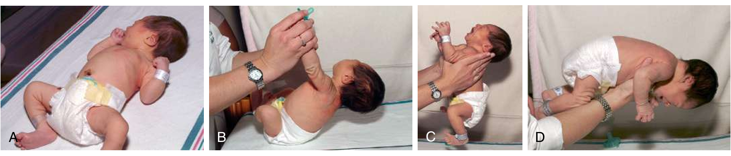
EXAMINATION
Four bedside views reveal postural tone
A
Resting posture
B
Traction response
C
Vertical suspension
D
Horizontal suspension
Observe first. Then handle the infant gently and compare symmetry.
Approach to Hypotonia in Pediatrics
04
Notes:
[Sources]
User-provided image excerpted from Nelson Textbook of Pediatrics, 22nd ed., Fig. 630.3.
[/Sources]

Slide 5
HIGH-YIELD SIGNS
Know what “abnormal” looks like at the bedside
MANEUVER
ABNORMAL FINDING
INTERPRETATION
Pull-to-sit
Excessive or persistent head lag
Axial hypotonia
Vertical suspension
Slips through examiner’s hands
Shoulder-girdle hypotonia
Horizontal suspension
Drapes in an inverted U
Reduced axial and limb tone
Scarf sign / popliteal angle
Excess excursion or wide angle
Reduced passive resistance
Avoid overcalling head lag in a drowsy, hungry, ill, or preterm infant.
Approach to Hypotonia in Pediatrics
05
Notes:
[Sources]
Nelson Textbook of Pediatrics, 22nd ed., Chapter 630.
[/Sources]

Slide 6
LOCALIZATION STEP 1
The first diagnostic question: is the child weak?
TONE
STRENGTH
Passive examination
Active function
Resting posture
Antigravity movement
Range of passive movement
Cry, suck, and facial movement
Head lag and suspension
Respiratory effort
Joint resistance
Sit, rise, climb, jump
Hypotonia ≠ weakness
Approach to Hypotonia in Pediatrics
06
Notes:
[Sources]
Nelson Textbook of Pediatrics, 22nd ed., Chapter 630; AAP NeoReviews: The Floppy Infant (clinical localization principles).
[/Sources]

Slide 7
LOCALIZATION STEP 2
Central or peripheral? Reflexes usually break the tie
CENTRAL
PERIPHERAL MOTOR UNIT
Alertness often impaired
Alert and interactive
Dysmorphism / seizures
Prominent weakness / fatigability
Weakness mild relative to tone
Poor antigravity movement
Reflexes normal or brisk
Reflexes reduced or absent
Babinski may be extensor
Fasciculations or muscle atrophy
Brisk reflexes → think brain. Absent reflexes → think motor unit.
Approach to Hypotonia in Pediatrics
07
Notes:
[Sources]
Nelson Textbook of Pediatrics, 22nd ed., Chapter 630; Leyenaar et al. A schematic approach to hypotonia in infancy. Paediatr Child Health.
[/Sources]

Slide 8
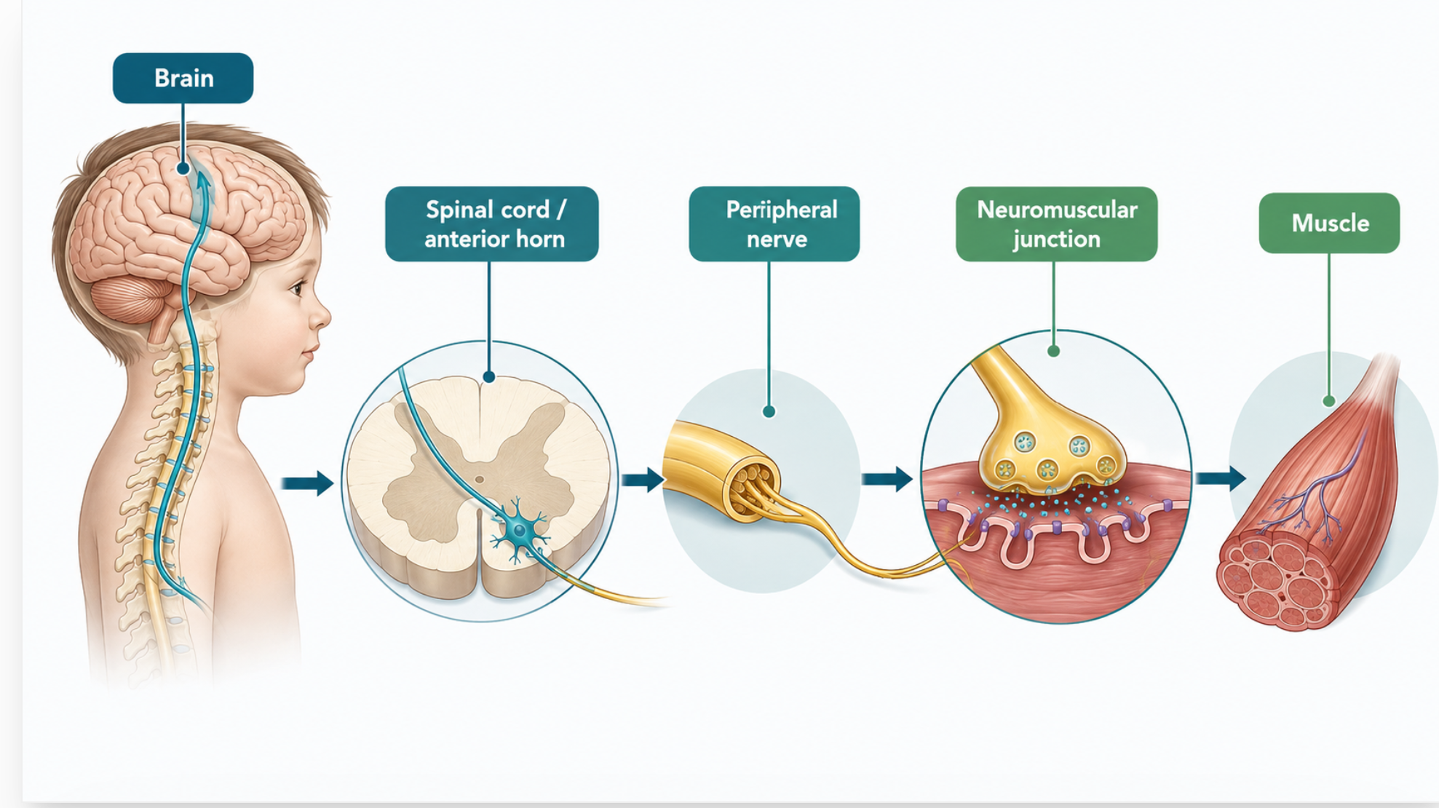
BOARD FRAMEWORK
Localize along the motor pathway
Brain
Encephalopathy • seizures • brisk reflexes
Spinal cord / anterior horn
Weakness • absent reflexes • tongue fasciculations
Peripheral nerve
Distal > proximal weakness • sensory involvement
Neuromuscular junction
Fluctuation • ptosis • bulbar weakness
Muscle
Proximal weakness • Gowers sign • CK elevation
Approach to Hypotonia in Pediatrics
08
Notes:
[Sources]
Nelson Textbook of Pediatrics, 22nd ed., Chapter 630; GeneReviews disease-specific chapters for SMA, congenital myopathies, and congenital myasthenic syndromes.
[/Sources]

Slide 9
LOCALIZATION MADE SIMPLE
Start with one split: upper or lower motor unit?
UPPER MOTOR UNIT
LOWER MOTOR UNIT
Brain or spinal cord
Motor unit below the cord
Weakness is usually mild–moderate
Weakness is usually marked
Tone becomes increased / spastic*
Tone is low / flaccid
Reflexes are normal or brisk
Reflexes are reduced or absent
Babinski may be present
Babinski is absent
Memory rule: brisk reflexes point UP; absent reflexes point DOWN.
*Acute brain or spinal injury may initially be hypotonic and areflexic.
Approach to Hypotonia in Pediatrics
09
Notes:
[Sources]
Nelson Textbook of Pediatrics, 22nd ed., Table 647.1.
[/Sources]

Slide 10
UPPER MOTOR UNIT
Upper motor unit: brain or spinal cord?
BRAIN
SPINAL CORD
Consciousness may be reduced
Consciousness usually normal
Seizures or developmental regression
A sensory level may be present
Cortical signs: language, vision, asymmetry
Bowel / bladder dysfunction
Sensation often normal
Radicular or back pain
Hemibody or generalized pattern
Deficits below a spinal level
Brain gives cortical clues. Cord gives a LEVEL.
Approach to Hypotonia in Pediatrics
10
Notes:
[Sources]
Nelson Textbook of Pediatrics, 22nd ed., Table 647.1.
[/Sources]

Slide 11
LOWER MOTOR UNIT
Lower motor unit: follow the signal to the muscle
1
2
3
4
Anterior horn cell
Peripheral nerve
Neuromuscular junction
Muscle
Motor neuron body
Signal cable
Signal transfer
Final contraction
All four can cause marked weakness + hypotonia.
To separate them, ask: sensation? fasciculations? fluctuation? CK?
Approach to Hypotonia in Pediatrics
11
Notes:
[Sources]
Nelson Textbook of Pediatrics, 22nd ed., Table 647.1.
[/Sources]

Slide 12
LOWER MOTOR UNIT • PART 1
Anterior horn cell versus peripheral nerve
ANTERIOR HORN CELL
PERIPHERAL NERVE
Sensation is normal
Sensation is abnormal
Reflexes are absent
Reflexes are absent early
Fasciculations are a major clue
Weakness often distal
Weakness often proximal in SMA
Nerve territory or stocking–glove pattern
CK may be normal or moderately high
CK normal or mildly elevated
Think: SMA
Think: neuropathy / GBS
Best discriminator: normal sensation = horn cell; abnormal = nerve.
Approach to Hypotonia in Pediatrics
12
Notes:
[Sources]
Nelson Textbook of Pediatrics, 22nd ed., Table 647.1; GeneReviews: Spinal Muscular Atrophy.
[/Sources]

Slide 13
LMU • PART 2
Neuromuscular junction versus muscle
NM JUNCTION
MUSCLE
Sensation is normal
Sensation is normal
Reflexes often preserved
Reflexes preserved until late
No atrophy early
Proximal > distal weakness
Fluctuating or fatigable weakness
Gowers sign / myalgia
Ocular and bulbar signs are common
Atrophy or pseudohypertrophy
CK is normal
CK may be markedly elevated
Think: myasthenia
Think: dystrophy / myopathy
Fluctuation → junction. Proximal weakness + high CK → muscle.
Approach to Hypotonia in Pediatrics
13
Notes:
[Sources]
Nelson Textbook of Pediatrics, 22nd ed., Table 647.1.
[/Sources]

Slide 14
ONE-MINUTE REVIEW
Memorize five discriminators—not the whole table
SITE
REFLEXES
SENSATION
SPECIAL CLUE
CK
Brain / cord
↑
Cord: ↓ below level
Cortical signs / level
Normal
Anterior horn
↓ / absent
Normal
Fasciculations
Normal–↑
Peripheral nerve
↓ / absent
Abnormal
Distal pattern
Normal–mild ↑
NM junction
Usually normal
Normal
Fatigability
Normal
Muscle
Normal → ↓ late
Normal
Gowers / proximal
Normal–very ↑
Reflexes locate the level; sensation and CK refine it.
Approach to Hypotonia in Pediatrics
14
Notes:
[Sources]
Simplified from Nelson Textbook of Pediatrics, 22nd ed., Table 647.1.
[/Sources]

Slide 15
HISTORY
A focused history often localizes before testing
Onset
Pregnancy & birth
At birth, acute, or progressive?
Reduced fetal movement, polyhydramnios, prematurity, HIE?
Feeding & breathing
Development
Weak suck, choking, prolonged feeds, apnea?
Delay alone—or loss of acquired skills?
Family clues
Exposure
Consanguinity, sibling deaths, maternal myasthenia?
Drugs, toxins, infection, trauma?
Regression is never explained by benign hypotonia.
Approach to Hypotonia in Pediatrics
15
Notes:
[Sources]
Nelson Textbook of Pediatrics, 22nd ed.; AAP NeoReviews: evaluation of the hypotonic infant.
[/Sources]

Slide 16
PRACTICAL EXAM
Examine in a fixed sequence
1
Observe
Alertness • posture • spontaneous movement • breathing
2
Cranial & bulbar
Eye movements • ptosis • facial movement • suck and swallow
3
Tone
Axial then appendicular • passive range • suspension
4
Power
Antigravity movement • functional tasks • symmetry
5
Reflexes
DTRs • plantar response • primitive reflexes
6
Systemic clues
Dysmorphism • organomegaly • contractures • skin findings
Approach to Hypotonia in Pediatrics
16
Notes:
[Sources]
Nelson Textbook of Pediatrics, 22nd ed., Chapter 630.
[/Sources]

Slide 17
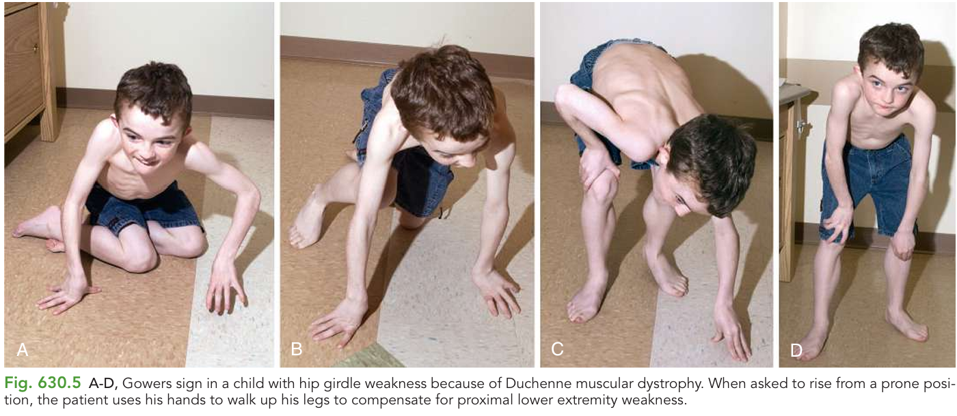
OLDER CHILD
Gowers sign reveals proximal weakness
Gowers sign
The child uses the hands to “climb” up the legs when rising from the floor.
Think:
proximal pelvic-girdle weakness
Classic association: Duchenne muscular dystrophy—but the sign is not disease-specific.
Approach to Hypotonia in Pediatrics
17
Notes:
[Sources]
User-provided image excerpted from Nelson Textbook of Pediatrics, 22nd ed., Fig. 630.5.
[/Sources]

Slide 18
RED FLAGS
Stabilize before you localize
!
Respiratory
Weak cry • shallow breathing • apnea • paradoxical respiration
!
Bulbar
Poor secretion handling • choking • recurrent aspiration
!
Acute weakness
Rapid progression • autonomic instability • recent infection
!
Metabolic
Encephalopathy • vomiting • hypoglycemia • acidosis
!
Spinal
Trauma • sensory level • bowel/bladder dysfunction
Airway • breathing • glucose • urgent neurology/critical care support
Approach to Hypotonia in Pediatrics
18
Notes:
[Sources]
Nelson Textbook of Pediatrics, 22nd ed.; pediatric neuromuscular emergency principles.
[/Sources]

Slide 19
INVESTIGATIONS
Testing follows localization—not the other way around
ALL CHILDREN
CENTRAL PATTERN
PERIPHERAL PATTERN
Glucose, electrolytes, Ca/Mg
Brain MRI
CK ± AST/ALT
CBC; liver and renal profile
EEG if seizures / encephalopathy
SMA testing urgently if suspected
TSH / free T4 when indicated
Metabolic testing guided by clues
EMG / nerve conduction selectively
CK as a low-cost screen
Chromosomal / genomic testing
Neuromuscular gene testing
Do not delay targeted SMA testing: disease-modifying treatment is time-sensitive.
Approach to Hypotonia in Pediatrics
19
Notes:
[Sources]
Nelson Textbook of Pediatrics, 22nd ed.; ACMG guidance on genetic evaluation; GeneReviews: Spinal Muscular Atrophy.
[/Sources]

Slide 20
APPLY THE FRAMEWORK
Three board-style pivots
1
A sleepy newborn
Central hypotonia
Brain imaging / metabolic evaluation
Hypotonia + seizures + brisk reflexes
2
A bright “floppy” infant
Anterior horn cell
Urgent SMA molecular testing
Weak cry + tongue fasciculations + absent reflexes
3
A child who climbs up the legs
Muscle disease
Dystrophin testing after CK
Calf enlargement + proximal weakness + high CK
Approach to Hypotonia in Pediatrics
20
Notes:
[Sources]
Nelson Textbook of Pediatrics, 22nd ed.; GeneReviews: Spinal Muscular Atrophy and Dystrophinopathies.
[/Sources]

Slide 21
DIFFERENTIAL • FIRST BRANCH
Causes of hypotonia: first ask “sick or stable?”
ILL-APPEARING INFANT
STABLE INFANT
Treat the physiology first
Localize before ordering tests
Sepsis or CNS infection
Central nervous system
Hypoglycemia or electrolyte disturbance
Genetic or chromosomal syndrome
Hypoxic–ischemic injury / hemorrhage
Metabolic or endocrine disease
Organ failure, toxin, or sedating drug
Primary neuromuscular disorder
Respiratory failure may be the presenting sign
Skeletal or connective-tissue disorder
Unwell infant → stabilize and screen for reversible causes before detailed localization.
Approach to Hypotonia in Pediatrics • Continuation
01
Notes:
[Sources]
User-provided UpToDate excerpts: causes of hypotonia and weakness in infancy; Nelson Textbook of Pediatrics, 22nd ed.
[/Sources]

Slide 22
CAUSES • MEMORY MAP
Organize the differential into five memorable buckets
1
SYSTEMIC / ACUTE
Infection • hypoxia • glucose • electrolytes
2
CENTRAL / GENETIC
Brain injury • syndromes • posterior fossa
3
METABOLIC / ENDOCRINE
IEM • hypothyroidism • hypoglycemia • CAH
4
NEUROMUSCULAR
Motor neuron • nerve • NMJ • muscle
5
SKELETAL / CONNECTIVE
Dysplasia • laxity • contractures
Board strategy: identify the bucket, then use the clue that points to one diagnosis.
Approach to Hypotonia in Pediatrics • Continuation
02
Notes:
[Sources]
Synthesized from user-provided UpToDate excerpts and Nelson Textbook of Pediatrics, 22nd ed.
[/Sources]

Slide 23
CENTRAL / GENETIC
Genetic syndromes: phenotype directs the test
Down syndrome
Characteristic dysmorphism • congenital heart disease
Prader–Willi
Profound neonatal hypotonia • poor suck • cryptorchidism
Trisomy 18 / 13
Multiple congenital anomalies • growth restriction
Skeletal dysplasias
Disproportionate short limbs • abnormal spine or thorax
Do not order a broad “hypotonia panel” when the phenotype strongly suggests a specific syndrome.
Approach to Hypotonia in Pediatrics • Continuation
03
Notes:
[Sources]
User-provided UpToDate excerpt: genetic syndromes associated with hypotonia.
[/Sources]

Slide 24
CENTRAL • STRUCTURAL
Posterior fossa disease can produce profound neonatal hypotonia
CEREBELLUM / BRAINSTEM
Clues that justify brain MRI
Dandy–Walker malformation
Abnormal head size or growth
Vermian hypoplasia
Abnormal eye movements or apnea
Joubert syndrome
Cranial-nerve / bulbar dysfunction
Chiari II malformation
Dysmorphism or congenital anomalies
Seizures or impaired consciousness
Localization clue: marked axial hypotonia with brainstem or cerebellar signs.
Approach to Hypotonia in Pediatrics • Continuation
04
Notes:
[Sources]
User-provided UpToDate excerpt: posterior fossa abnormalities causing neonatal hypotonia.
[/Sources]

Slide 25
BOARD-EXAM EXCEPTION
Cerebral palsy may begin with low tone
EARLY INFANCY
WITH TIME
Hypotonia may be prominent
Spasticity and/or dystonia emerges
Delayed motor milestones
Brisk reflexes and clonus
Poor postural control
Persistent primitive reflexes
Asymmetry may already be present
Abnormal movement patterns
CP is a heterogeneous consequence of injury to the developing brain—not one specific cause.
Approach to Hypotonia in Pediatrics • Continuation
05
Notes:
[Sources]
User-provided UpToDate excerpt: cerebral palsy and hypotonia in early infancy.
[/Sources]

Slide 26
METABOLIC CAUSES
Metabolic hypotonia: look for decompensation
WHEN TO SUSPECT
High-yield categories
Poor feeding or vomiting
Organic acidemias
Encephalopathy / episodic deterioration
Urea-cycle defects
Hypoglycemia or metabolic acidosis
Fatty-acid oxidation / carnitine defects
Hyperammonemia
Glycogen-storage disorders
Peroxisomal disorders
Hepatomegaly or cardiomyopathy
Congenital disorders of glycosylation
Regression after normal development
Tay–Sachs / creatine disorders
Pattern: systemic illness + neurologic dysfunction → metabolic testing guided by the acute biochemistry.
Approach to Hypotonia in Pediatrics • Continuation
06
Notes:
[Sources]
User-provided UpToDate excerpt: inborn errors of metabolism associated with hypotonia.
[/Sources]

Slide 27
ENDOCRINE
Endocrine causes are reversible—screen early
CONGENITAL HYPOTHYROIDISM
Prolonged jaundice • macroglossia • constipation • large fontanelle
TSH + free T4
HYPOGLYCEMIA
Jitteriness or lethargy • poor feeding • seizures
Immediate bedside glucose
CONGENITAL ADRENAL HYPERPLASIA
Vomiting • dehydration • shock • electrolyte disturbance
Na/K, glucose, cortisol / 17-OHP as indicated
Glucose is part of the initial assessment of every ill or encephalopathic hypotonic infant.
Approach to Hypotonia in Pediatrics • Continuation
07
Notes:
[Sources]
User-provided UpToDate excerpt: endocrine abnormalities presenting with hypotonia and weakness.
[/Sources]

Slide 28
PERIPHERAL CAUSES
Primary neuromuscular disease: weakness dominates
MOTOR NEURON
PERIPHERAL NERVE
SMA
CMT / neuropathy
Tongue fasciculations • absent reflexes
Distal weakness • sensory findings
NM JUNCTION
MUSCLE
Congenital myasthenic syndrome
Myopathy / dystrophy / Pompe
Fatigability • ptosis • bulbar weakness
Proximal weakness • CK or cardiomyopathy
Peripheral pattern = little antigravity movement + reduced reflexes + preserved alertness.
Approach to Hypotonia in Pediatrics • Continuation
08
Notes:
[Sources]
User-provided UpToDate excerpts: primary neuromuscular disorders; Nelson Textbook of Pediatrics, 22nd ed.
[/Sources]

Slide 29
FOCUSED HISTORY • PRENATAL & PERINATAL
History starts before birth
Polyhydramnios
May reflect decreased fetal swallowing
Reduced fetal movement
Suggests fetal akinesia or congenital weakness
Breech / malpresentation
May accompany impaired fetal movement
Birth trauma
Raises concern for spinal cord or peripheral nerve injury
Perinatal depression
Could be the cause—or reduced reserve from congenital disease
Do not automatically attribute hypotonia to “birth asphyxia” when prenatal weakness was already present.
Approach to Hypotonia in Pediatrics • Continuation
09
Notes:
[Sources]
User-provided UpToDate excerpt: obstetric and perinatal history in congenital neuromuscular disorders.
[/Sources]

Slide 30
FOCUSED HISTORY • FAMILY
The pedigree can localize the disease
Maternal weakness / myotonia
Affected male relatives
Congenital myotonic dystrophy
X-linked muscular dystrophy
Sibling deaths in infancy
Consanguinity
Autosomal-recessive neuromuscular or metabolic disease
Raises recessive disease probability
Neuropathy / foot deformity
Episodic crises / cardiomyopathy
Charcot–Marie–Tooth disease
Mitochondrial disease, FAOD, or Pompe
Ask specifically—families may not recognize mild maternal or adult weakness as relevant.
Approach to Hypotonia in Pediatrics • Continuation
10
Notes:
[Sources]
User-provided UpToDate excerpt: family history in neuromuscular hypotonia.
[/Sources]

Slide 31
PHYSICAL EXAMINATION
Before the neurologic exam, inspect the whole child
APPEARANCE
GROWTH
Illness • alertness • interaction
Weight • length • head circumference
DYSMORPHISM
SKIN
Face • palate • congenital anomalies
Pallor • bruising • petechiae • trauma
BREATHING
FEEDING
Rate • pattern • diaphragm • weak cry
Suck • swallow • secretion handling
Observation before handling often reveals the diagnosis—and identifies respiratory risk.
Approach to Hypotonia in Pediatrics • Continuation
11
Notes:
[Sources]
User-provided UpToDate excerpt: physical examination of the hypotonic infant.
[/Sources]

Slide 32
PHYSICAL EXAMINATION • CLUE → CAUSE
Systemic clues point to specific disease groups
Cardiomyopathy
Pompe • carnitine deficiency • fatty-acid oxidation defect
Genital anomalies
Prader–Willi • Smith–Lemli–Opitz • endocrine disease
Contractures
Fetal akinesia • arthrogryposis • congenital neuromuscular disease
Joint laxity
Connective-tissue disorder • Down syndrome
Rhizomelic shortening / kyphosis
Skeletal dysplasia
Dolichocephaly + high-arched palate
Congenital myopathy
Approach to Hypotonia in Pediatrics • Continuation
12
Notes:
[Sources]
User-provided UpToDate excerpts: systemic examination findings in hypotonia.
[/Sources]

Slide 33
NEUROLOGIC EXAMINATION
Focused neurologic exam: use a fixed sequence
1
Tone
Resistance to passive movement
2
Strength
Spontaneous and antigravity movement
3
Reflexes
Brisk/clonus versus reduced/absent
4
Primitive reflexes
Moro • grasp • tonic neck • stepping
5
Cranial & bulbar
Eyes • face • suck • swallow • cry
6
Muscle / nerve clues
Bulk • fasciculations • distribution
Approach to Hypotonia in Pediatrics • Continuation
13
Notes:
[Sources]
User-provided UpToDate excerpt: strength, tone, motor reflexes, eye movements, facial movements, and tongue fasciculations.
[/Sources]

Slide 34
CRANIAL & BULBAR CLUES
Eyes, face, and tongue are high-yield localizers
Absent fixation + preserved oculocephalic reflex
Lesion above the brainstem
Ptosis or ophthalmoparesis
Neuromuscular junction or congenital myopathy
Facial diplegia
Congenital myotonic dystrophy or congenital myopathy
Tongue fasciculations
Strongly suggests anterior horn cell disease / SMA
Weak suck, swallow, or cry
Bulbar weakness—assess airway and aspiration risk
Board pearl: a bright infant with tongue fasciculations and absent reflexes → SMA until proven otherwise.
Approach to Hypotonia in Pediatrics • Continuation
14
Notes:
[Sources]
User-provided UpToDate excerpt: eye movements, facial weakness, and tongue fasciculations.
[/Sources]

Slide 35
NARROWING THE DIFFERENTIAL
Central hypotonia: tone is worse than strength
FUNCTION
REFLEX PATTERN
Antigravity movement is retained
Stretch reflexes remain present
Weakness is mild relative to low tone
May be normal, reduced, or brisk
Head lag usually mild–moderate
Extensor plantar response may occur
Alertness may be impaired
Primitive reflexes may persist
Memory: CENTRAL = the baby is “floppy” but still moves against gravity.
Approach to Hypotonia in Pediatrics • Continuation
15
Notes:
[Sources]
User-provided UpToDate excerpt: clinical pattern of central hypotonia.
[/Sources]

Slide 36
NARROWING THE DIFFERENTIAL
Peripheral hypotonia: weakness is worse than tone
FUNCTION
REFLEX PATTERN
Marked or profound weakness
Stretch reflexes reduced or absent
Little or no antigravity movement
Primitive reflexes may be absent
Reduced muscle bulk
Plantar response flexor
Significant head lag
Alertness usually preserved
Memory: PERIPHERAL = the baby is alert, but cannot generate movement.
Approach to Hypotonia in Pediatrics • Continuation
16
Notes:
[Sources]
User-provided UpToDate excerpt: clinical pattern of peripheral hypotonia.
[/Sources]

Slide 37
IMPORTANT EXCEPTIONS
Do not force every infant into one box
Prader–Willi syndrome
Central disease can produce profound hypotonia and weakness
Acute CNS injury
Hemorrhage, infarction, or spinal shock may initially be areflexic
Mixed central + peripheral
Congenital muscular dystrophy • mitochondrial • peroxisomal disease
Pompe disease
Myopathy plus cardiomyopathy and systemic clues
Mild congenital myopathy
May retain some antigravity limb movement
If the pattern conflicts, re-examine serially and consider a mixed disorder.
Approach to Hypotonia in Pediatrics • Continuation
17
Notes:
[Sources]
User-provided UpToDate excerpt: exceptions to central versus peripheral localization.
[/Sources]

Slide 38
TARGETED EVALUATION
Evaluation should answer the question raised by the exam
All ill infants
Glucose • electrolytes/Ca/Mg • CBC/cultures as indicated • organ function
Central pattern
Brain MRI ± EEG • metabolic tests guided by clues
Muscle pattern
CK • AST/ALT • ECG/echo if cardiomyopathy suspected
SMA pattern
Urgent SMN1 molecular testing
Syndromic pattern
Diagnosis-specific genetic test or chromosomal analysis
Unclear congenital hypotonia
Early genetics consultation; broad exome/genome often high yield
Approach to Hypotonia in Pediatrics • Continuation
18
Notes:
[Sources]
User-provided UpToDate excerpt: evaluation of infant hypotonia; Nelson Textbook of Pediatrics, 22nd ed.
[/Sources]

Slide 39
ADVANCED TESTING
Choose EMG, genetics, and biopsy deliberately
GENETIC TESTING
Usually provides the most precise diagnosis; targeted test when phenotype is specific, broad sequencing when it is not.
EMG / NCS
Useful for peripheral localization, but technically difficult and less sensitive in very young infants.
MUSCLE BIOPSY
Now selective—consider when genetic testing is unrevealing and pathology will change diagnosis or management.
Test selection should follow localization and be interpreted with neurology / genetics expertise.
Approach to Hypotonia in Pediatrics • Continuation
19
Notes:
[Sources]
User-provided UpToDate excerpt: EMG/NCS, genetic testing, and muscle biopsy.
[/Sources]

Slide 40
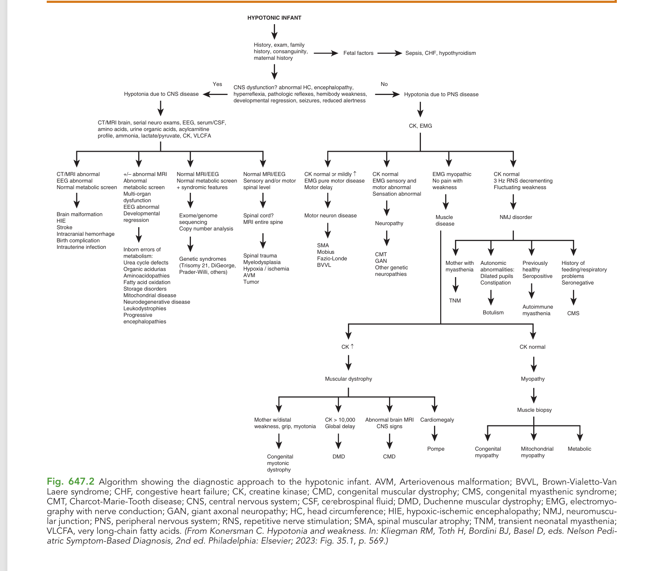

Slide 41
APPROACH TO HYPOTONIA
A simple diagnostic algorithm for the hypotonic infant
1 STABILIZE FIRST
Breathing • bulbar function • glucose • sepsis/systemic illness
Treat urgent causes before localization
HYPOTONIA CONFIRMED
↓
Is there true muscle weakness?
NO / MINIMAL
↙
↘
YES
2A CENTRAL PATTERN
2B PERIPHERAL PATTERN
Clues
Altered alertness • seizures • dysmorphism
Abnormal head circumference • brisk reflexes
Weakness absent or less prominent
Clues
Alert child • clear weakness • reduced/absent reflexes
Atrophy or fasciculations • bulbar/respiratory weakness
Next
Brain MRI ± EEG • targeted metabolic/genetic testing
Next
Localize the motor unit
↓
TAKE-HOME
ANTERIOR HORN
PERIPHERAL NERVE
NM JUNCTION
MUSCLE
Hypotonia is a sign. Weakness localizes the lesion.
SMA test
NCS / EMG
RNS • antibodies/genetics
CK • genetics ± EMG
Central and peripheral features may overlap—use the whole clinical picture.
Hypotonia in Pediatrics • Diagnostic approach
Notes:
Teaching point: first decide whether the infant is physiologically safe, especially breathing and swallowing.
Hypotonia without clear weakness usually suggests a central pattern; hypotonia with definite weakness and reduced reflexes suggests peripheral motor-unit disease.
Peripheral localization: anterior horn cell, peripheral nerve, neuromuscular junction, or muscle.
[Sources] Kliegman RM, Toth H, Bordini BJ, Basel D, eds. Nelson Pediatric Symptom-Based Diagnosis. 2nd ed. Elsevier; 2023. Hypotonia and weakness, diagnostic algorithm (user-provided figure).
[Sources] Darras BT, Jones HR Jr, Ryan MM, De Vivo DC, eds. Neuromuscular Disorders of Infancy, Childhood, and Adolescence. 2nd ed. Academic Press; 2015.

Slide 42
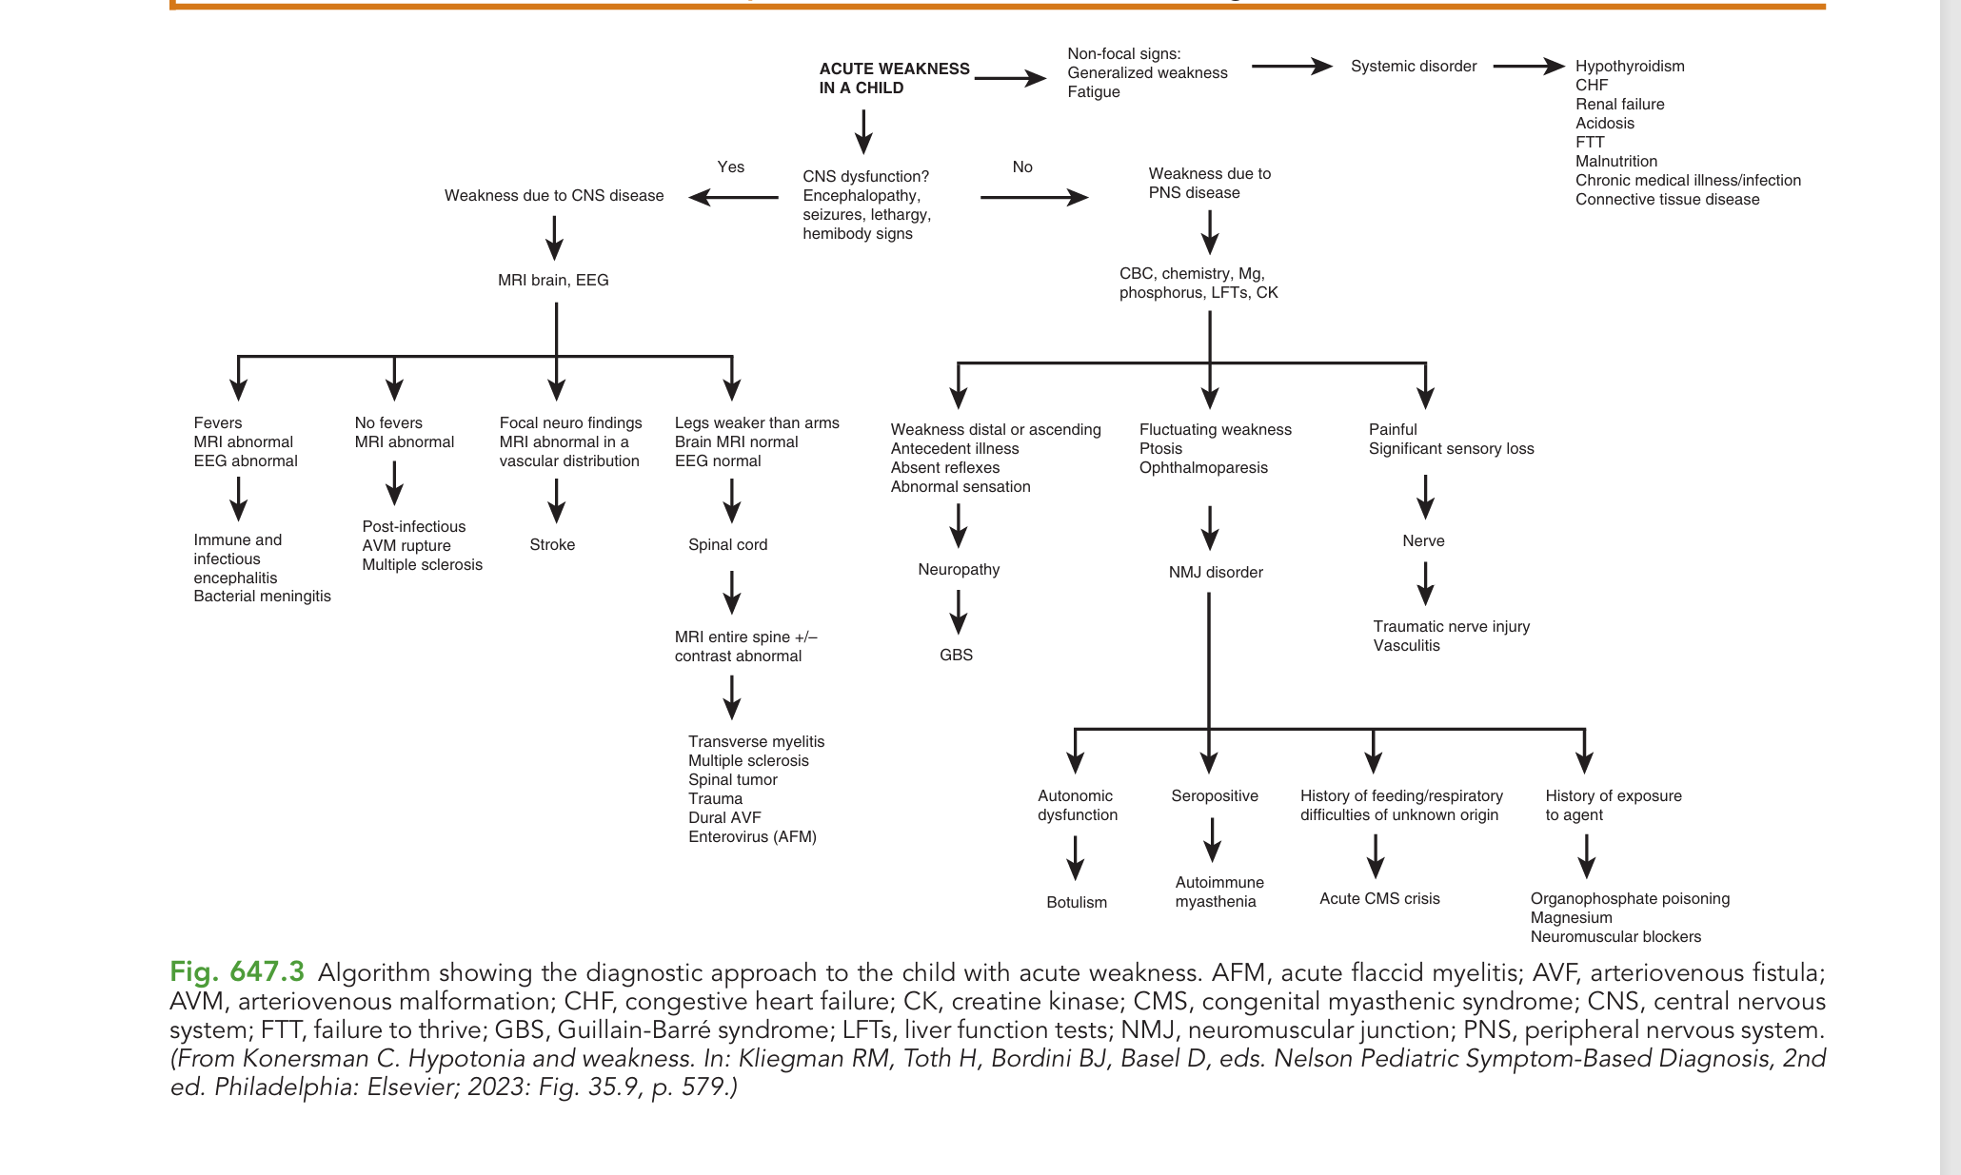

Slide 43
ACUTE WEAKNESS IN CHILDREN
Localize acute weakness before ordering extensive tests
1 ASSESS URGENCY
Rapid progression • breathing • swallowing • autonomic instability
Monitor FVC/CO₂ when indicated
2 EXCLUDE SYSTEMIC MIMICS
Non-focal fatigue/generalized weakness → glucose, electrolytes, renal/liver function, thyroid, infection, nutrition
If objective weakness is present:
Are there signs of CNS dysfunction?
YES
↙
↘
NO
3A CENTRAL
Encephalopathy • seizures • focal/hemibody signs
Sensory level or legs ≫ arms suggests spinal cord
3B PERIPHERAL
Alert child • absent/reduced reflexes • clear motor pattern
CBC, electrolytes, Mg/P, LFTs and CK guide localization
MRI brain ± EEG | MRI spine if cord signs
Use the pattern—not a long untargeted test list
ASCENDING + AREFLEXIA
FLUCTUATING / OCULAR
PAINFUL + SENSORY LOSS
MYALGIA + CK ↑
± sensory symptoms
Ptosis • bulbar weakness
Focal or multifocal
Proximal weakness
GBS
NMJ: MG • botulism • CMS
Nerve injury • vasculitis
Myositis • rhabdomyolysis
Acute weakness + bulbar or respiratory involvement is a neurologic emergency.
Hypotonia in Pediatrics • Acute weakness
Notes:
Teaching point: establish objective weakness and assess respiratory, bulbar, and autonomic risk before localization.
Non-focal fatigue can reflect systemic disease rather than a primary neurologic lesion.
Central clues direct brain or spinal imaging; peripheral patterns help distinguish GBS, neuromuscular-junction disorders, focal nerve disease, and acute muscle injury.
[Sources] Kliegman RM, Toth H, Bordini BJ, Basel D, eds. Nelson Pediatric Symptom-Based Diagnosis. 2nd ed. Elsevier; 2023. Acute weakness diagnostic algorithm (user-provided figure).
[Sources] Kliegman RM, St Geme JW, eds. Nelson Textbook of Pediatrics. 22nd ed. Elsevier; 2024. Evaluation of neuromuscular disorders.

Slide 44
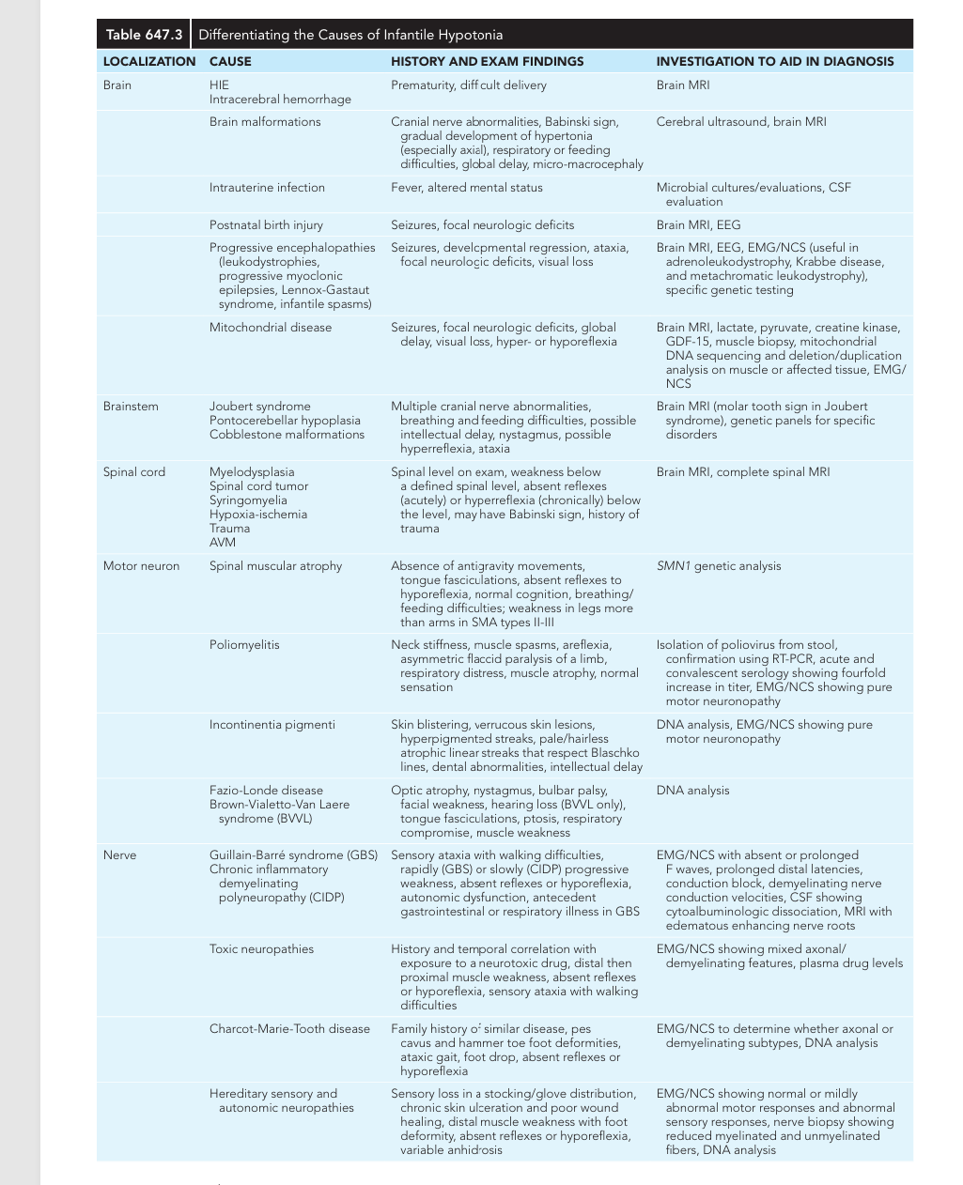

Slide 45
INFANTILE HYPOTONIA
Five locations explain most examination patterns
Use the dominant clue to choose the first test
LOCALIZE
KEY CLUE
FIRST INVESTIGATION
1
BRAIN
Altered alertness • seizures • dysmorphism
Abnormal head size or brisk reflexes
Brain MRI ± EEG
Targeted metabolic/genetic tests
2
BRAINSTEM
Cranial nerve signs • nystagmus
Feeding or breathing difficulty ± ataxia
Brain MRI
Syndrome-specific genetics
3
SPINAL CORD
Sensory level • legs weaker than arms
Sphincter signs or Babinski response
MRI of the entire spine
4
MOTOR NEURON
Pure motor weakness • tongue fasciculations
Absent reflexes with preserved sensation
SMN1 testing first
if SMA is suspected
5
PERIPHERAL NERVE
Distal or ascending weakness • areflexia
Sensory symptoms or autonomic features
NCS / EMG
± CSF or genetic testing
FAST RULE
Mental status → reflexes → sensory pattern → distribution of weakness
Hypotonia in Pediatrics • Localization map
Notes:
Teaching point: do not memorize the long differential as a list. Localize first, then select a targeted investigation.
Brain disease is suggested by altered consciousness, seizures, dysmorphism, abnormal head circumference, or brisk reflexes.
Brainstem disease adds cranial nerve, feeding, breathing, nystagmus, or ataxia findings.
Spinal cord disease produces a level or long-tract pattern; motor neuron disease produces pure motor weakness with fasciculations and areflexia; peripheral nerve disease commonly adds distal, sensory, ascending, or autonomic features.
[Sources] Kliegman RM, St Geme JW, eds. Nelson Textbook of Pediatrics. 22nd ed. Elsevier; 2024. Table 647.3, Differentiating the Causes of Infantile Hypotonia (user-provided image).

Slide 46
BOARD PATTERN • INFANTILE HYPOTONIA
Congenital myotonic dystrophy: examine the mother
BOARD CLUE
Floppy newborn + weak respiratory effort + mother with difficulty releasing her grip
1
THE INFANT
2
LOOK AT THE MOTHER
3
CONFIRM THE DIAGNOSIS
• Severe hypotonia and weakness
• Minimal antigravity movement
• Weak cry, poor suck, respiratory failure
• Open ‘tented’ mouth / facial diplegia
• Frog-leg posture ± contractures
• Grip myotonia: delayed hand opening
• Percussion myotonia
• Distal > proximal weakness
• Myopathic face + temporal wasting
• Cataracts or subtle symptoms may coexist
FIRST: DMPK CTG-repeat analysis
Supportive tests:
• EMG: myotonic discharges*
• CK: normal or mildly elevated
• Test the mother, then other relatives
WHY MATERNAL?
Autosomal dominant DMPK expansion + anticipation → the congenital severe form is usually maternally transmitted
*Myotonic discharges may be absent or difficult to demonstrate in the newborn period.
Standalone board-review slide
Notes:
Board approach: when a neonate is profoundly hypotonic with feeding or respiratory weakness, examine the mother before ordering a broad neuromuscular panel.
The mother may have subtle grip or percussion myotonia, distal weakness, facial weakness, temporal wasting, or early cataracts.
Congenital myotonic dystrophy is caused by a CTG-repeat expansion in DMPK and demonstrates anticipation. The congenital severe phenotype is most often maternally transmitted.
Molecular testing confirms the diagnosis. CK is usually normal or only mildly elevated; EMG may show myotonic discharges but may be nondiagnostic in neonates.
[Sources] Kliegman RM, St Geme JW, eds. Nelson Textbook of Pediatrics. 22nd ed. Elsevier; 2024. Table 647.3, congenital myotonic dystrophy (user-provided image).

Slide 47
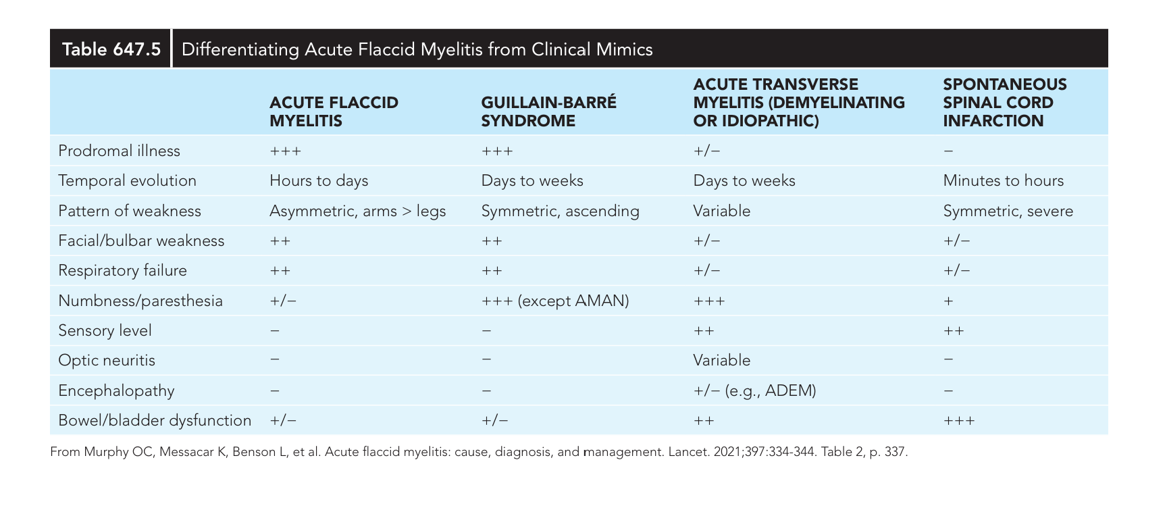

Slide 48
ACUTE FLACCID WEAKNESS
Four patterns separate AFM from its major mimics
Ask three questions: How fast? Symmetric or asymmetric? Is there a sensory level?
AFM
GBS
ATM
SCI
ACUTE FLACCID
MYELITIS
GUILLAIN–BARRÉ
SYNDROME
ACUTE TRANSVERSE
MYELITIS
SPINAL CORD
INFARCTION
ONSET
ONSET
ONSET
ONSET
Hours → days
Days → weeks
Days → weeks
Minutes → hours
WEAKNESS
WEAKNESS
WEAKNESS
WEAKNESS
Asymmetric
Arms > legs
Symmetric
Ascending
Variable
Below cord lesion
Sudden, severe
Usually bilateral
BEST CLUE
BEST CLUE
BEST CLUE
BEST CLUE
Minimal sensory symptoms
No sensory level
Paresthesia + areflexia
No sensory level
SENSORY LEVEL
Bowel/bladder dysfunction
SENSORY LEVEL
Early bladder dysfunction
Bulbar/respiratory weakness may occur
Autonomic instability may occur
Optic neuritis or encephalopathy possible
Abrupt onset is the key discriminator
FAST RULE
Asymmetric arms > legs → AFM | Ascending + areflexia → GBS | Sensory level → spinal cord
Any respiratory, bulbar, or rapidly progressive weakness requires urgent monitoring.
Standalone teaching slide
Notes:
Teaching approach: do not memorize plus signs. Start with tempo, symmetry, and the presence or absence of a sensory level.
AFM: typically follows a prodrome and produces acute asymmetric weakness, often affecting arms more than legs, with relatively little sensory involvement.
GBS: usually symmetric and ascending with areflexia; paresthesia and autonomic involvement support the diagnosis, although sensory symptoms may be absent in AMAN.
Acute transverse myelitis and spinal cord infarction both produce a sensory level and bowel/bladder dysfunction; infarction is distinguished by hyperacute onset over minutes to hours.
[Sources] Murphy OC, Messacar K, Benson L, et al. Acute flaccid myelitis: cause, diagnosis, and management. Lancet. 2021;397:334-344. Table 2 (user-provided image).
[Sources] Kliegman RM, St Geme JW, eds. Nelson Textbook of Pediatrics. 22nd ed. Elsevier; 2024. Table 647.5.

Slide 49
ACUTE FLACCID WEAKNESS
MRI and CSF usually reveal the correct localization
Read the spinal MRI first, then use CSF and one targeted test
AFM
GBS
ATM
SCI
ACUTE FLACCID
MYELITIS
GUILLAIN–BARRÉ
SYNDROME
ACUTE TRANSVERSE
MYELITIS
SPINAL CORD
INFARCTION
SPINAL MRI
SPINAL MRI
SPINAL MRI
SPINAL MRI
Gray-matter–predominant
ill-defined cord lesion
± root enhancement
Cord usually normal
± nerve-root enhancement
Well-defined enhancing lesion
White matter > gray matter
Nonenhancing anterior cord
or gray-matter lesion
CSF
CSF
CSF
CSF
Mild–moderate
pleocytosis
Protein ↑ with few cells
(albuminocytologic dissociation)
Mild–moderate
pleocytosis
Often normal
± mild protein/cell rise
TARGETED TEST
TARGETED TEST
TARGETED TEST
TARGETED TEST
Respiratory + stool/rectal
samples for enterovirus PCR
NCS / EMG
± antiganglioside antibodies
MOG-IgG • AQP4-IgG
CSF oligoclonal bands
Consider vascular imaging
when clinically indicated
FAST RULE
Gray matter → AFM | Normal cord + high CSF protein → GBS | Enhancing white matter → ATM | Hyperacute nonenhancing lesion → infarction
Do not delay respiratory monitoring or urgent MRI while awaiting confirmatory tests.
Standalone investigation slide
Notes:
Teaching point: MRI localizes the lesion; CSF and focused testing refine the diagnosis.
AFM typically involves spinal gray matter and may have CSF pleocytosis; collect appropriate respiratory and stool/rectal samples promptly.
GBS commonly has a normal cord or root enhancement, with albuminocytologic dissociation; early CSF may still be normal.
Acute transverse myelitis generally shows an enhancing inflammatory cord lesion; spinal cord infarction is hyperacute and typically nonenhancing.
[Sources] Murphy OC, Messacar K, Benson L, et al. Acute flaccid myelitis: cause, diagnosis, and management. Lancet. 2021;397:334-344. Table 2 (user-provided image).
[Sources] Kliegman RM, St Geme JW, eds. Nelson Textbook of Pediatrics. 22nd ed. Elsevier; 2024. Table 647.5.

Slide 50
THE CLINICAL ALGORITHM
Hypotonia is a sign.
Localization is the diagnosis engine.
1
2
3
4
5
Confirm low tone
Assess weakness
Check reflexes
Localize
Target tests
Reflexes + pattern of weakness are the highest-yield bedside discriminators.
Manar Shawabake
Notes:
[Sources]
Synthesis based on Nelson Textbook of Pediatrics, 22nd ed., Chapter 630 and standard pediatric neuromuscular localization.
[/Sources]

Slide 51
BOARD REVIEW
BOARD-STYLE MCQ 1
1
An alert 4-month-old
Best localization?
Sensation is preserved and weakness is prominent.
Poor antigravity movement, tongue fasciculations, absent reflexes
2
A. Brain
C. Peripheral nerve
D. Neuromuscular junction
B. Anterior horn cell
3
Answer: B
Board pearl
In a bright floppy infant, this pattern suggests SMA.
Fasciculations + areflexia + normal sensation localize to the anterior horn cell.
Approach to Hypotonia • Board MCQs
51
Notes:
[Sources]
Nelson Textbook of Pediatrics, 22nd ed.; GeneReviews: Spinal Muscular Atrophy and Dystrophinopathies.
[/Sources]

Slide 52
BOARD REVIEW
BOARD-STYLE MCQ 2
1
A bright floppy infant
Best first test?
Choose the most urgent targeted investigation.
Weak cry, tongue fasciculations, profound weakness, absent reflexes
2
A. Brain MRI
C. SMN1 testing
D. Muscle biopsy
B. Serum CK only
3
Answer: C
Do not delay
Urgent SMN1 molecular testing enables time-sensitive treatment.
The examination is classic for spinal muscular atrophy.
Approach to Hypotonia • Board MCQs
52
Notes:
[Sources]
Nelson Textbook of Pediatrics, 22nd ed.; GeneReviews: Spinal Muscular Atrophy and Dystrophinopathies.
[/Sources]

Slide 53
BOARD REVIEW
BOARD-STYLE MCQ 3
1
An 8-year-old with ptosis
Best localization?
Sensation and reflexes are preserved.
Weakness worsens after school and improves after rest; CK is normal
2
A. Brain
C. NM junction
D. Muscle
B. Anterior horn cell
3
Answer: C
Memory rule
Fluctuation → junction; proximal weakness + high CK → muscle.
Fluctuating ocular weakness with normal CK points to the NM junction.
Approach to Hypotonia • Board MCQs
53
Notes:
[Sources]
Nelson Textbook of Pediatrics, 22nd ed.; GeneReviews: Spinal Muscular Atrophy and Dystrophinopathies.
[/Sources]

Slide 54
BOARD REVIEW
BOARD-STYLE MCQ 4
1
A 5-year-old boy
Best next test?
The phenotype suggests a dystrophinopathy.
Gowers sign, calf enlargement, proximal weakness, markedly elevated CK
2
A. Brain MRI
C. Dystrophin testing
D. Nerve conduction study
B. SMN1 testing
3
Answer: C
Board pearl
Gowers sign is not specific, but this combination strongly suggests DMD.
Gowers sign + calf pseudohypertrophy + high CK localize to muscle.
Approach to Hypotonia • Board MCQs
54
Notes:
[Sources]
Nelson Textbook of Pediatrics, 22nd ed.; GeneReviews: Spinal Muscular Atrophy and Dystrophinopathies.
[/Sources]

Slide 55
BOARD REVIEW
BOARD-STYLE MCQ 5
1
A floppy newborn
Diagnosis?
The maternal examination is the decisive clue.
Respiratory failure, facial diplegia; mother has delayed hand opening
2
A. SMA
C. Congenital DM1
D. Peripheral neuropathy
B. Prader–Willi syndrome
3
Answer: C
Confirm with
DMPK CTG-repeat analysis; congenital severe disease is usually maternally transmitted.
Maternal grip myotonia + severe neonatal hypotonia is classic.
Approach to Hypotonia • Board MCQs
55
Notes:
[Sources]
Nelson Textbook of Pediatrics, 22nd ed.; GeneReviews: Spinal Muscular Atrophy and Dystrophinopathies.
[/Sources]

Slide 56
BOARD REVIEW
BOARD-STYLE MCQ 6
1
A 10-year-old after URI
Diagnosis?
There is no sensory level or bowel/bladder dysfunction.
Five days of symmetric ascending weakness, paresthesia, and areflexia
2
A. Acute flaccid myelitis
C. Myelitis (ATM)
D. Cord infarction
B. Guillain–Barré syndrome
3
Answer: B
Supportive tests
NCS/EMG; CSF may show high protein with few cells.
Symmetric ascending weakness + areflexia is the classic GBS pattern.
Approach to Hypotonia • Board MCQs
56
Notes:
[Sources]
Nelson Textbook of Pediatrics, 22nd ed.; GeneReviews: Spinal Muscular Atrophy and Dystrophinopathies.
[/Sources]

