Slide 1
ENTAMOEBA
HISTOLYTICA
E. histolytica
PROTOZOAN
PARASITE
Recognition • Diagnosis • Treatment
Resident-level clinical review
Dr. Manar Shawabkeh
Pediatrics
Notes:
[Sources]
CDC DPDx: Amebiasis; WHO. Entamoeba histolytica background document, 2025.
[/Sources]

Slide 2
AMEBIASIS • RESIDENT REVIEW
DR. MANAR SHAWABKEH
Know the organism before the syndrome
What is it?
Where does it live?
How is it acquired?
Unicellular eukaryotic protozoan
• True nucleus
• Motile trophozoite
• Environment-resistant cyst
Colon lumen → mucosal invasion
Portal spread → liver
Rare spread → lung / brain
Fecal–oral ingestion of mature cysts
Contaminated food or water
Person-to-person transmission
MEMORY LINE
CYST enters → TROPHOZOITE invades → LIVER is the classic distant site
02
Notes:
[Sources]
CDC DPDx: Amebiasis, Life Cycle and Clinical Presentation.
[/Sources]

Slide 3
AMEBIASIS • RESIDENT REVIEW
DR. MANAR SHAWABKEH
Epidemiology changes pretest probability
Think exposure—not geography alone.
Higher burden
Poor sanitation • unsafe water • crowded settings
Higher risk
Residence in or migration from endemic regions
Also consider
Institutional exposure • fecal–oral sexual exposure
Pediatrics
Young age, malnutrition, and immunosuppression increase severity
Clinical pearl
Short-term travel alone is a weak clue; compatible syndrome + meaningful exposure is stronger.
03
Notes:
[Sources]
WHO. Entamoeba histolytica background document, 2025; CDC DPDx: Amebiasis.
[/Sources]

Slide 4
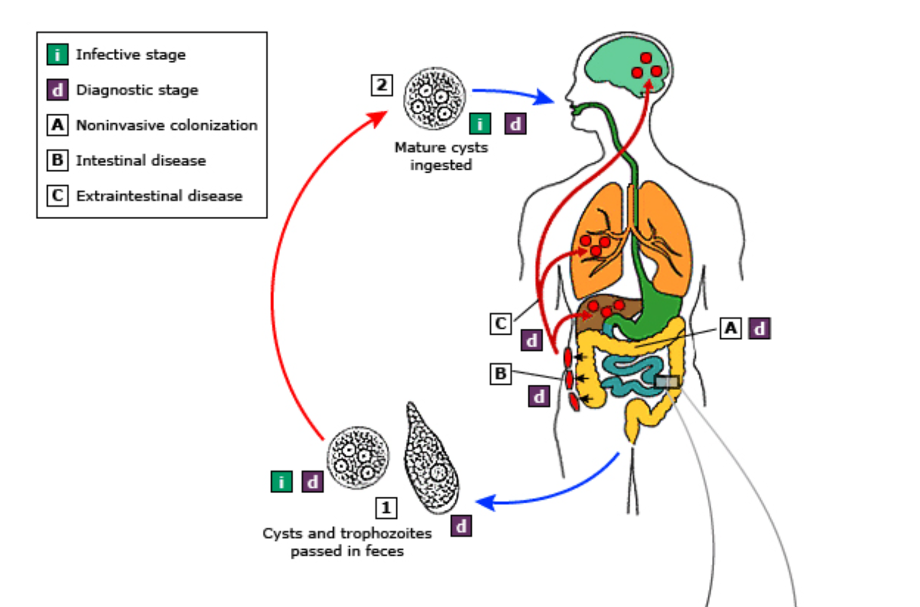
AMEBIASIS • RESIDENT REVIEW
DR. MANAR SHAWABKEH
The mature cyst is the infective stage
1 Ingestion
Mature cysts enter by the fecal–oral route.
2 Colon
Excystation → trophozoites multiply in the large bowel.
3 Outcomes
Luminal carriage • colitis • portal spread to liver
04
Notes:
[Sources]
Image: CDC DPDx, Amebiasis life cycle. https://www.cdc.gov/dpdx/amebiasis/index.html
[/Sources]

Slide 5
AMEBIASIS • RESIDENT REVIEW
DR. MANAR SHAWABKEH
Clinical disease ranges from silent carriage to invasion
LUMINAL
INTESTINAL
EXTRAINTESTINAL
Asymptomatic
Amebic colitis
Liver abscess
Cysts in stool
No tissue invasion
Still requires treatment if
E. histolytica is confirmed
Subacute diarrhea
Abdominal pain
Blood + mucus
Weight loss
Fulminant colitis: rare
Fever
Right upper-quadrant pain
Hepatomegaly
Diarrhea may be absent
Rare: lung / brain
05
Notes:
[Sources]
WHO. Entamoeba histolytica background document, 2025; CDC DPDx: Amebiasis.
[/Sources]

Slide 6
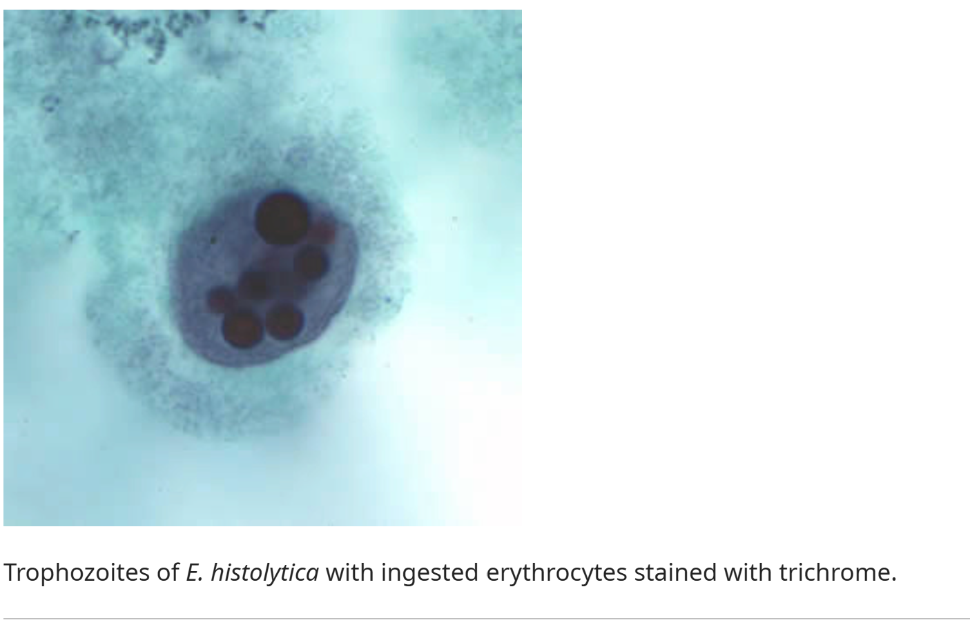
AMEBIASIS • RESIDENT REVIEW
DR. MANAR SHAWABKEH
Ingested erythrocytes strongly suggest invasive amebiasis
TROPHOZOITE
• Motile form
• Found in diarrheal stool
• May contain ingested RBCs
Do not overcall microscopy
E. dispar and E. moshkovskii are morphologically similar.
06
Notes:
[Sources]
Image supplied by user; caption identifies trichrome-stained E. histolytica trophozoite with ingested erythrocytes. CDC DPDx: Amebiasis.
[/Sources]

Slide 7
AMEBIASIS • RESIDENT REVIEW
DR. MANAR SHAWABKEH
Confirm the species whenever possible
Suspect: subacute bloody diarrhea + epidemiologic exposure
Stool PCR
Preferred when available • highest specificity • distinguishes species
Stool antigen
Good alternative • species-specific assays available
Microscopy ×3
Lower sensitivity • operator dependent • cannot reliably separate look-alikes
Avoid:
Diagnosing E. histolytica from a single “ova and parasite” microscopy result alone.
07
Notes:
[Sources]
CDC DPDx: Amebiasis; WHO. Entamoeba histolytica background document, 2025.
[/Sources]

Slide 8
AMEBIASIS • RESIDENT REVIEW
DR. MANAR SHAWABKEH
Treatment depends on invasion—not symptom intensity alone
CONFIRMED E. HISTOLYTICA
Asymptomatic
luminal infection
Symptomatic colitis
or liver abscess
Fulminant colitis /
perforation
Luminal agent
Nitroimidazole
Resuscitate + IV therapy
+ broad enteric coverage
+ early surgery
THEN
paromomycin preferred
Luminal agent
Never use metronidazole alone as definitive therapy for invasive amebiasis.
08
Notes:
[Sources]
Nelson Textbook of Pediatrics, 22nd ed., Table 327.1 and treatment section; WHO background document, 2025.
[/Sources]

Slide 9
AMEBIASIS • RESIDENT REVIEW
DR. MANAR SHAWABKEH
Pediatric regimens: memorize the sequence
Clinical state
Tissue therapy
Luminal eradication
Asymptomatic
—
Paromomycin 25–35 mg/kg/day PO ÷3 × 7 days
Colitis / liver abscess
Metronidazole 35–50 mg/kg/day PO ÷3 × 7–10 days
Then paromomycin 25–35 mg/kg/day PO ÷3 × 7 days
Alternative tissue agent
Tinidazole 50 mg/kg PO once daily × 3 days
(liver abscess: 3–5 days)
Then a luminal agent
Verify local formulary and pediatric reference before prescribing.
09
Notes:
[Sources]
Nelson Textbook of Pediatrics, 22nd ed., Table 327.1. Doses shown as supplied in the user's Nelson excerpt.
[/Sources]

Slide 10
AMEBIASIS • RESIDENT REVIEW
DR. MANAR SHAWABKEH
Amebic liver abscess: treat first, drain selectively
Presentation
Fever • RUQ pain • tender hepatomegaly; bowel symptoms may be absent
Imaging
Ultrasound or CT confirms an abscess but is not organism-specific
Therapy
Metronidazole or tinidazole → then luminal eradication
Drain if
Uncertain diagnosis • poor response • impending rupture • high-risk location
Practice point
Stool testing can be negative in isolated extraintestinal disease; integrate serology, imaging, and exposure.
10
Notes:
[Sources]
WHO. Entamoeba histolytica background document, 2025; CDC DPDx: Amebiasis.
[/Sources]

Slide 11
AMEBIASIS • RESIDENT REVIEW
DR. MANAR SHAWABKEH
Five mistakes residents should avoid
01
Treating any Entamoeba seen on microscopy
02
Giving metronidazole for asymptomatic carriage
03
Stopping after metronidazole in invasive disease
04
Assuming fever must accompany amebic colitis
05
Missing liver abscess because diarrhea is absent
11
Notes:
[Sources]
Synthesis based on CDC DPDx, WHO 2025 background document, and Nelson Textbook of Pediatrics, 22nd ed.
[/Sources]

Slide 12
AMEBIASIS • RESIDENT REVIEW
DR. MANAR SHAWABKEH
The resident’s one-slide algorithm
1
Recognize
Blood/mucus ± abdominal pain + exposure
2
Confirm
PCR preferred → antigen → microscopy ×3
3
Classify
Luminal vs intestinal invasion vs liver abscess
4
Treat
Luminal only OR tissue agent → luminal agent
Species-specific diagnosis prevents both undertreatment and unnecessary therapy.
12
Notes:
[Sources]
Synthesis based on CDC DPDx, WHO 2025 background document, and Nelson Textbook of Pediatrics, 22nd ed.
[/Sources]

Slide 13
BOARD-STYLE APPLICATION
DR. MANAR SHAWABKEH
Question 1
A 7-year-old boy recently immigrated from an endemic region. He has 10 days of abdominal cramps and stools containing blood and mucus. Stool microscopy reports “E. histolytica/E. dispar complex.” Which test best confirms the pathogenic species?
A
Serum antibody testing
B
Stool bacterial culture
C
Species-specific stool PCR
D
Repeat microscopy of the same specimen
13
Notes:
[Sources]
CDC DPDx: Amebiasis; Nelson Textbook of Pediatrics, 22nd ed., Amebiasis chapter.
[/Sources]
Answer: C — Species-specific stool PCR
Rationale: PCR has high sensitivity and specificity and distinguishes E. histolytica from morphologically similar E. dispar and E. moshkovskii.

Slide 14
BOARD-STYLE APPLICATION
DR. MANAR SHAWABKEH
Question 2
An asymptomatic 9-year-old girl has species-specific stool antigen testing positive for E. histolytica during a household investigation. Examination is normal. What is the most appropriate treatment?
A
Metronidazole alone
B
Paromomycin alone
C
Metronidazole followed by paromomycin
D
No therapy unless symptoms develop
14
Notes:
[Sources]
CDC DPDx: Amebiasis; Nelson Textbook of Pediatrics, 22nd ed., Amebiasis chapter.
[/Sources]
Answer: B — Paromomycin alone
Rationale: Confirmed asymptomatic luminal infection requires a luminal amebicide; tissue-active nitroimidazole therapy is not needed.

Slide 15
BOARD-STYLE APPLICATION
DR. MANAR SHAWABKEH
Question 3
A 12-year-old boy with confirmed amebic colitis improves after a 10-day course of metronidazole. Which next step best reduces relapse and transmission?
A
Stop treatment because symptoms resolved
B
Give a luminal amebicide
C
Repeat metronidazole for another 10 days
D
Add an antimotility agent
15
Notes:
[Sources]
CDC DPDx: Amebiasis; Nelson Textbook of Pediatrics, 22nd ed., Amebiasis chapter.
[/Sources]
Answer: B — Give a luminal amebicide
Rationale: Metronidazole treats invasive trophozoites but does not reliably eradicate intraluminal carriage.

Slide 16
BOARD-STYLE APPLICATION
DR. MANAR SHAWABKEH
Question 4
A 14-year-old girl from an endemic area has fever, right upper-quadrant pain, hepatomegaly, and a solitary liver lesion. She has no diarrhea. Amebic liver abscess is suspected. Which treatment principle is correct?
A
Luminal therapy alone is sufficient
B
Nitroimidazole therapy should be followed by a luminal agent
C
Immediate drainage is required in every case
D
Negative stool microscopy excludes the diagnosis
16
Notes:
[Sources]
CDC DPDx: Amebiasis; Nelson Textbook of Pediatrics, 22nd ed., Amebiasis chapter.
[/Sources]
Answer: B — Nitroimidazole therapy followed by a luminal agent
Rationale: Extraintestinal invasive disease requires tissue therapy and subsequent luminal eradication; absence of diarrhea or negative stool microscopy does not exclude it.

Slide 17
BOARD-STYLE REVIEW
DR. MANAR SHAWABKEH
Answers & teaching points
1 C
PCR distinguishes pathogenic E. histolytica from look-alikes.
2 B
Asymptomatic confirmed infection → luminal agent only.
3 B
Invasive disease → tissue agent, then luminal eradication.
4 B
Liver abscess may occur without diarrhea; treat both compartments.
Cyst enters • trophozoite invades • PCR confirms • luminal therapy completes cure
17
Notes:
[Sources]
CDC DPDx: Amebiasis; WHO. Entamoeba histolytica background document, 2025; Nelson Textbook of Pediatrics, 22nd ed.
[/Sources]

