Slide 1
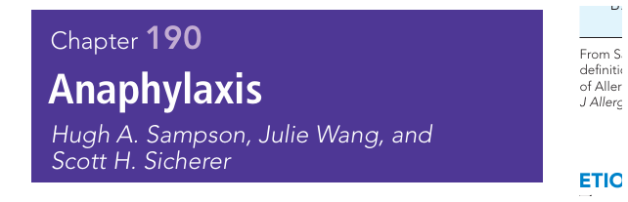
PEDIATRIC EMERGENCY ALLERGY
Anaphylaxis
Resident-level recognition, emergency management, exam pearls & MCQs
The one rule that saves lives:
Give IM epinephrine early — do not wait for complete criteria.
Dr. Manar Shawabkeh
Pediatric Board Teaching • 2026
1

Slide 2
RESIDENT ROADMAP
How to Think Like the Doctor at the Bedside
1
2
3
4
Recognize
Act
Rescue
Prevent
Anaphylaxis is clinical; skin may be absent.
IM epinephrine first, lateral thigh.
Airway, oxygen, fluids, repeat epinephrine.
Observe, prescribe 2 auto-injectors, action plan.
Exam mindset
Most wrong answers delay epinephrine: antihistamine first, nebulizer first, steroids first, “observe first,” or “wait for tryptase.”
Sources: Nelson Textbook of Pediatrics Ch. 190 screenshots provided; WAO 2020; AAAAI/ACAAI 2023; RCH / Resuscitation Council UK.
2

Slide 3
DEFINITION
Anaphylaxis: A Clinical Diagnosis
Rapid onset, potentially life-threatening systemic hypersensitivity reaction involving airway / breathing / circulation ± skin / GI.
Classic pattern
Skin or mucosa + respiratory compromise, reduced BP, or persistent GI symptoms.
Resident pearl
Treat the patient, not the checklist. If anaphylaxis is possible and severity is evolving, epinephrine is safer than delay.
Known allergen
Hypotension, bronchospasm, or laryngeal involvement after exposure can be enough.
Important trap
No hives does not rule out anaphylaxis. Infants may present with crying, drooling, vomiting, lethargy, or sudden collapse.
Possible anaphylaxis?
Give IM epinephrine now
Sources: WAO Anaphylaxis Guidance 2020; AAAAI/ACAAI Practice Parameter Update 2023; RCH Clinical Practice Guideline.
3

Slide 4
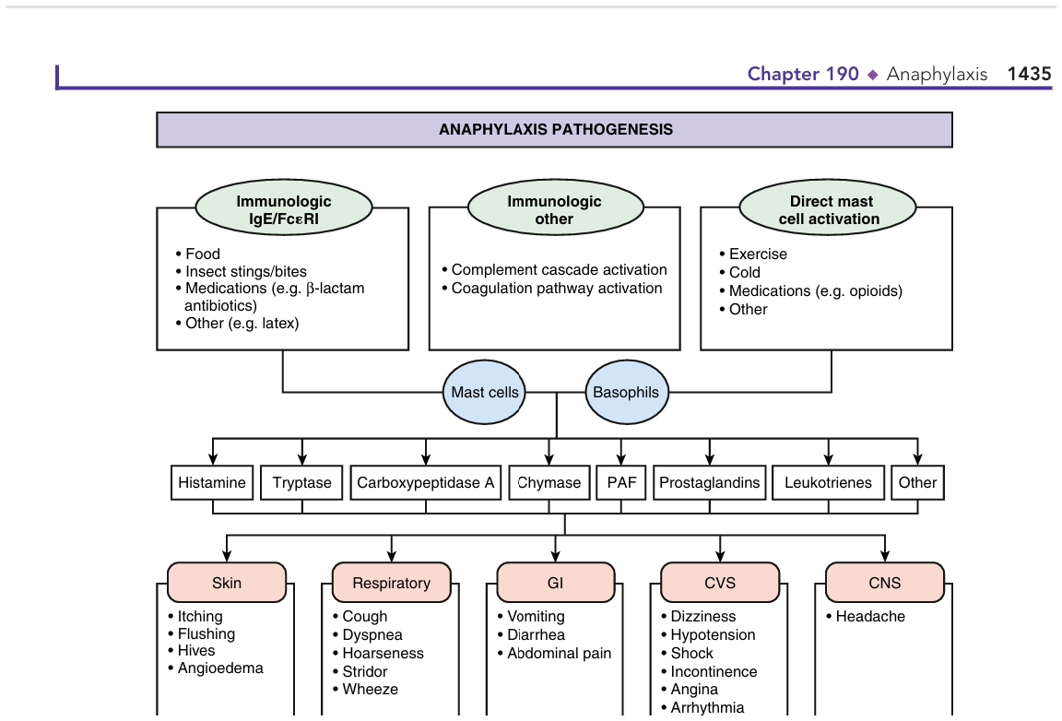
MECHANISM
Pathophysiology: Why One Trigger Becomes Multi-System
Memorize the chain
Trigger
food, drug, sting, latex, exercise/cold
Mast cell / basophil
IgE or non-IgE pathways
Mediators
histamine, leukotrienes, prostaglandins, PAF, tryptase
Organs
skin + airway + gut + cardiovascular ± CNS
Why epinephrine?
It reverses vasodilation/leak, supports cardiac output, bronchodilates, and reduces further mediator release.
Source image: Nelson Textbook of Pediatrics Ch. 190 screenshot provided.
4

Slide 5
CLINICAL RECOGNITION
The Five Organ Systems: Convert Symptoms Into Diagnosis
SKIN / MUCOSA
RESPIRATORY
GI
CVS
CNS
hives, flushing, pruritus, angioedema
cough, wheeze, stridor, hoarseness, dyspnea
repetitive vomiting, abdominal cramping, diarrhea
hypotension, syncope, collapse, incontinence
headache, sudden drowsiness, sense of doom
Exam shortcut
Anaphylaxis usually involves ≥2 organ systems — but isolated hypotension after a known allergen is enough.
Sources: Nelson Ch. 190 screenshot; WAO 2020; AAAAI/ACAAI 2023.
5

Slide 6
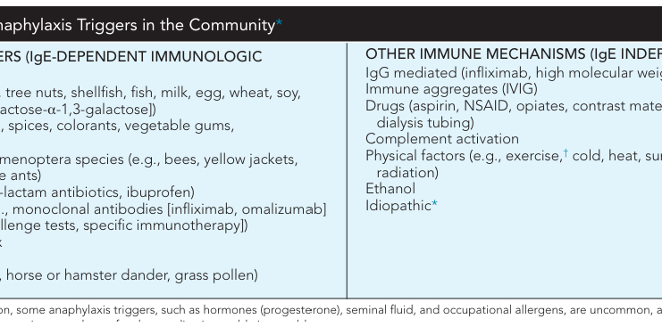
ETIOLOGY
Triggers: Ask the Exposure Question Before the Vital Signs Normalize
Community
food is the most common pediatric trigger: peanut/tree nut, milk, egg, fish/shellfish, wheat, soy.
Hospital
medications and latex become more prominent; β-lactams, biologics, vaccines, contrast, opioids.
Hidden clues
exercise + food, cold/heat, NSAID cofactor, idiopathic or mast cell disorder.
Pearl for history
Ask: “What did the child eat, take, touch, or receive in the last 2 hours?” Then ask about exercise/cold/NSAID cofactors.
Source image: Nelson Textbook of Pediatrics Ch. 190 screenshot provided.
6

Slide 7
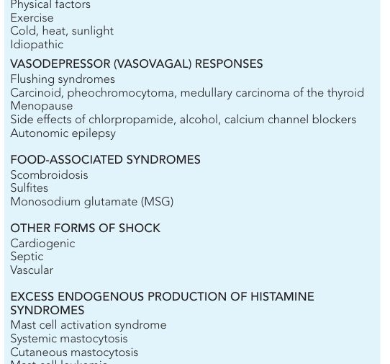
EXAM TRAP
Differential Diagnosis: What Can Look Like Anaphylaxis?
Vasovagal
pallor, bradycardia, rapid improvement supine; usually no urticaria/wheeze.
Asthma
wheeze alone; but asthma + allergy exposure = give epinephrine first.
Sepsis/shock
fever/toxicity; slower evolution, no clear trigger.
Scombroid/MSG
flushing after fish/food additive; mimic histamine release.
Hereditary angioedema
angioedema without urticaria; poor response to epinephrine/antihistamines.
Key rule
Differential diagnosis should never delay epinephrine when airway, breathing, or circulation is threatened.
Source image: Nelson Ch. 190 Table 190.4 screenshot; WAO/AAAAI guidance.
7

Slide 8
EMERGENCY ACTION
First 60 Seconds: The Resident Algorithm
CALL HELP
ABCDE
EPI IM
POSITION
REASSESS
Activate emergency response
Airway, breathing, circulation
1 mg/mL, lateral thigh
flat / legs raised; avoid standing
repeat q5–15 min if needed
Do not do first
Do not start with antihistamine, salbutamol, steroids, IV cannula, or tryptase. These are not first-line.
Sources: RCH Clinical Guideline; Resuscitation Council UK; WAO 2020.
8

Slide 9
DRUG DOSE
Epinephrine: Dose You Must Know Without Looking
Auto-injector memory
7.5–13 kg: 0.1 mg; <25 kg: 0.15 mg; ≥25 kg: 0.3 mg.
IM EPINEPHRINE
0.01 mg/kg
Maximum dose
Many emergency guidelines use max 0.5 mg IM; follow local pediatric policy.
of 1 mg/mL (1:1000) solution
into mid-outer thigh
Route trap
IM thigh is first-line. IV epinephrine bolus is not routine; use infusion/critical care for refractory shock.
Repeat every 5–15 minutes if symptoms persist or worsen.
Board phrase
“No absolute contraindication to epinephrine in anaphylaxis.”
Sources: WAO 2020; AAAAI/ACAAI 2023; RCH Clinical Guideline; Resuscitation Council UK 2021.
9

Slide 10
MECHANISM TO MEMORIZE
Why Lateral Thigh? Why Early?
α1
vasoconstriction → improves BP, reduces mucosal edema
Practical teaching line
Epinephrine treats the mechanism of death: airway edema, bronchospasm, vasodilation, capillary leak, and cardiovascular collapse.
β1
increases cardiac contractility and rate
Common error
The child looks “only urticarial” at minute 2, then collapses at minute 8. Early epinephrine prevents delay.
β2
bronchodilation + reduces mediator release from mast cells
Sources: WAO 2020; AAAAI/ACAAI 2023; Resuscitation Council UK.
10

Slide 11
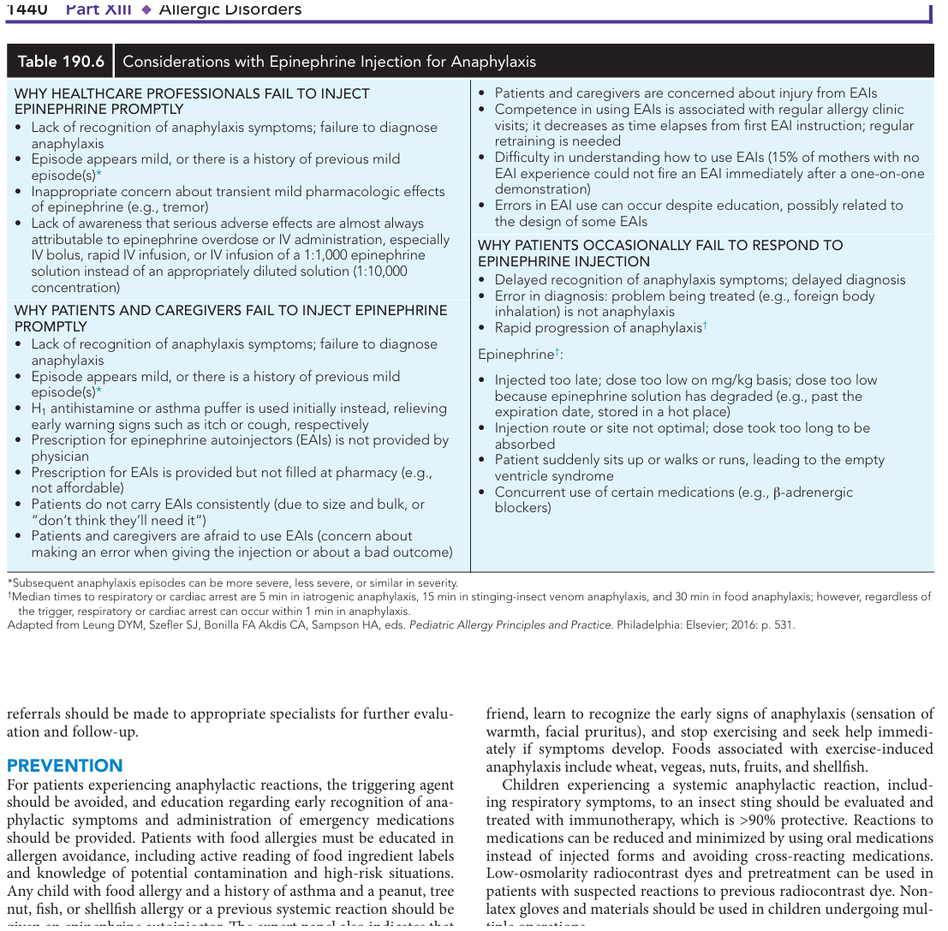
RESUSCITATION
After Epinephrine: Support the Failing System
Airway
hoarseness, stridor, tongue swelling → early senior/anaesthesia help.
Oxygen
high-flow oxygen if respiratory distress, hypoxia, hypotension, or shock.
Fluids
if hypotensive/shock: isotonic crystalloid bolus 20 mL/kg; repeat by response.
Bronchodilator
salbutamol for wheeze after epinephrine; it does not treat shock or airway edema.
Monitor
continuous vitals, cardiac monitor if severe; establish IV/IO without delaying IM epi.
Positioning saves lives
Lay flat with legs raised; let respiratory distress sit with legs extended. Do not allow standing/walking after symptoms resolve.
Source image: Nelson Ch. 190 treatment algorithm screenshot; RCH/Resuscitation Council UK.
11

Slide 12
CRITICAL CARE
Refractory Anaphylaxis: When the First Dose Is Not Enough
Persistent symptoms
airway, wheeze, hypotension, collapse
Never do this
Repeated nebulized salbutamol without repeated epinephrine is a common dangerous mistake.
Repeat IM epi
every 5–15 min while reassessing
IV epinephrine
Aggressive fluids
20 mL/kg boluses; consider IO if no IV
Use only by experienced clinicians with monitoring, ideally as infusion for refractory shock, not as routine bolus.
Escalate
epinephrine infusion / PICU / anaesthesia
β-blocker patient
Poor response may occur. Add glucagon while continuing standard resuscitation.
Special case
β-blocker exposure → consider glucagon
Sources: WAO 2020; RCH Clinical Guideline; Resuscitation Council UK.
12

Slide 13
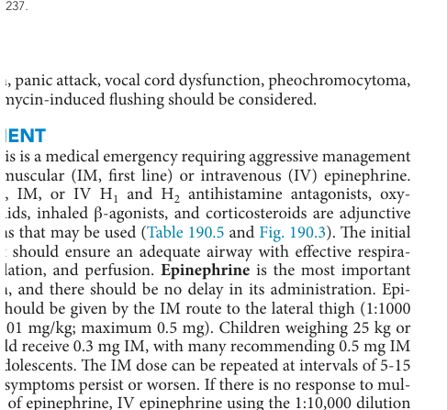
TREATMENT HIERARCHY
Adjuncts: Helpful, But Never First-Line
Antihistamines
relieve itch/urticaria only; do not treat airway edema, bronchospasm, or shock.
Steroids
delayed onset; not reliable for acute reversal or prevention of biphasic reactions.
Albuterol
for persistent wheeze after epinephrine.
H2 blockers
optional for cutaneous symptoms; not life-saving.
Glucagon
consider when anaphylaxis is refractory in a patient on β-blocker.
Memory line
Epinephrine saves life. Antihistamines save comfort. Steroids save neither acutely.
Sources: Nelson Ch. 190 screenshot; AAAAI/ACAAI 2020/2023; WAO 2020.
13

Slide 14
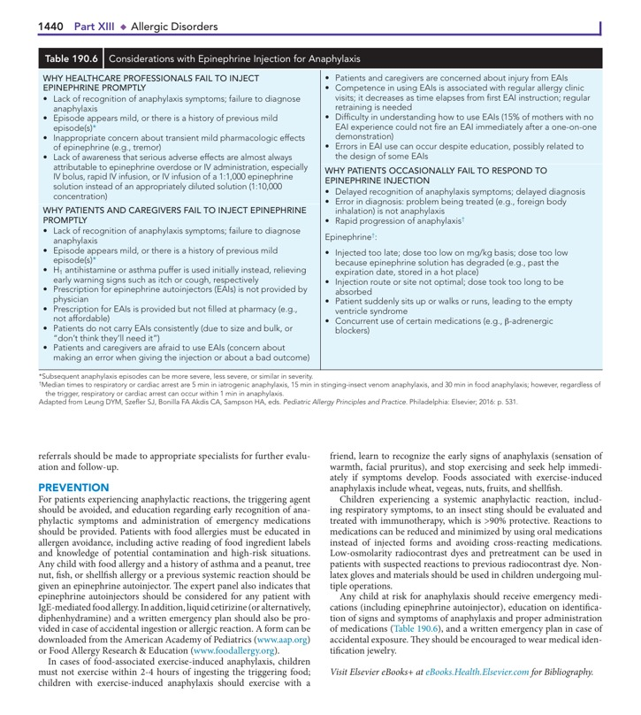
DISPOSITION
After Stabilization: Prevent the Second Emergency
Observe
duration individualized; longer if severe, asthma, hypotension, delayed epi, or >1 epi dose.
Biphasic risk
severe initial reaction, need for repeated epinephrine, delayed epinephrine, comorbid asthma.
Before discharge
2 epinephrine auto-injectors, written action plan, demonstration, trigger avoidance.
Follow-up
allergy/immunology referral; consider tryptase interpretation if severe/idiopathic/recurrent.
Exam pearl
Clinical improvement after epinephrine confirms treatment response — it is not required before giving epinephrine.
Sources: AAAAI/ACAAI Practice Parameter 2023; WAO 2020; Nelson Ch. 190 screenshot.
14

Slide 15
SYSTEMS SAFETY
Clinic Preparedness: What Must Be Ready Before the Reaction
□
Anaphylaxis protocol visible in every treatment area
Safety metric
□
Time from recognition to IM epinephrine should be measured in minutes, not after “trying” other drugs.
Epinephrine 1 mg/mL with syringes/needles or auto-injectors
□
Weight-based dose chart and roles assigned
Training tip
□
Oxygen, bag-mask, suction, nebulizer, IV/IO access plan
Teach caregivers to inject first and call emergency services immediately after.
□
Mock drill: who injects, who calls ambulance, who documents time
□
Aftercare template: action plan + EAI teaching + referral
Sources: Resuscitation Council UK anaphylaxis pack guidance; AAAAI/ACAAI 2023.
15

Slide 16
MEMORIZE
One-Minute Memory Framework: “EPI–FLOW”
Epinephrine IM first
Position: flat / legs raised; do not stand
IV/IO fluids if hypotensive
Follow airway and oxygen
E
P
I
F
Look for wheeze → bronchodilator after epi
Observe for biphasic risk
Written action plan + two auto-injectors
L
O
W
Teaching finish
Ask every resident: “What kills first — rash or airway/shock?” Then: “What reverses it?”
Sources: Nelson Textbook of Pediatrics Ch. 190 screenshots provided; WAO 2020; AAAAI/ACAAI 2023; RCH / Resuscitation Council UK.
16

Slide 17
CASE PRACTICE
Clinical Case 1: Recognize Before Collapse
Scenario
Answer
A 4-year-old with known peanut allergy develops generalized hives, repetitive cough, hoarseness, and vomiting 10 minutes after eating cake at school. BP is still normal.
Yes. Multi-system involvement after likely allergen: skin + respiratory + GI. Normal BP does not make it mild.
Management
IM epinephrine now. Call help, oxygen/position, reassess. Do not give antihistamine first.
Question: Is this anaphylaxis?
Sources: WAO 2020; AAAAI/ACAAI 2023; RCH Clinical Guideline.
17

Slide 18
CASE PRACTICE
Clinical Case 2: The Cofactor Trap
Scenario
Likely pattern
food-dependent exercise-induced anaphylaxis
A 13-year-old develops urticaria, abdominal cramps, wheeze, and dizziness while running 1 hour after eating shrimp. He has had shrimp before without symptoms.
Ask about
exercise, NSAIDs, infection, alcohol, menstruation, cold exposure
Management
treat now with IM epinephrine; prevention: avoid exercise after trigger food
What history makes the diagnosis more likely?
Exam pearl
Food tolerated on rest days may still trigger anaphylaxis with exercise/cofactors.
Sources: Nelson Ch. 190 triggers screenshot; WAO 2020.
18

Slide 19
ATTACHED SOURCE IMAGE
Nelson Visual Anchor: Treatment Algorithm
Read top-down
suspected anaphylaxis → immediate intervention.
If response
observe, prescribe epinephrine auto-injector, allergy referral.
If no response
repeat epi, oxygen, fluids, bronchodilator, adjuncts, escalate.
If arrest
CPR + high-dose epi + rapid volume expansion + ICU transfer.
How to teach it
Every box should answer one question: “Do I inject now? Do I repeat? Do I escalate? Do I discharge safely?”
Source image: Nelson Textbook of Pediatrics Ch. 190 screenshot provided.
19

Slide 20
EXAM PRACTICE
MCQ 1: Single Best Answer
A 6-year-old develops generalized urticaria, lip swelling, cough, wheeze, and repeated vomiting 15 minutes after eating a cookie at a party. BP is normal and oxygen saturation is 94%. What is the most appropriate immediate treatment?
A
Oral cetirizine and observe for progression
B
Nebulized salbutamol and reassess before epinephrine
C
IM epinephrine in the mid-outer thigh
D
IV hydrocortisone and H1/H2 blockers
E
Serum tryptase before treatment
Answer: C
Skin/mucosa + respiratory + GI symptoms after likely allergen = anaphylaxis. Normal BP does not justify delay. IM epinephrine is first-line.
MCQ style: single-best-answer, resident level; sources: WAO 2020; AAAAI/ACAAI 2023; RCH/Resus UK.
20

Slide 21
EXAM PRACTICE
MCQ 2: Single Best Answer
A 10-kg infant with suspected anaphylaxis has stridor, diffuse hives, and poor perfusion after antibiotic administration. Which epinephrine dose is most appropriate as first-line treatment?
A
0.01 mg IM of 1 mg/mL epinephrine in the lateral thigh
B
0.1 mg IV bolus of 1:10,000 epinephrine
C
0.15 mg IM autoinjector only; weight-based dosing is not used
D
0.3 mg IM epinephrine because all children receive the same dose
E
Nebulized racemic epinephrine only because stridor is present
Answer: A
Dose is 0.01 mg/kg IM of 1 mg/mL solution in the mid-outer thigh. Nebulized epinephrine may help upper airway symptoms but does not replace IM epinephrine.
MCQ style: single-best-answer, resident level; sources: WAO 2020; AAAAI/ACAAI 2023; RCH/Resus UK.
21

Slide 22
EXAM PRACTICE
MCQ 3: Single Best Answer
A 12-year-old with peanut-triggered anaphylaxis receives IM epinephrine and oxygen. After 8 minutes he remains hypotensive with persistent wheeze. What is the next best step?
A
Wait 30 minutes because epinephrine takes time to work
B
Repeat IM epinephrine and start isotonic fluid bolus
C
Give diphenhydramine as the main escalation therapy
D
Give oral prednisolone and discharge when rash improves
E
Order serum tryptase before repeating epinephrine
Answer: B
Persistent airway/breathing/circulation symptoms after the first dose require repeat IM epinephrine every 5–15 minutes plus fluid resuscitation for hypotension/shock.
MCQ style: single-best-answer, resident level; sources: WAO 2020; AAAAI/ACAAI 2023; RCH/Resus UK.
22

Slide 23
EXAM PRACTICE
MCQ 4: Single Best Answer
A teenager on a β-blocker develops severe anaphylaxis and remains hypotensive despite repeated IM epinephrine and fluid boluses while critical care support is being mobilized. Which adjunct may improve catecholamine-resistant hypotension?
A
Glucagon
B
Cetirizine
C
Ranitidine alone
D
Methylprednisolone as the only rescue drug
E
Aspirin
Answer: A
β-blockers can blunt epinephrine response. Glucagon may be considered in refractory anaphylaxis while continuing epinephrine-based resuscitation.
MCQ style: single-best-answer, resident level; sources: WAO 2020; AAAAI/ACAAI 2023; RCH/Resus UK.
23

Slide 24
EXAM PRACTICE
MCQ 5: Single Best Answer
A 7-year-old treated for anaphylaxis required two IM epinephrine doses and a fluid bolus before full recovery. Which discharge plan is most appropriate?
A
Discharge immediately once the rash disappears
B
Observe longer because of biphasic risk, prescribe two auto-injectors, teach use, give a written action plan, and arrange allergy follow-up
C
Discharge with oral antihistamine only
D
Routine steroids are sufficient to prevent biphasic reaction
E
No referral is needed if the trigger is known
Answer: B
Need for repeated epinephrine and hypotension increase risk for recurrence/biphasic reaction. Discharge requires observation, two epinephrine auto-injectors, education, action plan, and referral.
MCQ style: single-best-answer, resident level; sources: WAO 2020; AAAAI/ACAAI 2023; RCH/Resus UK.
24

Slide 25
TAKE-HOME
One Slide to Memorize Before the Exam
1
Anaphylaxis is clinical — skin may be absent.
2
IM epinephrine is first-line; do not wait.
3
Dose: 0.01 mg/kg of 1 mg/mL IM lateral thigh; repeat 5–15 min.
4
Airway/oxygen/fluids support after epinephrine.
5
Antihistamines/steroids are adjuncts, not rescue treatment.
6
Discharge = observe + two auto-injectors + action plan + referral.
Final line for residents
When in doubt: epinephrine first, then think.
Sources: Nelson Textbook of Pediatrics Ch. 190 screenshots provided; WAO 2020; AAAAI/ACAAI 2023; RCH / Resuscitation Council UK.
25

Slide 26
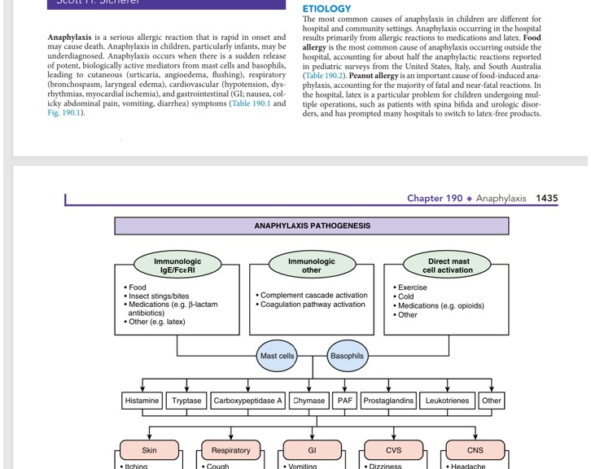
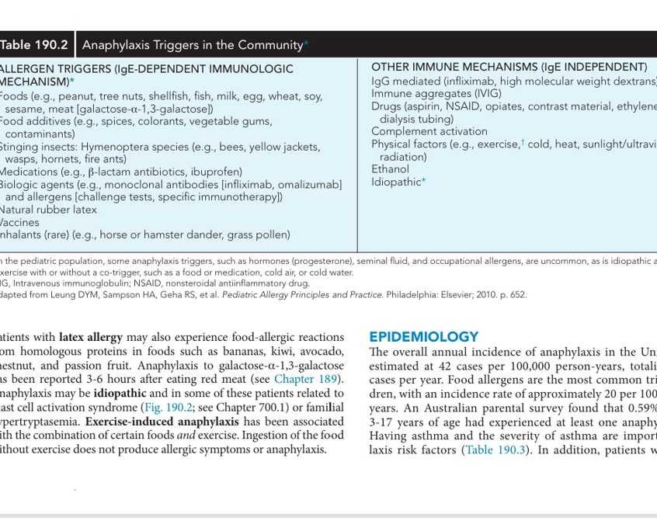
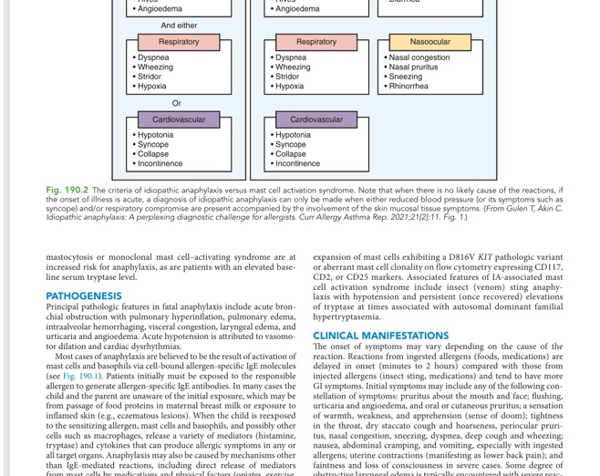
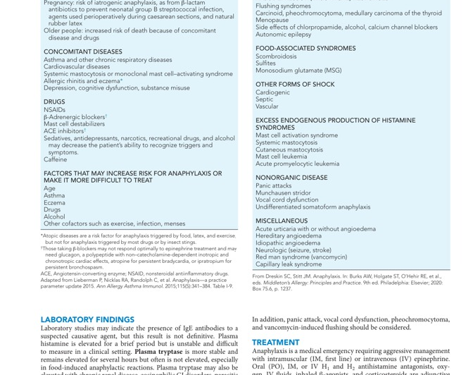
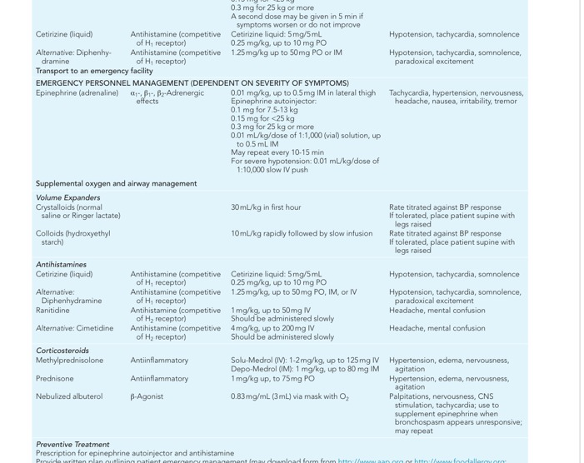
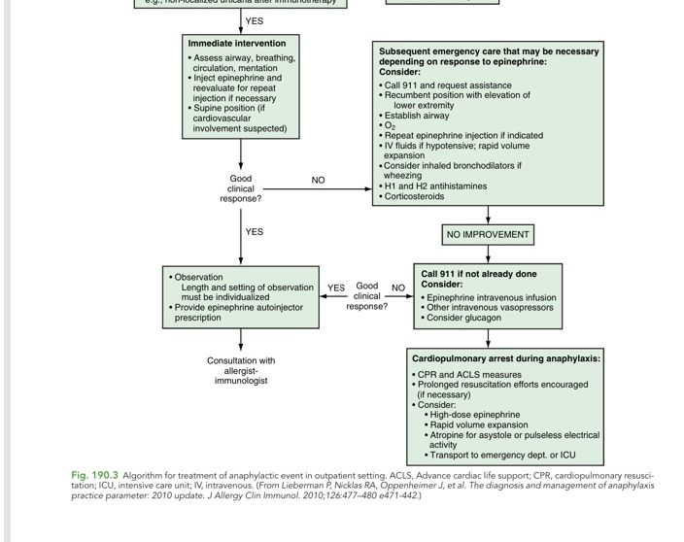
SOURCE IMAGES
Attached Images Used as Visual Anchors
Image 264
Image 265
Image 266
Image 267
Image 268
Image 269
Image 270
All source screenshots were provided by the user and incorporated as visual anchors.
26

Slide 27
SOURCES
References
Nelson Textbook of Pediatrics, Chapter 190: Anaphylaxis — screenshots supplied in this chat.
World Allergy Organization Anaphylaxis Guidance 2020.
AAAAI/ACAAI Joint Task Force: Anaphylaxis Practice Parameter Update 2023 / practice guidance.
Royal Children's Hospital Melbourne Clinical Practice Guideline: Anaphylaxis.
Resuscitation Council UK: Emergency Treatment of Anaphylaxis Guideline 2021.
Update note
Medication doses and observation/discharge policies should be aligned with local hospital protocol. This lecture emphasizes principles consistent with major international guidance.
27

