Slide 1

PEDIATRIC NEPHROLOGY
Chronic Kidney
Disease
Resident board review • recognition, complications & renal replacement therapy
Dr. Manar Mohammad Alshawabkeh
High-yield clinical reasoning • 2026
Notes:
Opening: CKD is not a creatinine diagnosis—it is a duration + damage/GFR diagnosis.
[Sources]
- Nelson Textbook of Pediatrics, 22nd ed., Ch. 572–573; KDIGO 2024 CKD Guideline.

Slide 2
PEDIATRIC NEPHROLOGY • RESIDENT BOARD REVIEW
Start with the child—not the creatinine
What should your brain do first?
BOARD STEM
8-year-old
•
Confirm chronicity: ≥3 months
poor growth • pallor • nocturia
BP 128/82 • mild ankle edema
•
Stage by eGFR—and describe albuminuria
•
Search for cause: congenital vs glomerular
Hb 8.9 g/dL
HCO₃⁻ 16 mmol/L
Ca ↓ • PO₄ ↑
•
Treat the complications that accelerate progression
Board pivot: children may have advanced CKD before “uremic” symptoms appear.
Dr. Manar Mohammad Alshawabkeh
02
Notes:
[Sources]
- Nelson Textbook of Pediatrics, 22nd ed., Ch. 572.2 Chronic Kidney Disease.

Slide 3
PEDIATRIC NEPHROLOGY • RESIDENT BOARD REVIEW
CKD = abnormal kidney structure/function for ≥3 months
1
Kidney damage
2
eGFR <60
Urine, blood, imaging, or biopsy abnormality—GFR may be normal.
OR
mL/min/1.73 m² persisting for ≥3 months—with or without damage markers.
Not CKD
A single elevated creatinine • isolated AKI • transient proteinuria during fever/exercise
ESKD is the treated subset: dialysis or kidney transplantation.
Dr. Manar Mohammad Alshawabkeh
03
Notes:
[Sources]
- Nelson Textbook of Pediatrics, 22nd ed., Table 572.7; KDIGO 2024 Clinical Practice Guideline for CKD.

Slide 4
PEDIATRIC NEPHROLOGY • RESIDENT BOARD REVIEW
Stage the GFR, then add the albuminuria signal
G stage
eGFR (mL/min/1.73 m²)
Board meaning
Pediatric pearl
G1
≥90
Damage marker required
Creatinine depends on muscle mass.
Trend height-based eGFR and growth—not creatinine alone.
G2
60–89
Damage marker required
G3a
45–59
Mild–moderate loss
G3b
30–44
Moderate–severe loss
G4
15–29
Severe loss; prepare
A1 / A2 / A3
ACR <30 • 30–300 • >300 mg/g
G5
<15
Kidney failure
Memory: “90 • 60 • 45 • 30 • 15”
Dr. Manar Mohammad Alshawabkeh
04
Notes:
[Sources]
- KDIGO 2024 CKD Guideline, GFR and albuminuria categories; Nelson Textbook of Pediatrics, 22nd ed., Ch. 572.2.

Slide 5
PEDIATRIC NEPHROLOGY • RESIDENT BOARD REVIEW
Age narrows the differential before any serology
Clue
Younger child (<5 y)
Older child / adolescent
Dominant pattern
CAKUT / reduced nephron mass
Acquired or inherited glomerular disease
Examples
Dysplasia, hypoplasia, PUV, reflux
FSGS, IgA nephropathy, lupus, Alport
Urinalysis
May be bland; concentrating defect
Hematuria ± proteinuria; active sediment
Imaging
Small/dysplastic or obstructed system
Often normal size early; disease-specific changes
Board discriminator
Prenatal US / recurrent UTI
Edema + HTN + hematuria/proteinuria
MEMORY ANCHOR • “Small child → structural; school child → sediment”
Dr. Manar Mohammad Alshawabkeh
05
Notes:
[Sources]
- Nelson Textbook of Pediatrics, 22nd ed., Table 572.9 and CKD etiology section.

Slide 6
PEDIATRIC NEPHROLOGY • RESIDENT BOARD REVIEW
Nephron loss creates a self-amplifying hyperfiltration loop
1
2
3
4
↓ nephron mass
Single-nephron
hyperfiltration
Proteinuria +
glomerulosclerosis
Further GFR loss
CAKUT • injury
↑ intraglomerular pressure
ongoing damage
cycle repeats
Interrupt the loop
Control BP • reduce proteinuria • avoid dehydration/AKI • treat UTI promptly
Dr. Manar Mohammad Alshawabkeh
06
Notes:
[Sources]
- Nelson Textbook of Pediatrics, 22nd ed., Ch. 572.2 pathogenesis and progression.

Slide 7
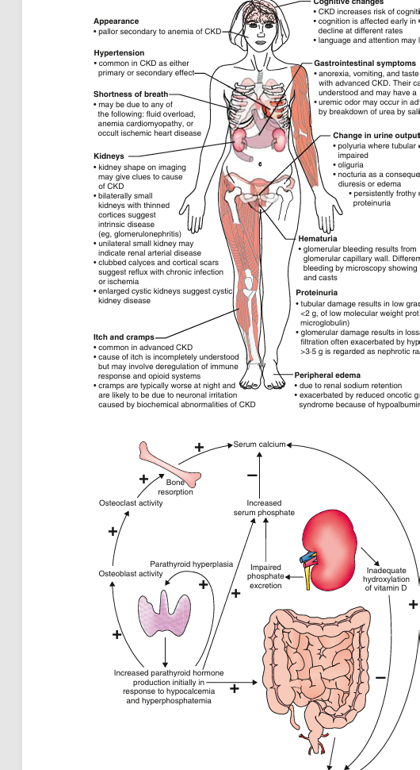
PEDIATRIC NEPHROLOGY • RESIDENT BOARD REVIEW
The multisystem exam tells you how advanced CKD is
Growth
poor velocity, delayed puberty
Volume/BP
edema, hypertension, dyspnea
Hematology
pallor; normocytic anemia
Bone
pain, deformity, SCFE risk
Neuro/GI
fatigue, cognition, nausea, anorexia
Dr. Manar Mohammad Alshawabkeh
07
Notes:
Use the visual to sweep head-to-toe.
[Sources]
- Nelson Textbook of Pediatrics, 22nd ed., Fig. 572.4 and clinical manifestations section.

Slide 8
PEDIATRIC NEPHROLOGY • RESIDENT BOARD REVIEW
Every abnormal lab points back to a lost kidney function
Finding
Mechanism
Clinical response
Metabolic acidosis
↓ ammoniagenesis + net acid excretion
Alkali; support growth
Hyperkalemia
↓ excretion + acidosis + excess intake
ECG if severe; stabilize/shift/remove
Hyperphosphatemia
↓ phosphate clearance
Diet + binder with meals
Hypocalcemia / ↑ PTH
↓ calcitriol + phosphate retention
Correct 25-OH D; active vitamin D
Normocytic anemia
↓ EPO ± iron deficiency
Check iron; ESA when appropriate
Poor growth
nutrition + acidosis + GH resistance
Calories, correct factors, consider GH
Dr. Manar Mohammad Alshawabkeh
08
Notes:
[Sources]
- Nelson Textbook of Pediatrics, 22nd ed., Table 572.10 and CKD complications sections.

Slide 9
PEDIATRIC NEPHROLOGY • RESIDENT BOARD REVIEW
A focused CKD work-up answers four questions
1 Is it chronic?
Prior creatinine • growth chart • US: small echogenic kidneys
2 How severe?
eGFR • BP • K⁺/HCO₃⁻ • volume status
3 What caused it?
UA + ACR/PCR • culture • renal US ± complements/ANA/genetics
4 What is it doing?
CBC/iron • Ca/PO₄/ALP/PTH/25-OH D • nutrition
Ultrasound is the pediatric “etiology shortcut”; urine sediment is the glomerular shortcut.
Dr. Manar Mohammad Alshawabkeh
09
Notes:
[Sources]
- Nelson Textbook of Pediatrics, 22nd ed., Ch. 572.2 laboratory findings and evaluation.

Slide 10
PEDIATRIC NEPHROLOGY • RESIDENT BOARD REVIEW
Protect growth: do not apply adult protein restriction to children
100%
Protein
~100% DRI for ideal weight; often more on dialysis
estimated energy needs—then adjust to growth, activity, and BMI response
If oral intake fails
Energy-dense supplements → NG/G-tube feeding
Correct growth brakes
Acidosis • anemia • CKD-MBD • salt/water imbalance
Board trap: “low protein” is not the default pediatric answer.
Dr. Manar Mohammad Alshawabkeh
10
Notes:
[Sources]
- Nelson Textbook of Pediatrics, 22nd ed., Ch. 572.2 nutrition and growth.

Slide 11
PEDIATRIC NEPHROLOGY • RESIDENT BOARD REVIEW
CKD–MBD begins before the X-ray changes
↓ GFR
↑ FGF-23
↓ Ca²⁺
High turnover
phosphate retention
↓ calcitriol
PTH rises
renal osteodystrophy
Monitor
Treat when abnormal
Avoid the trap
Ca, PO₄, ALP, PTH, 25-OH D
Restrict phosphate; binder with meals
Aluminum binders → toxicity
25-OH vitamin D
Replete native vitamin D
Calcitriol does not replace low 25-OH D
Persistent secondary HPT
Active vitamin D sterol
Oversuppression → adynamic bone
Clinical/radiographic bone disease
Multidisciplinary CKD-MBD care
SCFE can present as knee pain
Dr. Manar Mohammad Alshawabkeh
11
Notes:
[Sources]
- Nelson Textbook of Pediatrics, 22nd ed., Ch. 572.2 CKD mineral and bone disorder; KDIGO 2017 CKD-MBD update.

Slide 12
PEDIATRIC NEPHROLOGY • RESIDENT BOARD REVIEW
Anemia of CKD is usually normocytic—but iron still matters
Before ESA
↓ functioning renal mass
•
CBC + reticulocytes
↓ erythropoietin
•
Ferritin + transferrin saturation
•
Exclude blood loss, folate/B₁₂ deficiency
normocytic, normochromic anemia
•
Correct iron deficiency and inflammation
fatigue • poor cognition • cardiac strain
ESA response fails? Think iron deficiency, infection/inflammation, or nonadherence.
Dr. Manar Mohammad Alshawabkeh
12
Notes:
[Sources]
- Nelson Textbook of Pediatrics, 22nd ed., Ch. 572.2 anemia of CKD.

Slide 13
PEDIATRIC NEPHROLOGY • RESIDENT BOARD REVIEW
BP and proteinuria are modifiable progression accelerators
Treatment ladder
Target concept
1
Sodium restriction + healthy weight
Aim low when tolerated
2
ACE inhibitor or ARB
Nelson board pearl:
SBP/DBP <50th percentile—especially with proteinuria
3
Diuretic for salt/fluid retention
ABPM reveals masked hypertension.
4
Add CCB / β-blocker / clonidine
Monitor creatinine + K⁺ after RAAS blockade
Dr. Manar Mohammad Alshawabkeh
13
Notes:
[Sources]
- Nelson Textbook of Pediatrics, 22nd ed., Ch. 572.2 hypertension/proteinuria; ESCAPE Trial, N Engl J Med 2009.

Slide 14
PEDIATRIC NEPHROLOGY • RESIDENT BOARD REVIEW
Treat today’s danger while preserving tomorrow’s kidneys
Problem
Immediate board action
CKD-specific caution
K⁺ with ECG change
IV calcium → insulin/glucose ± β₂ agonist
Dialysis if refractory
Pulmonary edema
Oxygen + loop diuretic; assess dialysis
Avoid indiscriminate fluid bolus
Severe acidosis
Treat cause; bicarbonate selectively
Consider dialysis if refractory
Uremic symptoms
Urgent nephrology/KRT assessment
Do not wait for a single eGFR number
Dehydration / UTI
Prompt isotonic rehydration; culture/treat
Prevent additional nephron loss
AEIOU still frames urgent dialysis: Acidosis • Electrolytes • Intoxication • Overload • Uremia
Dr. Manar Mohammad Alshawabkeh
14
Notes:
[Sources]
- Nelson Textbook of Pediatrics, 22nd ed., Ch. 572.2; standard pediatric nephrology indications for kidney replacement therapy.

Slide 15
PEDIATRIC NEPHROLOGY • RESIDENT BOARD REVIEW
Prevent avoidable harm: vaccines, dosing, and nephrotoxins
Vaccines
Live vaccines
Medications
Routine schedule
Annual influenza
Pneumococcal risk-based vaccination
Give before transplant when possible
Withhold during significant immunosuppression
Dose to eGFR and dialysis modality
Avoid NSAIDs and nephrotoxic combinations
Recheck K⁺/creatinine after ACEi/ARB
Board habit: every prescription asks “What is the eGFR—and is the child dialyzed?”
Dr. Manar Mohammad Alshawabkeh
15
Notes:
[Sources]
- Nelson Textbook of Pediatrics, 22nd ed., Ch. 572.2 immunizations and drug-dose adjustment; CDC risk-based pneumococcal guidance.

Slide 16
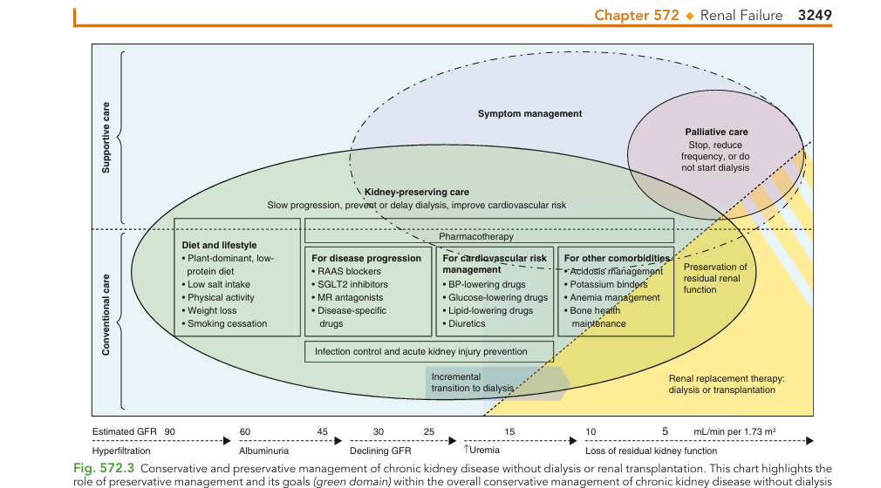
PEDIATRIC NEPHROLOGY • RESIDENT BOARD REVIEW
Kidney replacement planning starts before the crisis
Prepare in G4
•
Education + modality choice
•
Preserve vessels
•
Transplant work-up
•
Access planning
•
Psychosocial + school support
Start for symptoms/complications—not merely because eGFR crossed a number.
Dr. Manar Mohammad Alshawabkeh
16
Notes:
[Sources]
- Nelson Textbook of Pediatrics, 22nd ed., Fig. 572.3; KDIGO 2024 CKD Guideline.

Slide 17
PEDIATRIC NEPHROLOGY • RESIDENT BOARD REVIEW
PD offers home flexibility; HD offers efficient intermittent clearance
Decision point
Peritoneal dialysis
Hemodialysis
Where / frequency
Home; commonly 6–7 d/week
Center; usually 3×/week
Access
Peritoneal catheter
AV fistula/graft or tunneled catheter
Strength
Independence; gentle continuous fluid removal
Efficient solute and fluid removal
Key infection
Peritonitis
Bloodstream/access infection
Contraindication
Major adhesions/abdominal defects; unreliable caregiver
Inadequate vascular access
Board pearl
Preserves school routine; caregiver burden matters
Prefer internal jugular over subclavian catheter
Dr. Manar Mohammad Alshawabkeh
17
Notes:
[Sources]
- Nelson Textbook of Pediatrics, 22nd ed., dialysis section preceding Ch. 573.

Slide 18
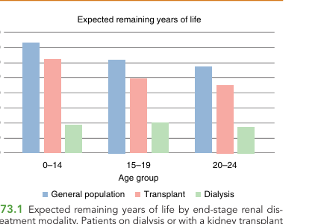
PEDIATRIC NEPHROLOGY • RESIDENT BOARD REVIEW
Transplantation is the optimal long-term therapy for pediatric ESKD
Why it wins
•
Better survival than remaining on dialysis
•
Improved growth and development potential
•
Restores school and family participation
•
Pre-emptive transplant may avoid dialysis
Never forget
Vaccinate, assess adherence, and plan lifelong immunosuppression.
Dr. Manar Mohammad Alshawabkeh
18
Notes:
[Sources]
- Nelson Textbook of Pediatrics, 22nd ed., Ch. 573 Renal Transplantation; USRDS Annual Data Report 2020 (figure source).

Slide 19
PEDIATRIC NEPHROLOGY • RESIDENT BOARD REVIEW
Six board traps worth memorizing
Normal eGFR ≠ no CKD
One creatinine ≠ CKD
G1/G2 require a damage marker
Duration must be ≥3 months
Creatinine alone misleads
Protein restriction ≠ pediatric default
Low muscle mass can mask low GFR
Growth takes priority
Binder timing matters
Dialysis ≠ eGFR alone
Give phosphate binder with meals
Symptoms and refractory complications decide
Dr. Manar Mohammad Alshawabkeh
19
Notes:
[Sources]
- Nelson Textbook of Pediatrics, 22nd ed., Ch. 572–573; KDIGO 2024 CKD Guideline.

Slide 20
PEDIATRIC NEPHROLOGY • RESIDENT BOARD REVIEW
Rapid-fire board check
1
Child with CKD + proteinuria + HTN
ACE inhibitor / ARB
2
High PO₄ + low Ca + high PTH
Secondary hyperparathyroidism
3
CKD + low Hb; MCV normal
EPO deficiency—check iron first
4
Advanced CKD + pulmonary edema despite diuretic
Urgent kidney replacement therapy
If you can explain the “why,” you can survive the distractors.
Dr. Manar Mohammad Alshawabkeh
20
Notes:
[Sources]
- Nelson Textbook of Pediatrics, 22nd ed., Ch. 572–573.

Slide 21
THE BOARD FRAME
Recognize → Stage → Explain → Protect → Prepare
1
2
3
4
5
Recognize
Stage
Explain
Protect
Prepare
≥3 months
damage or eGFR <60
GFR + albuminuria
+ BP + growth
Age, urine sediment,
and ultrasound
BP/proteinuria, nutrition,
acid–base, bone, anemia
PD vs HD; transplant
before crisis
Dr. Manar Mohammad Alshawabkeh
Pediatric Chronic Kidney Disease • Resident Board Review
Notes:
[Sources]
- Nelson Textbook of Pediatrics, 22nd ed., Ch. 572–573; KDIGO 2024 CKD Guideline.

