Slide 1


PEDIATRIC ELECTROCARDIOGRAPHY
Reading the Child's ECG
From Basics to Arrhythmias — A Practical Lecture for Residents
Presented by Dr. Manar Shawabkeh
Dr. Manar Shawabkeh
Pediatric ECG • Nelson Textbook of Pediatrics

Slide 2





LEARNING OBJECTIVES
What You Will Master Today
The normal pediatric ECG
A systematic reading approach
Why a child's ECG is NOT a small adult's — RV dominance & its evolution
Rate → rhythm → axis → intervals → chambers → ST/T
Chamber enlargement & hypertrophy
Conduction & repolarization
Spotting RAE, LAE, RVH and LVH on the tracing
Bundle branch block, long QT, K⁺ abnormalities, ischemia
Arrhythmias in children
Self-assessment
SVT, WPW, flutter, fibrillation, VT, heart block
End-of-lecture MCQs to test recall
Dr. Manar Shawabkeh
Pediatric ECG • Nelson Textbook of Pediatrics
1

Slide 3
PART 1
The Normal Pediatric ECG
Anatomy, chamber dominance, and how the ECG changes with age
Dr. Manar Shawabkeh
Pediatric ECG • Nelson Textbook of Pediatrics

Slide 4
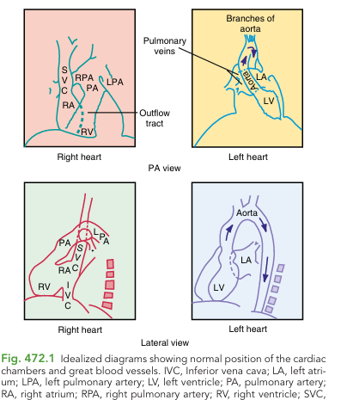

FOUNDATIONS
Heart Anatomy Behind the ECG
Why anatomy matters
The ECG records the summed electrical vectors of the heart's chambers.
In the fetus, PVR ≈ SVR, so both ventricles pump against equal resistance → equal muscle mass.
The RV sits anterior and rightward; the LV is posterior and leftward.
Right-sided chest leads (V₃R, V₄R) and V₁ therefore 'see' the RV directly — vital in children.
KEY CONCEPT
At birth the RV is as thick as the LV. The newborn ECG is normally right-dominant — the opposite of the adult.
Fig 472.1 — Normal position of the cardiac chambers & great vessels
Dr. Manar Shawabkeh
Pediatric ECG • Nelson Textbook of Pediatrics
2

Slide 5





PHYSIOLOGY
The Great Shift: RV → LV Dominance
After birth, the lungs expand → pulmonary vascular resistance (PVR) falls → the RV wall thins while the LV grows. The ECG follows this over years.
Newborn
Childhood
Adolescent / Adult
Right axis +110° to +180°. Tall R in V₁, upright T in V₁ (first 48–72 h only). R/S in V₁ > 1.
Axis normalises toward +60°. QRS gradually shifts leftward as the RV regresses.
Dominant S in V₁, tall R in V₆. Normal adult R-wave progression. LV dominant.
Common pitfall: A T wave that stays upright in V₁ after 1 week of life is abnormal — it suggests RVH or RV strain. Adult cardiologists frequently misread this.
Dr. Manar Shawabkeh
Pediatric ECG • Nelson Textbook of Pediatrics
3

Slide 6
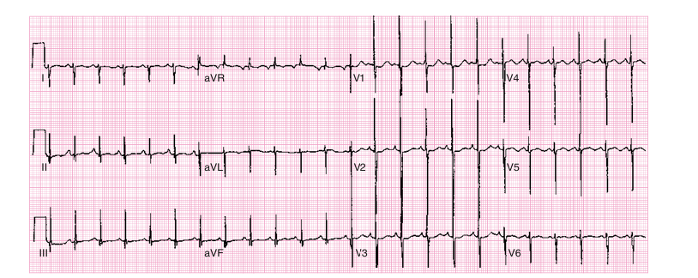
NORMAL BY AGE
Newborn ECG (5 days old)
What's normal here?
Marked right axis deviation (≈ +150°) — expected in a newborn.
Prominent voltages in the precordial leads with a tall R in V₁.
Suggests right ventricular preponderance, NOT hypertrophy.
QRS duration is short (≈ 60 ms) — conduction is fast in small hearts.
Fig 472.2 — Normal ECG, 5-day-old term infant. Frontal QRS axis ≈ 150°.
KEY POINT
Right-axis + tall R in V₁ in a neonate = physiologic RV dominance, not pathology.
Dr. Manar Shawabkeh
Pediatric ECG • Nelson Textbook of Pediatrics
4

Slide 7
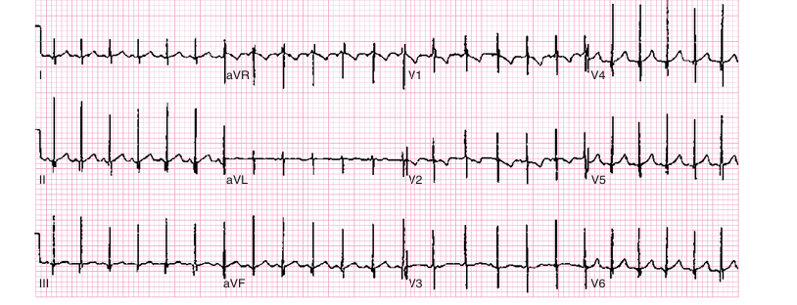

NORMAL BY AGE
Infant ECG (8 months old)
How it has changed
Axis has already migrated to ≈ +60° — the RV is regressing.
Smaller R wave in V₁ and smaller S wave in V₆ than the newborn.
Less evidence of right ventricular preponderance.
The transition from right to left dominance is well under way.
Fig 472.3 — Normal ECG, healthy 8-month-old. Frontal QRS axis ≈ 60°.
CLINICAL PEARL
Compare serial ECGs by age — 'normal' is a moving target in the first years of life.
Dr. Manar Shawabkeh
Pediatric ECG • Nelson Textbook of Pediatrics
5

Slide 8

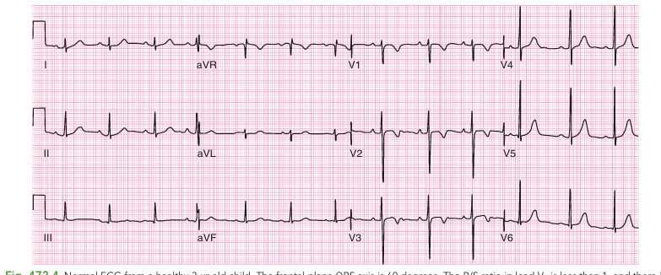
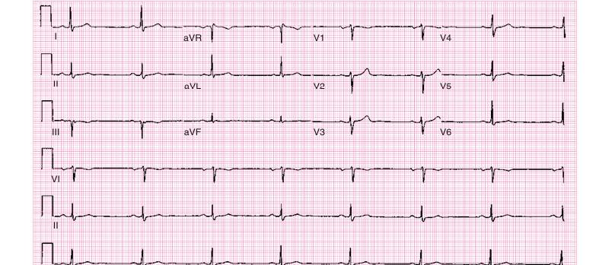
NORMAL BY AGE
Child vs Adolescent — The Maturing ECG
Key differences
3-yr-old: R/S ratio in V₁ now < 1 — LV starting to dominate.
By adolescence the dominant wave in V₁ is the S wave.
Normal R-wave progression: R grows taller from V₁ → V₆.
T waves become negative in V₁ during childhood (normal!).
Athletes may show sinus bradycardia as a normal finding.
Fig 472.4 — Healthy 3-yr-old. Axis ≈ 60°; R/S in V₁ < 1.
REMEMBER
An upright R/S >1 in V₁ that persists into an older child is a red flag for RVH.
Fig 472.5 — Normal 17-yr-old athlete. Adult pattern; sinus bradycardia 43 bpm.
Dr. Manar Shawabkeh
Pediatric ECG • Nelson Textbook of Pediatrics
6

Slide 9


METHOD
A Systematic Way to Read Every ECG
1 Rate
2 Rhythm
3 Axis
Count the rate — remember children run faster than adults.
Is a P wave before every QRS? Sinus origin (P upright in I & aVF)?
Estimate the frontal-plane QRS axis (age-dependent!).
4 Intervals
5 Chambers
6 ST / T waves
Measure PR, QRS width and the corrected QT (QTc).
Look for atrial enlargement & ventricular hypertrophy.
Assess repolarization — ischemia, K⁺, strain.
Follow the same order every time — it stops you missing subtle findings.
Dr. Manar Shawabkeh
Pediatric ECG • Nelson Textbook of Pediatrics
7

Slide 10
PART 2
Chambers: Enlargement & Hypertrophy
Recognising RAE, LAE, RVH and LVH on the tracing
Dr. Manar Shawabkeh
Pediatric ECG • Nelson Textbook of Pediatrics

Slide 11
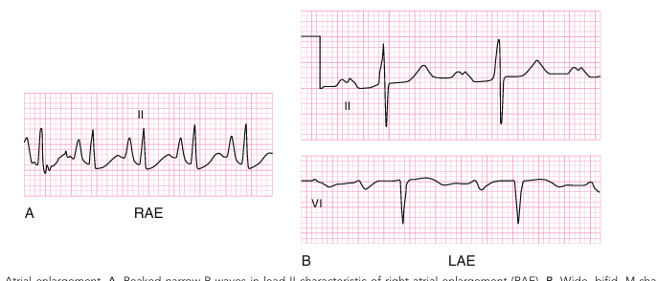
P WAVES
Atrial Enlargement (RAE & LAE)
Read the P wave
The P wave = atrial depolarization; its shape reveals atrial size.
RAE: tall (>2.5 mm), narrow, spiked P waves — best in II, V₃R, V₁.
RAE causes: pulmonary stenosis, Ebstein anomaly, tricuspid atresia, cor pulmonale.
LAE: wide, bifid ('M-shaped') P in II and biphasic P in V₁.
LAE causes: large L-to-R shunts (VSD, PDA), mitral stenosis/regurgitation.
Fig 472.8 — A: Peaked P waves (RAE). B: Wide, bifid / biphasic P waves (LAE).
PITFALL
Broad bifid P waves are a common false-positive on computerized ECG reads — always eyeball them.
Dr. Manar Shawabkeh
Pediatric ECG • Nelson Textbook of Pediatrics
8

Slide 12
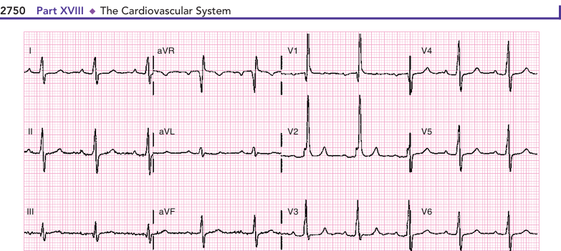
VENTRICULAR HYPERTROPHY
Right Ventricular Hypertrophy (RVH)
Signs of RVH (need ≥ 2)
Tall, pure R waves in right precordial leads (V₃R, V₄R, V₁).
Deep S waves in the left leads (V₆, V₇).
Upright T wave in V₁ after the first week (a strain sign in infants).
Marked right-axis deviation (> +120° beyond the newborn period).
qR pattern in the RV leads; reversed adult RS precordial pattern.
Fig 472.6 — Infant with RVH (tetralogy of Fallot). Tall R in V₁–V₂, deep S in V₆.
KEY POINT
Pressure overload (e.g. pulmonic stenosis) → tall pure R. Volume overload (ASD) → rsR′ pattern.
Dr. Manar Shawabkeh
Pediatric ECG • Nelson Textbook of Pediatrics
9

Slide 13
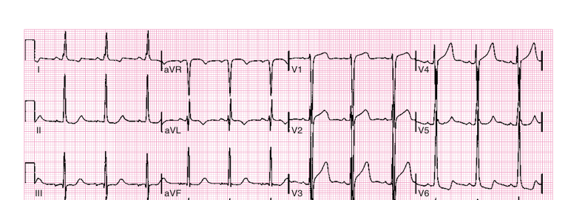
VENTRICULAR HYPERTROPHY
Left Ventricular Hypertrophy (LVH)
Signs of LVH
Increased S wave in V₃R/V₁ and/or R wave in V₆–V₇ (for age).
Sokolow index: S in V₁ (or V₂) + R in V₅ (or V₆) ≥ 35 mm.
Deep Q waves in the left precordial leads.
'Left ventricular strain': ST depression + T inversion in V₅, V₆, V₇.
Always compare voltages against age-specific normal values.
Fig 472.10 — LVH in a 12-yr-old with aortic stenosis. Deep S in V₁–V₃, tall R in V₅–V₆, T inversion V₆ (strain).
PITFALL
An ECG that looks 'normal' for an adult may actually be LVH in an infant — reference age-based norms.
Dr. Manar Shawabkeh
Pediatric ECG • Nelson Textbook of Pediatrics
10

Slide 14
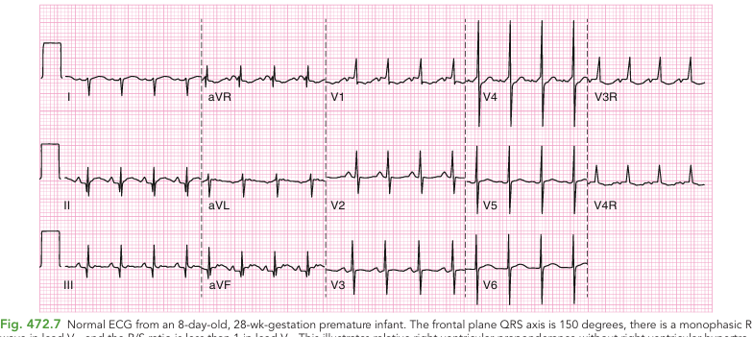
NORMAL VARIANT
The Premature Infant's ECG
Why prematurity matters
Preterm infants have lower PVR (less pulmonary arteriole muscle).
This produces a more 'mature' ECG than a term newborn of the same age.
A monophasic R in V₁ can still be normal here; QRS < 40 ms.
Some preterm babies show generalized low precordial voltage.
CLINICAL PEARL
Interpret voltages in the context of gestational age, not just chronological age.
Fig 472.7 — Normal ECG, 8-day-old, 28-week premature infant. Monophasic R in V₁, axis ≈ 150°.
Dr. Manar Shawabkeh
Pediatric ECG • Nelson Textbook of Pediatrics
11

Slide 15
PART 3
Conduction & Repolarization
Bundle branch block, intervals, K⁺, and ST–T abnormalities
Dr. Manar Shawabkeh
Pediatric ECG • Nelson Textbook of Pediatrics

Slide 16
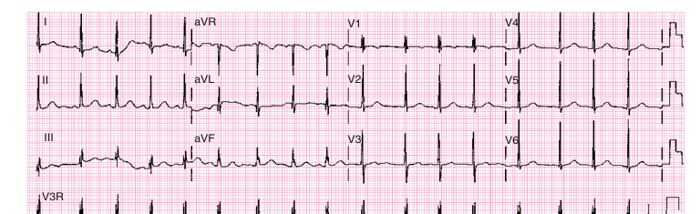
CONDUCTION
Minor RV Conduction Delay (rSR′)
rSR′ vs RBBB
An rSR′ in V₁ is a very common finding in children.
If QRS duration is normal → minor RV conduction delay (benign).
Classically seen with volume overload, e.g. atrial septal defect (ASD).
A true right bundle branch block has a PROLONGED QRS.
Fig 472.9 — rSR′ pattern in V₁ with NORMAL QRS duration (60 ms) — not a true RBBB.
KEY POINT
Always check QRS width before calling 'RBBB' — the rSR′ shape alone is not enough.
Dr. Manar Shawabkeh
Pediatric ECG • Nelson Textbook of Pediatrics
12

Slide 17
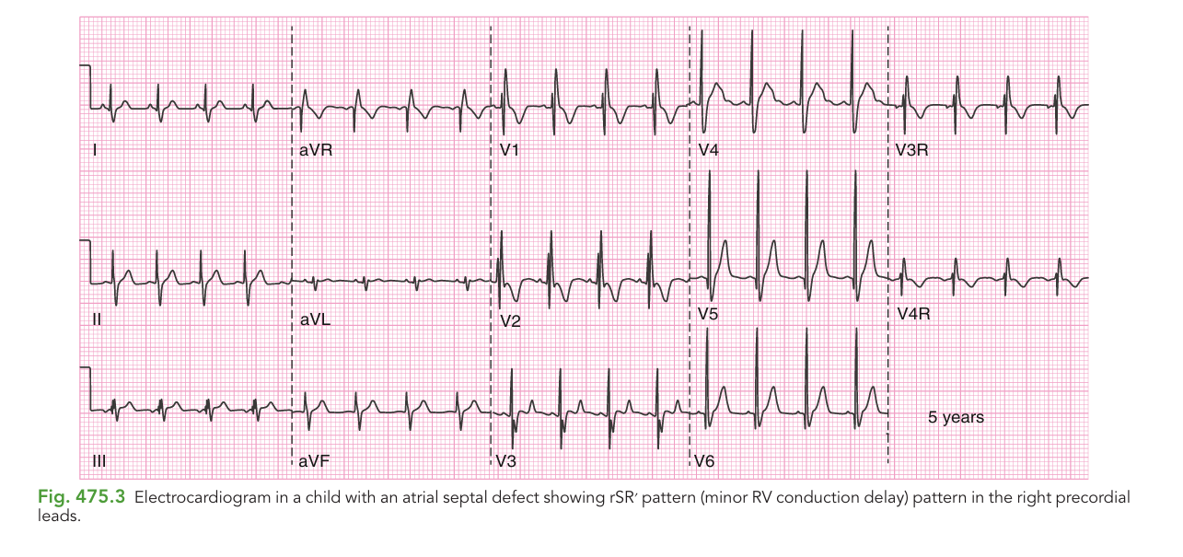
APPLIED
ASD — Volume Overload Pattern
Linking pattern to lesion
ASD causes a chronic left-to-right shunt → RV volume overload.
Classic ECG: rSR′ in the right precordial leads (V₁, V₃R, V₄R).
QRS is only mildly widened — distinguishing it from true RBBB.
Right-axis deviation may accompany the pattern.
CLINICAL PEARL
Pattern recognition: rSR′ + right axis in a child with a murmur → think ASD.
Fig 475.3 — Child with atrial septal defect: rSR′ pattern (minor RV conduction delay) in the right precordial leads.
Dr. Manar Shawabkeh
Pediatric ECG • Nelson Textbook of Pediatrics
13

Slide 18
CONDUCTION
Bundle Branch Block — RBBB vs LBBB
Right BBB (RBBB)
Left BBB (LBBB)
Prolonged QRS with rsR′ in V₁.
Wide S wave in V₆.
Often after surgery for CHD (e.g. TOF repair, ventriculotomy).
May be congenital.
Prolonged QRS, usually upright with rsR′ in V₆.
Wide S wave in V₁.
Much less common in children.
Seen with cardiomyopathy or after aortic/mitral valve surgery.
The unifying rule: A true bundle branch block always PROLONGS the QRS. A normal-width QRS with an rSR′ is only a conduction delay.
Dr. Manar Shawabkeh
Pediatric ECG • Nelson Textbook of Pediatrics
14

Slide 19
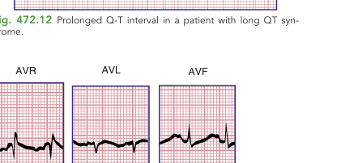
INTERVALS
PR and QT — The Timing of the Heart
PR interval
QT / QTc interval
Shortens as heart rate rises — use age/rate nomograms.
Long PR = first-degree AV block.
Causes: post-op, myocarditis, Lyme, rheumatic fever, digitalis, CCBs.
QTc = QT ÷ √(RR interval); normal QTc < 0.45 s.
Prolonged by hypokalemia, hypocalcemia, many drugs.
Congenital long-QT → risk of torsades de pointes & sudden death.
WHY IT MATTERS
Children with long-QT are at risk of torsades de pointes and sudden death. Take a careful drug history and screen the family.
Fig 472.12 — Prolonged QT in long-QT syndrome.
Dr. Manar Shawabkeh
Pediatric ECG • Nelson Textbook of Pediatrics
15

Slide 20

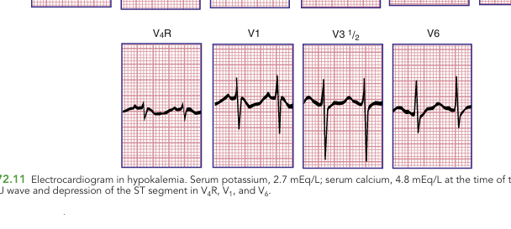
ELECTROLYTES
Hypokalemia on the ECG
Low potassium
Classic triad: ST depression, flattened T waves, and prominent U waves.
The T and U may fuse into a widened 'T–U' complex.
Prolongs the apparent QT and predisposes to arrhythmia.
Often coexists with hypocalcemia, which lengthens the true QT.
Fig 472.11 — Hypokalemia (K⁺ 2.7 mEq/L). Widened T–U wave and ST depression in V₄R, V₁, V₆.
KEY POINT
See a U wave? Check the potassium — and review diuretics and losses.
Dr. Manar Shawabkeh
Pediatric ECG • Nelson Textbook of Pediatrics
16

Slide 21
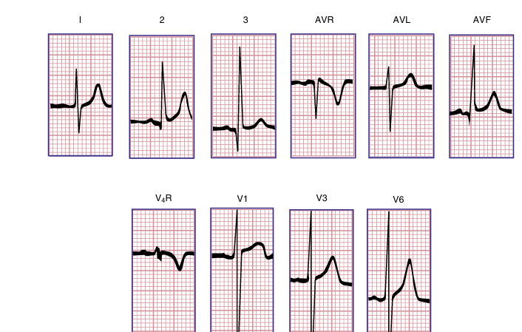
ELECTROLYTES
Hyperkalemia on the ECG
High potassium
Earliest sign: tall, narrow, 'tented' (peaked) T waves.
Progresses to: flattening P waves, PR prolongation, QRS widening.
Advanced hyperkalemia → sine-wave pattern → arrest.
A true emergency — correlate immediately with the serum level.
PITFALL
Peaked T waves are the ECG's early warning of a life-threatening potassium level.
Fig 472.14 — Hyperkalemia (K⁺ 6.5 mEq/L). Tall, tent-shaped T waves — best in I, II and V₆.
Dr. Manar Shawabkeh
Pediatric ECG • Nelson Textbook of Pediatrics
17

Slide 22
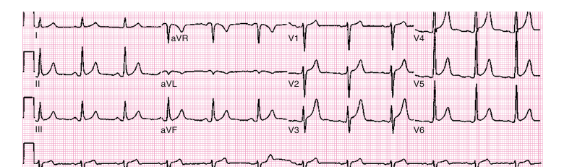
ST & T WAVES
Benign vs Dangerous ST–T Changes
Early repolarization (benign)
Common in healthy teenagers, especially males.
ST elevation limited to lateral leads (V₅, V₆).
Notch at the J point + concave (not convex) ST segment.
No concerning symptoms; resolves with exercise-tachycardia.
Fig 472.13 — Benign early repolarization in a teenage boy (lateral leads V₂–V₅).
Ischemia / injury (dangerous)
True ischemia (ST/T abnormalities as in adults) is RARE in children.
ST depression: severe anemia, CO poisoning, myocarditis, glycogen storage disease.
Anomalous left coronary from pulmonary artery (ALCAPA) mimics acute MI.
Consider Kawasaki disease with coronary aneurysms.
Maintain high suspicion in an infant with dilated cardiomyopathy or inconsolable crying.
Dr. Manar Shawabkeh
Pediatric ECG • Nelson Textbook of Pediatrics
18

Slide 23
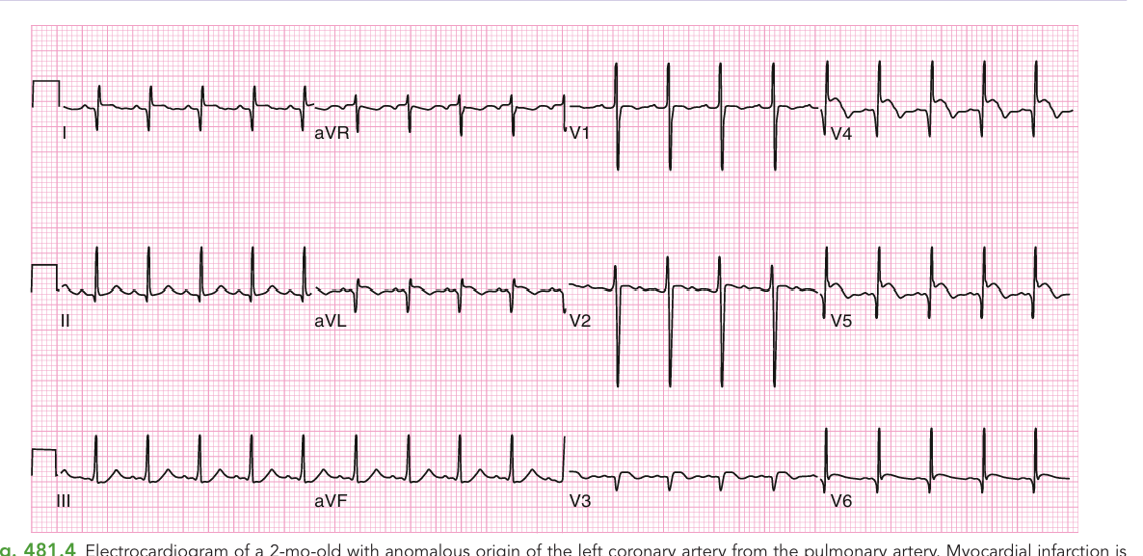
APPLIED ISCHEMIA
Infarction Pattern — ALCAPA
Recognising infant MI
ALCAPA = anomalous origin of the left coronary from the pulmonary artery.
Produces a genuine myocardial infarction pattern in a baby.
Abnormal Q waves in leads I, aVL and the anterolateral precordium.
ST elevation (V₄–V₅) signals ongoing ischemia.
Loss / diminution of R waves in the mid-precordial leads (V₂, V₃).
PITFALL
An 'infarct pattern' in an irritable, feeding-poor infant → think ALCAPA, not adult-type CAD.
Fig 481.4 — 2-mo-old with ALCAPA. Abnormal Q in I & aVL and anterolateral leads; ST elevation V₄–V₅.
Dr. Manar Shawabkeh
Pediatric ECG • Nelson Textbook of Pediatrics
19

Slide 24
PART 4
Arrhythmias in Children
From benign sinus arrhythmia to life-threatening VT
Dr. Manar Shawabkeh
Pediatric ECG • Nelson Textbook of Pediatrics

Slide 25
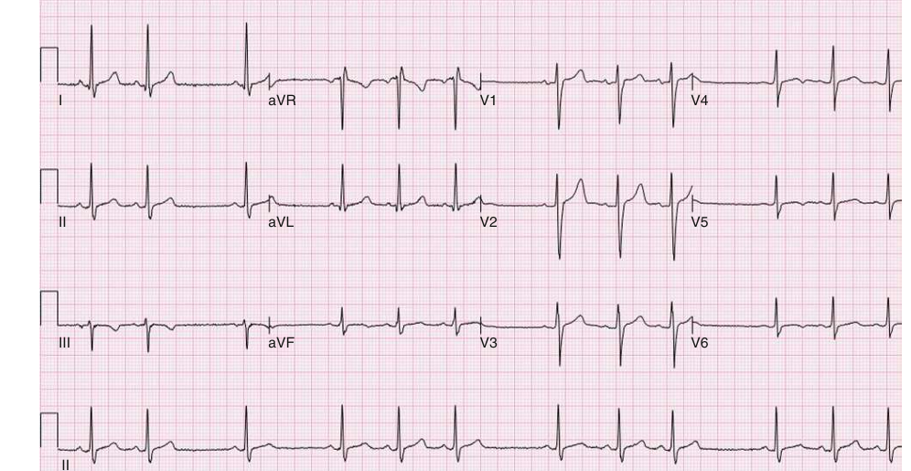
BENIGN RHYTHM
Sinus Arrhythmia — Normal!
Don't over-call it
The P–P (and R–R) interval varies with the respiratory cycle.
P-wave morphology and the PR interval stay constant.
Rate typically speeds up on inspiration, slows on expiration.
This is a completely NORMAL finding in healthy children.
CLINICAL PEARL
Same P shape + varying rate with breathing = benign sinus arrhythmia. Reassure, don't investigate.
Fig 484.1 — Phasic sinus arrhythmia. P–P interval varies; P morphology & PR are unchanged.
Dr. Manar Shawabkeh
Pediatric ECG • Nelson Textbook of Pediatrics
20

Slide 26
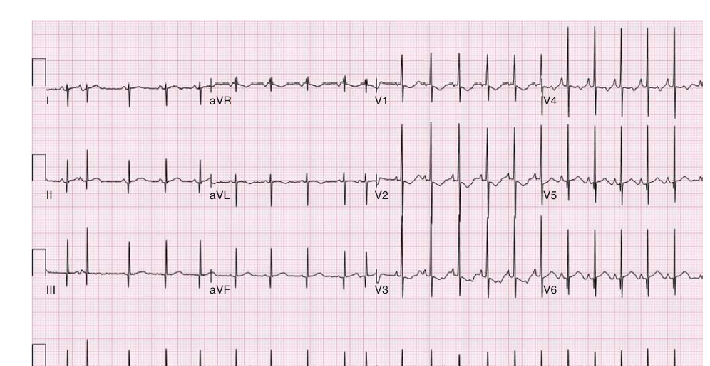
ECTOPY
Premature Atrial Contraction (PAC)
Spotting a PAC
An early beat that arises from atrial tissue, not the sinus node.
Look for a premature, abnormal P wave — often buried in the prior T wave.
The QRS is usually narrow (normal), because conduction is normal.
Generally benign; common in newborns and often resolves.
KEY POINT
A deformed T wave before an early beat is the clue that a hidden premature P is present.
Fig 484.2 — PAC: the 2nd & 10th beats are early; a deformed preceding T wave hides the premature P.
Dr. Manar Shawabkeh
Pediatric ECG • Nelson Textbook of Pediatrics
21

Slide 27
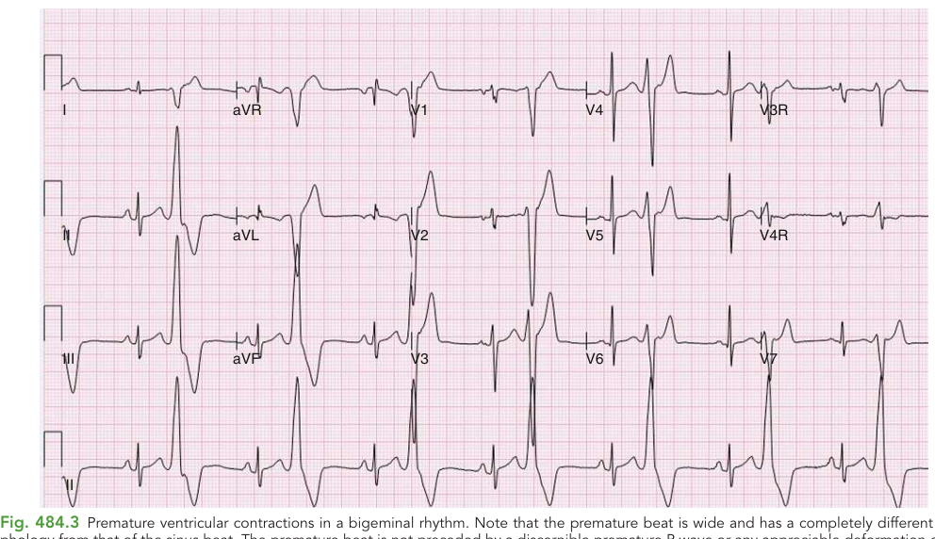
ECTOPY
Premature Ventricular Contraction (PVC)
Ventricular ectopy
The premature beat is WIDE and morphologically different from sinus beats.
No preceding premature P wave; often a full compensatory pause follows.
Bigeminy = every other beat is a PVC; trigeminy = every third.
Uniform (monomorphic) = one focus; multiform = multiple foci.
Fusion beats prove the ventricular origin of the ectopic beat.
KEY POINT
Wide + early + no P wave = ventricular. Narrow + early + abnormal P = atrial.
Fig 484.3 — PVCs in bigeminy: wide, bizarre beats with no preceding P wave.
Dr. Manar Shawabkeh
Pediatric ECG • Nelson Textbook of Pediatrics
22

Slide 28
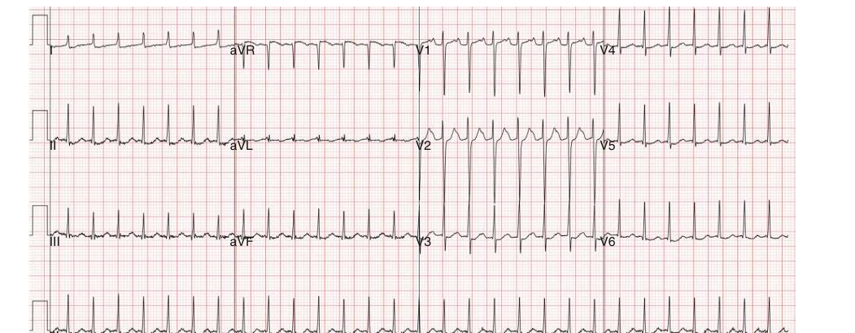
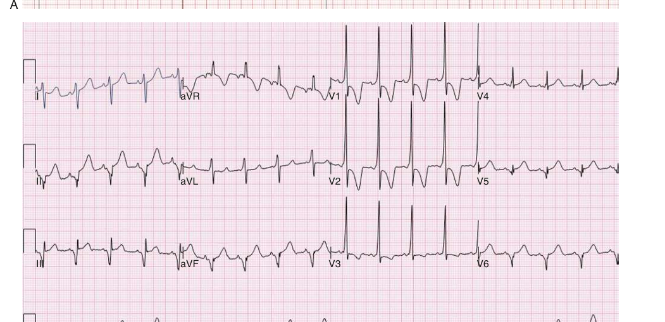
TACHYARRHYTHMIA
SVT & Wolff–Parkinson–White (WPW)
Key teaching points
SVT: sudden, regular, narrow-complex tachycardia (often > 220–230 bpm).
Rate is relatively FIXED — unlike sinus tachy which varies with tone.
WPW = an accessory pathway (bypass tract) between atria and ventricles.
WPW triad at rest: short PR, wide QRS, slurred upstroke = delta wave.
WPW carries a small but real risk of sudden death (AF → VF).
Syncope in WPW is an ominous sign → refer for EP study ± ablation.
Fig 484.4A — SVT in WPW: narrow QRS, retrograde P on the T upstroke.
Vs sinus tachy: look for a normal P-wave axis (upright in I & aVF) and rate that varies.
Fig 484.4B — Later, WPW features: short PR, wide QRS with slurred delta wave.
Dr. Manar Shawabkeh
Pediatric ECG • Nelson Textbook of Pediatrics
23

Slide 29
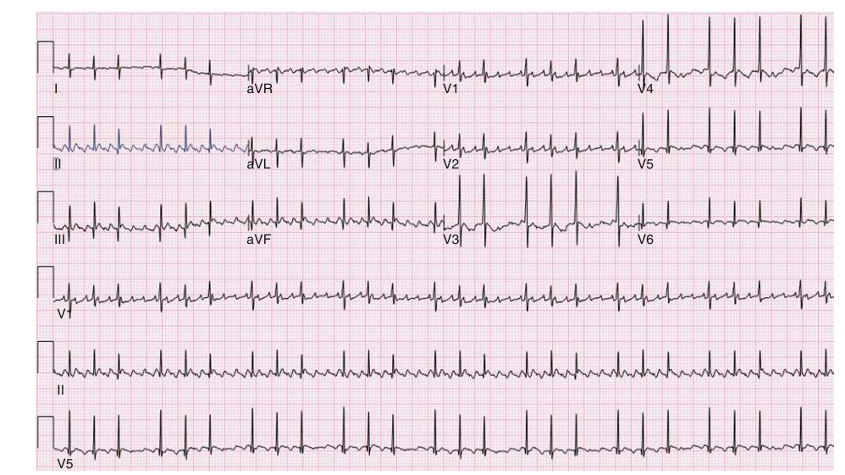
TACHYARRHYTHMIA
Atrial Flutter
The 'saw-tooth' rhythm
Rapid, regular atrial activity — classic saw-tooth 'F' waves.
Atrial rates ~250–400 bpm; the AV node blocks some impulses.
Variable AV conduction (e.g. 2:1, 3:1) sets the ventricular rate.
Ventricular response is often regular for a given conduction ratio.
KEY POINT
Saw-tooth baseline + a ventricular rate that is a neat fraction of the atrial rate = flutter.
Fig 484.8 — Neonatal atrial flutter: flutter waves at ~375 bpm with variable AV conduction.
Dr. Manar Shawabkeh
Pediatric ECG • Nelson Textbook of Pediatrics
24

Slide 30
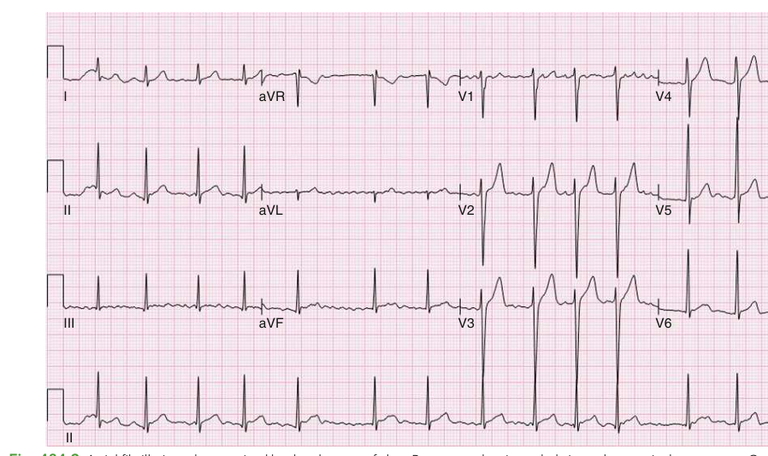
TACHYARRHYTHMIA
Atrial Fibrillation
Irregularly irregular
Absence of clear, organised P waves.
Chaotic, low-amplitude fibrillatory ('f') waves in the baseline.
The ventricular response is irregularly irregular — no two R–R alike.
Search carefully for f waves in every lead with an irregular rhythm.
KEY POINT
No two R–R intervals the same + no P waves = atrial fibrillation until proven otherwise.
Fig 484.9 — Atrial fibrillation: no clear P waves, irregularly irregular ventricular response.
Dr. Manar Shawabkeh
Pediatric ECG • Nelson Textbook of Pediatrics
25

Slide 31
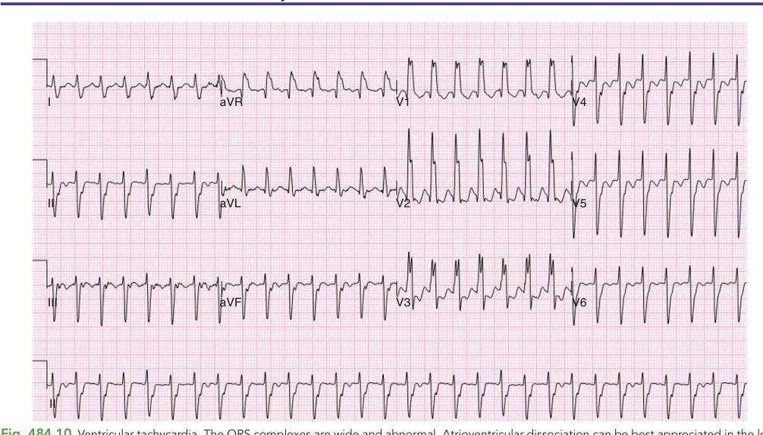
LIFE-THREATENING
Ventricular Tachycardia (VT)
A can't-miss diagnosis
A wide-complex tachycardia arising below the AV node.
QRS complexes are WIDE and abnormal in morphology.
AV dissociation — the atria and ventricles beat independently.
Capture beats and fusion beats confirm the diagnosis.
Treat any wide-complex tachycardia as VT until proven otherwise.
PITFALL
In a sick child, a wide-complex tachycardia is VT until proven otherwise — never assume SVT with aberrancy.
Fig 484.10 — VT: wide, abnormal QRS complexes; AV dissociation seen in the lead II rhythm strip.
Dr. Manar Shawabkeh
Pediatric ECG • Nelson Textbook of Pediatrics
26

Slide 32
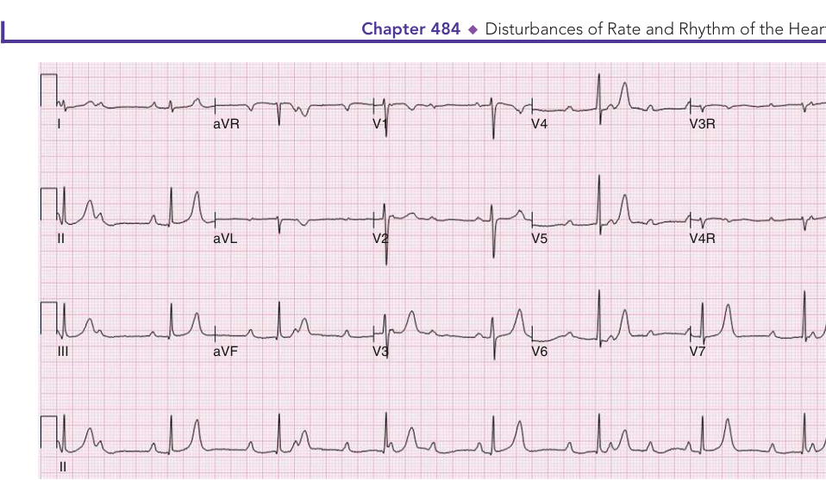
BRADYARRHYTHMIA
Complete (3rd-Degree) AV Block
Atria and ventricles divorced
No atrial impulse conducts to the ventricles — complete dissociation.
The atrial rate is faster and totally independent of the ventricular rate.
An escape rhythm drives the ventricles (here ~44 bpm).
In CONGENITAL complete AV block the QRS is often narrow/normal.
Associated with maternal anti-Ro/anti-La (neonatal lupus).
KEY POINT
Regular P's + regular QRS's marching independently = complete heart block.
Fig 484.14 — Congenital complete AV block: ventricular rate 44 bpm, atrial ~100 bpm, fully dissociated.
Dr. Manar Shawabkeh
Pediatric ECG • Nelson Textbook of Pediatrics
27

Slide 33
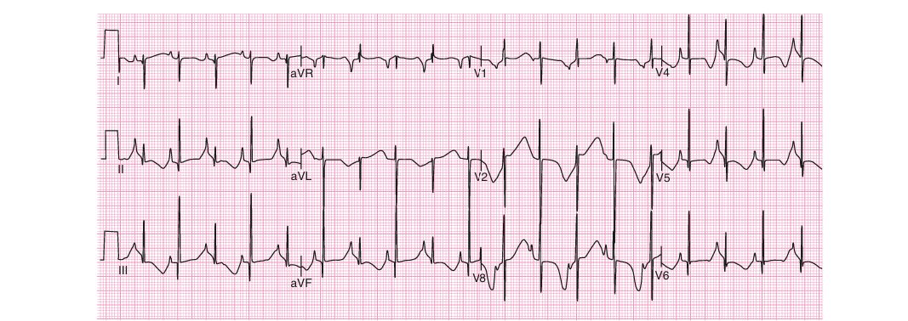
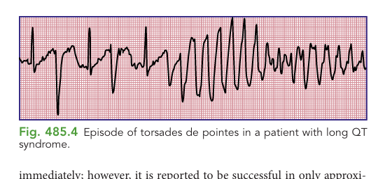
CHANNELOPATHY
Long-QT Syndrome → Torsades de Pointes
The lethal sequence
A prolonged QTc destabilizes ventricular repolarization.
T-wave alternans (beat-to-beat T change) signals high risk.
Can degenerate into torsades de pointes — a polymorphic VT.
Torsades may self-terminate or progress to VF and sudden death.
Causes: congenital channelopathy, drugs, hypokalemia, hypomagnesemia.
Fig 485.3 — Long-QT in a neonate: markedly prolonged QTc with T-wave alternans.
ACT ON IT
Screen the family, review QT-prolonging drugs, correct K⁺/Mg²⁺, and refer — an ICD may be needed.
Fig 485.4 — Torsades de pointes in long-QT syndrome.
Dr. Manar Shawabkeh
Pediatric ECG • Nelson Textbook of Pediatrics
28

Slide 34
QUICK REFERENCE
Diagnosing Tachyarrhythmias at a Glance
Rhythm
Rate (bpm)
P wave
Regularity
Sinus tachycardia
< 230
Always present, normal axis
Varies with respiration
Atrial tachycardia
180–320
Abnormal P morphology/axis
Usually regular
Atrial flutter
Atrial 250–400
Saw-tooth flutter waves
Regular (2:1, 3:1…)
Atrial fibrillation
120–180
Fibrillatory waves
Irregularly irregular
Junctional tachycardia
120–280
AV dissociation, capture beats
Regular (± capture)
Ventricular tachycardia
120–300
AV dissociation, fusion beats
Regular (± capture)
Adapted from Nelson Textbook of Pediatrics, Table 484.2.
Dr. Manar Shawabkeh
Pediatric ECG • Nelson Textbook of Pediatrics
29

Slide 35
KEY TAKEAWAYS
Five things to remember
A child's ECG is age-dependent — the normal newborn is right-dominant and evolves toward the adult pattern.
Read systematically every time: rate → rhythm → axis → intervals → chambers → ST/T.
Check QRS width before calling BBB; use age-based voltages before calling hypertrophy.
Peaked T = hyperkalemia; U waves = hypokalemia; long QT risks torsades — act fast.
A wide-complex tachycardia in a sick child is VT until proven otherwise.
Dr. Manar Shawabkeh
Pediatric ECG • Nelson Textbook of Pediatrics
30

Slide 36

PART 5
Test Yourself — MCQs
Apply what you have learned. Answers follow each question.
Dr. Manar Shawabkeh
Pediatric ECG • Nelson Textbook of Pediatrics

Slide 37
QUESTION 1
A healthy 3-day-old term newborn has an ECG showing a frontal QRS axis of +150° and a tall R wave in V₁. What is the most appropriate interpretation?
Normal ECG for age (physiologic RV dominance)
A
Right ventricular hypertrophy
B
Left ventricular hypertrophy
C
Right bundle branch block
D
Dr. Manar Shawabkeh
Pediatric ECG • Nelson Textbook of Pediatrics
31

Slide 38

ANSWER — QUESTION 1
Explanation & Rationale
Correct answer: Normal ECG for age
A
Why?
In a term newborn, right-axis deviation and a tall R wave in V₁ reflect physiologic right ventricular dominance — the RV is as thick as the LV at birth.
This pattern is expected in the first days of life and does NOT by itself indicate hypertrophy.
RVH would require additional criteria (≥ 2), such as an upright T in V₁ after the first week, a very tall pure R, or extreme axis deviation.
Dr. Manar Shawabkeh
Pediatric ECG • Nelson Textbook of Pediatrics
32

Slide 39
QUESTION 2
This rhythm strip shows a beat-to-beat variation in the P–P interval, but the P-wave shape and PR interval are unchanged. The diagnosis is:
Premature atrial contractions
A
Sinus arrhythmia (normal)
B
Second-degree AV block
C
Atrial fibrillation
D
Dr. Manar Shawabkeh
Pediatric ECG • Nelson Textbook of Pediatrics
33

Slide 40
ANSWER — QUESTION 2
Explanation & Rationale
Correct answer: Sinus arrhythmia (normal)
B
Why?
Phasic sinus arrhythmia produces variation in the P–P (and R–R) interval that follows the respiratory cycle.
Crucially, the P-wave morphology and the PR interval remain constant — the impulse still originates in the sinus node.
This is a normal finding in children and requires only reassurance, not investigation.
Dr. Manar Shawabkeh
Pediatric ECG • Nelson Textbook of Pediatrics
34

Slide 41
QUESTION 3
An infant's ECG shows tall, tent-shaped (peaked) T waves, best seen in leads II and V₆. What is the most likely cause?
Hypokalemia
A
Hypocalcemia
B
Hyperkalemia
C
Benign early repolarization
D
Dr. Manar Shawabkeh
Pediatric ECG • Nelson Textbook of Pediatrics
35

Slide 42
ANSWER — QUESTION 3
Explanation & Rationale
Correct answer: Hyperkalemia
C
Why?
Tall, narrow, 'tented' T waves are the earliest and most characteristic ECG sign of hyperkalemia.
As the potassium rises further, expect flattening P waves, PR prolongation, and QRS widening — eventually a sine-wave pattern.
Hypokalemia does the opposite: ST depression, flat T waves, and prominent U waves.
Dr. Manar Shawabkeh
Pediatric ECG • Nelson Textbook of Pediatrics
36

Slide 43
QUESTION 4
A child's resting ECG shows a short PR interval, a widened QRS, and a slurred upstroke of the QRS (delta wave). This is diagnostic of:
Right bundle branch block
A
First-degree AV block
B
Long-QT syndrome
C
Wolff–Parkinson–White (WPW) pre-excitation
D
Dr. Manar Shawabkeh
Pediatric ECG • Nelson Textbook of Pediatrics
37

Slide 44
ANSWER — QUESTION 4
Explanation & Rationale
Correct answer: Wolff–Parkinson–White (WPW)
D
Why?
The triad of a short PR interval, a wide QRS, and a delta wave (slurred QRS upstroke) is the classic resting pattern of WPW pre-excitation.
It reflects early ventricular activation through an accessory pathway that bypasses the AV node.
WPW carries a small but real risk of sudden death; syncope is an ominous symptom and warrants an EP study and consideration of catheter ablation.
Dr. Manar Shawabkeh
Pediatric ECG • Nelson Textbook of Pediatrics
38

Slide 45
QUESTION 5
A critically ill child has this wide-complex tachycardia. The lead II strip shows AV dissociation. The safest working diagnosis is:
Sinus tachycardia
A
Ventricular tachycardia (VT)
B
Atrial flutter with 1:1 conduction
C
Benign sinus arrhythmia
D
Dr. Manar Shawabkeh
Pediatric ECG • Nelson Textbook of Pediatrics
39

Slide 46
ANSWER — QUESTION 5
Explanation & Rationale
Correct answer: Ventricular tachycardia (VT)
B
Why?
Wide, abnormal QRS complexes with AV dissociation (and capture or fusion beats) are hallmarks of ventricular tachycardia.
In a sick child, any wide-complex tachycardia should be treated as VT until proven otherwise — never assume SVT with aberrancy.
Prompt recognition matters because VT can rapidly compromise the circulation and degenerate into ventricular fibrillation.
Dr. Manar Shawabkeh
Pediatric ECG • Nelson Textbook of Pediatrics
40

Slide 47
Thank You
Questions & Discussion
Dr. Manar Shawabkeh
Pediatric Electrocardiography • Lecture for Residents
Dr. Manar Shawabkeh
Pediatric ECG • Nelson Textbook of Pediatrics

